Slide 1
BIOL 342
Cardiovascular Disease and Pathology
Woosuk Steve Hur, Ph.D.
Postdoctoral Research Associate of Flick Lab
Department of Pathology and Laboratory Medicine
UNC Blood Research Center
UNC Nutrition Obesity Research Center
steve_hur@med.unc.edu

Slide 2
About Me
BSc from McGill University
Major: Biochemistry
PhD from University of British Columbia
Major: Biochemistry and Molecular Biology
Mentor: Dr. Christian Kastrup

Slide 3
About Me
Plasminogen
Vascular Damage
FXIII
Urokinase/tissue
plasminogen activator
Plasmin
BSc from McGill University
Major: Biochemistry
Thrombin
Activated FXIII
Crosslinked
Fibrin
Fibrin Degradation
Products
Fibrinogen
Fibrin
PhD from University of British Columbia
Major: Biochemistry and Molecular Biology
Mentor: Dr. Christian Kastrup

Slide 4
About Me
?
Plasminogen
Vascular Damage
FXIII
Urokinase/tissue
plasminogen activator
Plasmin
BSc from McGill University
Major: Biochemistry
Thrombin
?
Activated FXIII
Crosslinked
Fibrin
Fibrin Degradation
Products
Fibrinogen
Fibrin
PhD from University of British Columbia
Major: Biochemistry and Molecular Biology
Mentor: Dr. Christian Kastrup

Slide 5
About Me
?
Plasminogen
Vascular Damage
FXIII
Urokinase/tissue
plasminogen activator
Plasmin
BSc from McGill University
Major: Biochemistry
Thrombin
?
Activated FXIII
Crosslinked
Fibrin
Fibrin Degradation
Products
Fibrinogen
Fibrin
PhD from University of British Columbia
Major: Biochemistry and Molecular Biology
Mentor: Dr. Christian Kastrup

Slide 6
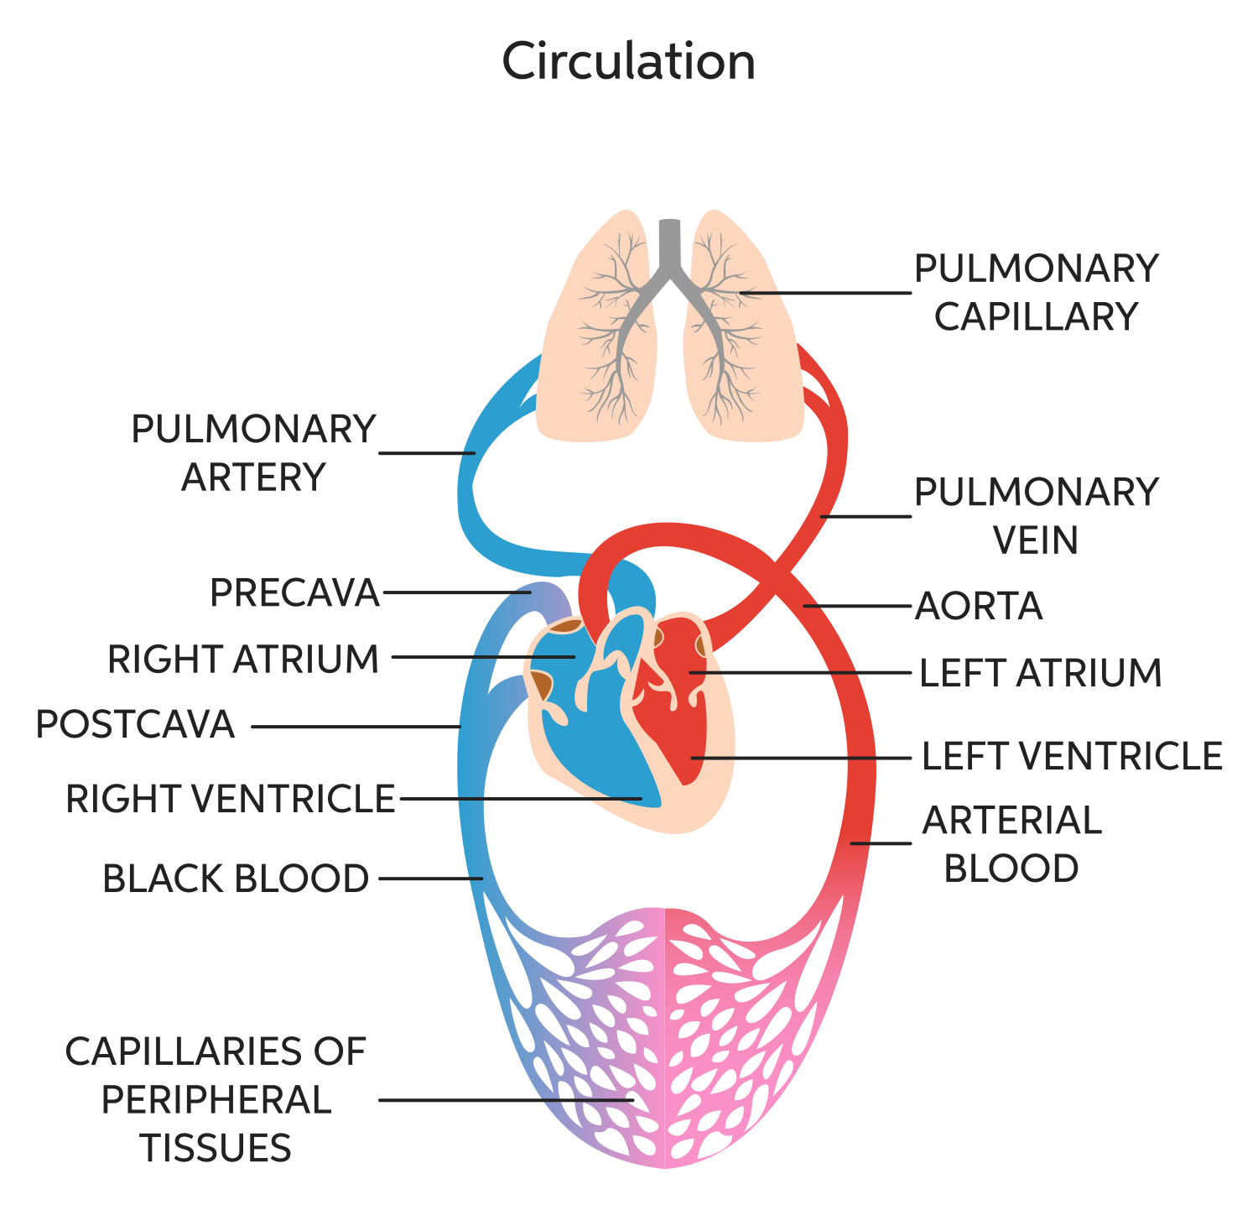
Circulatory System
https://www.chegg.com/learn/biology/anatomy-physiology-in-biology/components-of-circulatory-system
Source: http://humananatomybody.info/neck-arteries-model-labeled/

Slide 7
Cardiovascular Diseases
Name some cardiovascular diseases
Please type your answers in the zoom chat!

Slide 8
Cardiovascular Diseases
Atherosclerosis
Heart Attack
Heart Failure
Heart Valve Problems
Arrhythmia
Stroke
Ischemic
Hemorrhagic

Slide 9
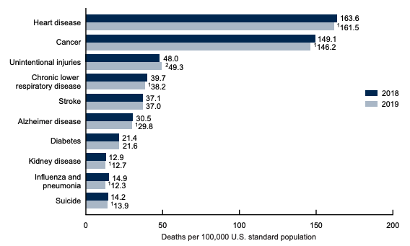
Cardiovascular Diseases
Leading cause of death in US
National Heart, Lung and Blood Institute Funding: $3 Billion.

Slide 10
Risk Factors for Cardiovascular Diseases
Name some risk factors for cardiovascular diseases
Please type your answers in the zoom chat!

Slide 11
Risk Factors for Cardiovascular Diseases
Diabetes
High cholesterol (hypercholesterolemia)
High blood pressure (hypertension)
Obesity
Unhealthy diet
Physical inactivity
Smoking
Heavy alcohol consumption

Slide 12
Atherosclerosis
Buildup of fatty deposits in the blood vessel.
Arteries become thick and stiff.
Reduces blood flow through vessels.
Can rupture, leading to thrombosis.
https://www.mayoclinic.org/diseases-conditions/arteriosclerosis-atherosclerosis/symptoms-causes/syc-20350569#dialogId40591634

Slide 13
Cholesterol Metabolism
Cholesterol and fatty acids hydrophobic and circulates bound to lipoproteins.
Liver releases VLDL, which circulate to deliver cholesterol and fatty acids to periphery.
HDL returns to liver for reverse cholesterol transport.
http://thescienceofhealthyscepticism.blogspot.com/2011/03/healthy-harmonious-lipoprotein-cycle.html

Slide 14
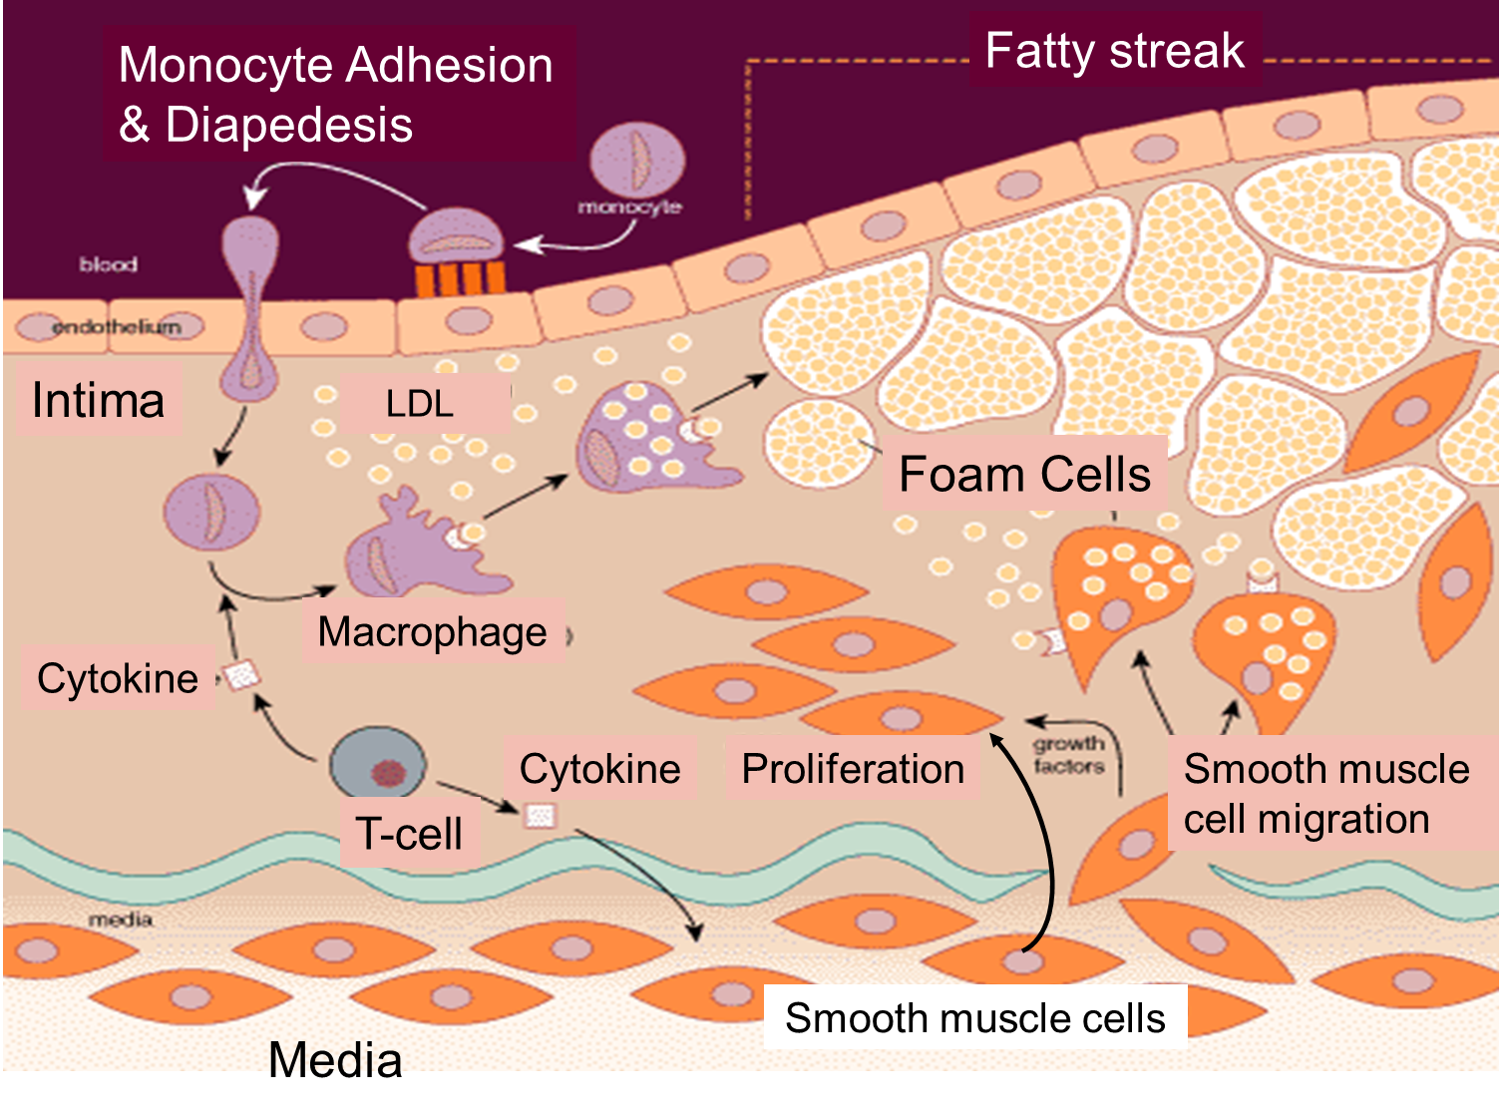
Pathogenesis of Atherosclerosis
LDL-cholesterol complex is endocytosed, leading to accumulation of fat deposits.
Macrophages are activated and phagocytose cholesterol and other lipids.
Become foam cells.
Release cytokines that recruit smooth muscle cells and their proliferation.
This early stage: fatty streak
https://sphweb.bumc.bu.edu/otlt/mph-modules/ph/ph709_heart/ph709_heart_print.html

Slide 15
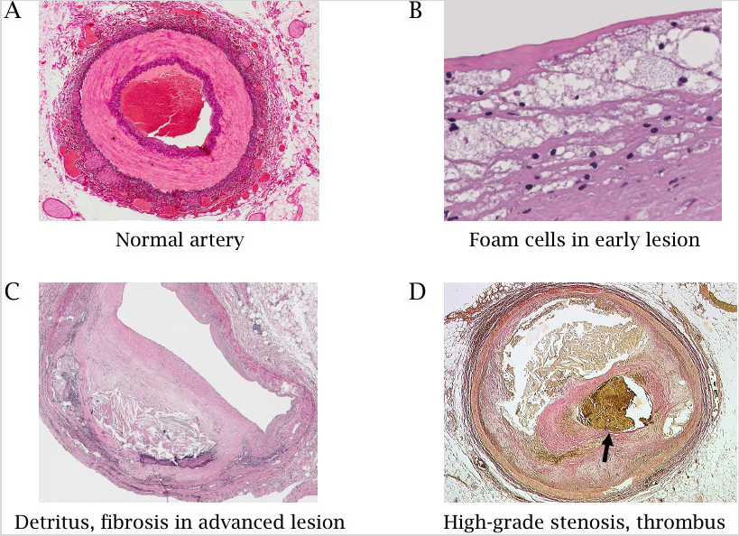
Pathogenesis of Atherosclerosis
Lipid core grows
Foam cells die from too much lipids and release their content
Smooth muscle cells reproduce and proliferate
Leads to bulging arteries
Calcification occurs
Fibrous collagen caps form
http://watcut.uwaterloo.ca/webnotes/Metabolism/Cholesterol.html
Notes:
Cyclic nature of atherosclerosis
Constriction of the blood flow

Slide 16
Pathogenesis of Atherosclerosis
The fibrotic cap becomes eroded
By sheer
By macrophage-derived enzymes
Thrombus formation
Release from sight → embolism
https://slideplayer.com/slide/4289862/
Notes:
Constriction of the blood flow

Slide 17
Prevalence of Atherosclerosis
No one knows
Asymptomatic unless problematic
Identified due to angina, heart attack and/or stroke
Can form as early as –teens.
https://news.mit.edu/2019/machine-learning-shows-no-difference-angina-symptoms-between-men-and-women-1106
Notes:
Constriction of the blood flow

Slide 18
Diagnosis of Atherosclerosis
Blood test
EKG
X ray
Echocardiography
Angiography
No clear BIOMARKER
http://heartdiseasendsublog.blogspot.com/2018/03/diagnosis-and-treatment.html
Notes:
Blood test – cholesterol, sugar, fats, proteins
Angiography – direct method, but can worsen the condition by physical disruption

Slide 19
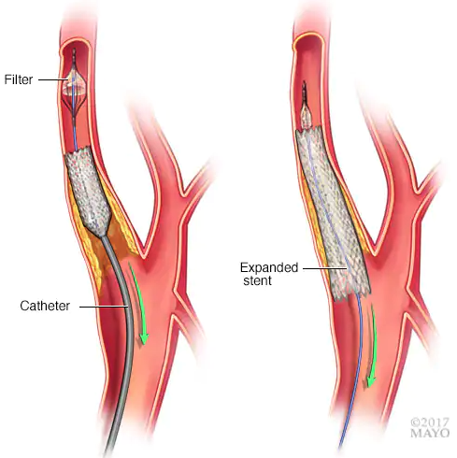
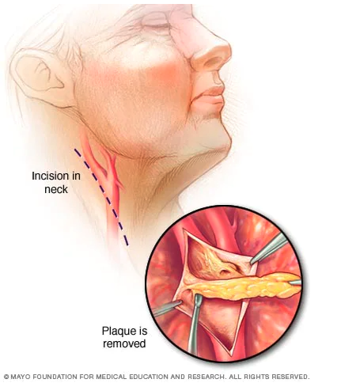
Treatment for Atherosclerosis
Lifestyle changes
Lowering cholesterol levels in blood – statins
Lowering high blood pressure
Anticoagulants
Coronary angioplasty
Bypass surgery
Atherectomy

Slide 20
Ongoing Research of Atherosclerosis
Imaging technologies
Biomarkers
Differences in women and ethnic minorities
Multi-ethnic study of atherosclerosis (MESA)
Atherosclerosis risk in communities (ARIC)
Genetic risk factor identification and personalized medicine
Novel therapies to reduce atherosclerotic plaques
Anti-inflammatory treatment
Bempedoic acid (ATP citrate lyase inhibitor)

Slide 21
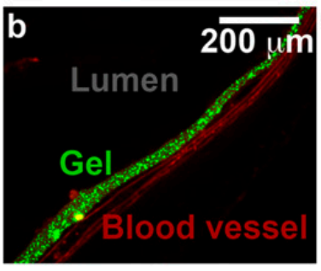
Ongoing Research of Atherosclerosis
Developed a method to coat atherosclerotic plaques to prevent rupture
Can also incorporate drugs to be released at the atherosclerotic plaques
Stable for over 4 months in mice

Slide 22
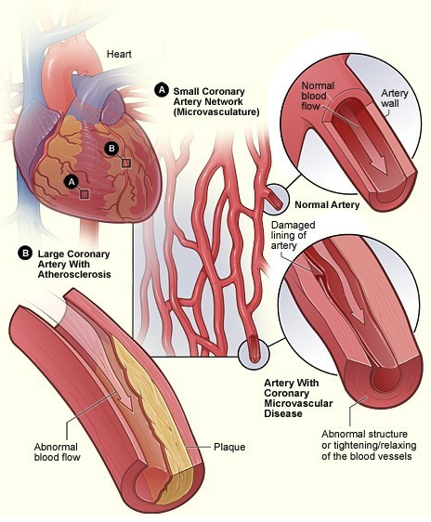
Coronary Heart Disease
When arteries of the heart cannot deliver oxygen-rich, nutrient-rich blood to the heart.
Heart attacks,
Heart failures,
Leading cause of death in US
1 in 36 seconds, someone dies of CVD
Classified as obstructive or non-obstructive
Obstructive = >50% blocked
Non-obstructive
Unresponsive to vasoconstriction/vasodilation
Vasospasm
https://www.nhlbi.nih.gov/health-topics/coronary-heart-disease

Slide 23
Risk Factors of Coronary Heart Disease
Age
>45 for men,
~>55 for women (menopause)
Genetics / family history
Lifestyle habits
Obesity
Abnormal sleep quality
Daylight saving time
Stress
Smoking
Underlying disease
Diabetes
Race or ethnicity
Asian Americans have lower incidence
Sex
Obstructive: Men>Women
Non-obstructive: Men<Women
https://tools.acc.org/ASCVD-Risk-Estimator-Plus/#!/calculate/estimate/
Notes:
Women’s probability increases following endometriosis, gestational diabetes, early menopause

Slide 24
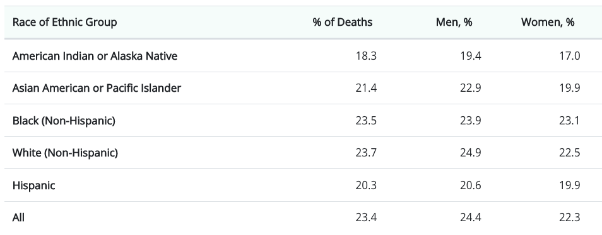
Risk Factors of Coronary Heart Disease
Notes:
Women’s probability increases following endometriosis, gestational diabetes, early menopause

Slide 25
Symptoms of Coronary Heart Disease
Angina
Behind breastbone, arm, shoulder, jaw, throat, back
Cold sweats
Dizziness
Light-headedness
Neck pain
Shortness of breath
Sleep disturbances
Fatigue
Nausea
Notes:
Heart failure → when your heart doesn’t pump enough blood for your body’s needs
Arrythmia → due to electrolyte imbalances
Cardiogenic shock → lack of blood to vital organs → most severe form of heart failure

Slide 26
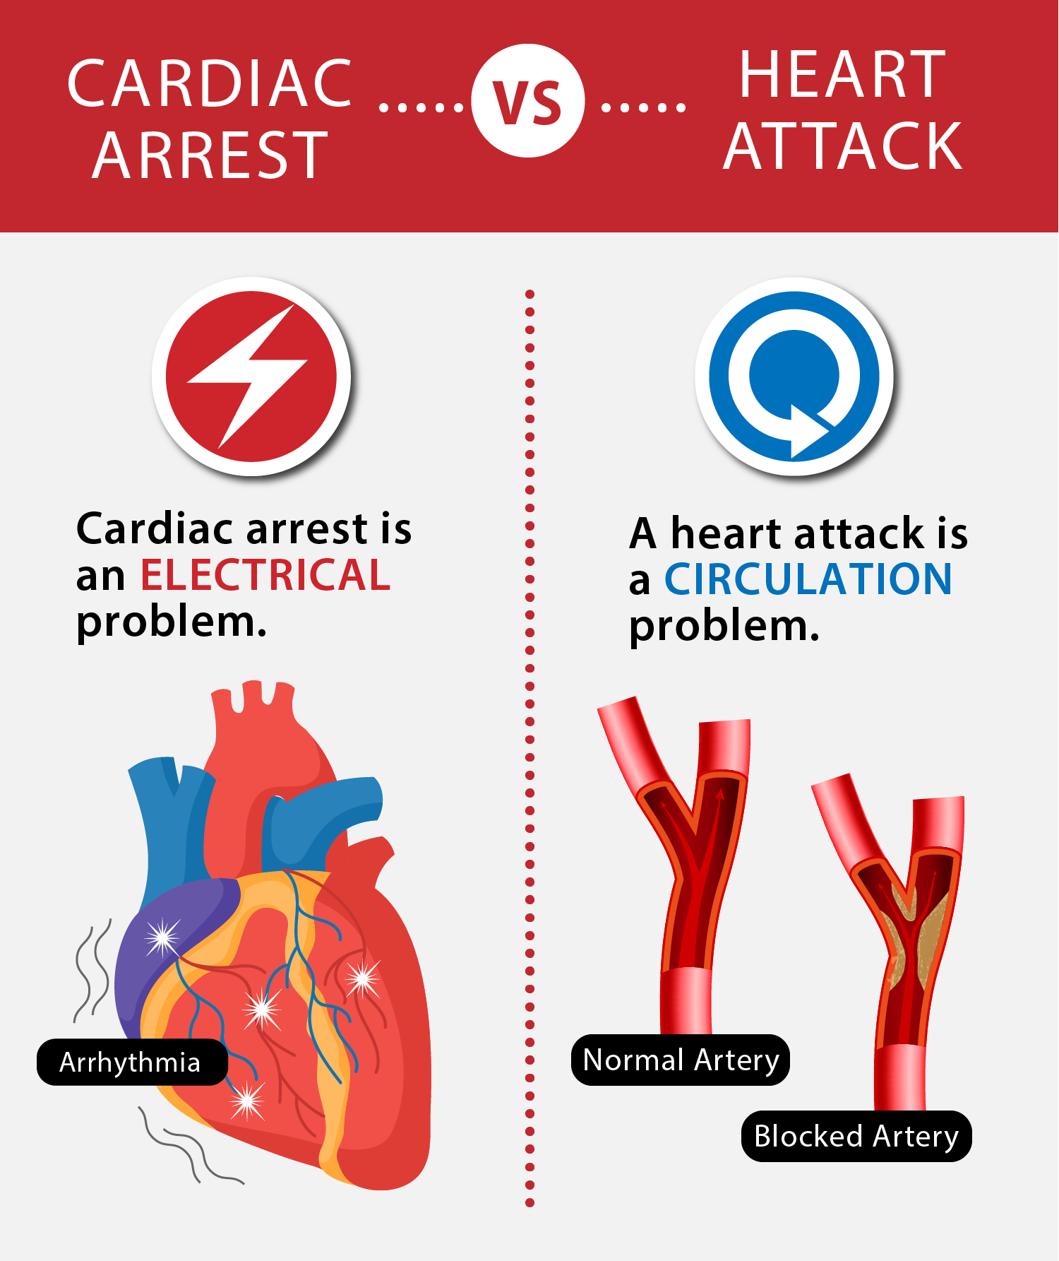
Complications of Coronary Heart Disease
Can lead to
Heart attack
Arrythmia
Sudden cardiac arrest
Heart failure
Cardiogenic shock
Notes:
Heart failure → when your heart doesn’t pump enough blood for your body’s needs
Arrythmia → due to electrolyte imbalances
Cardiogenic shock → lack of blood to vital organs → most severe form of heart failure

Slide 27
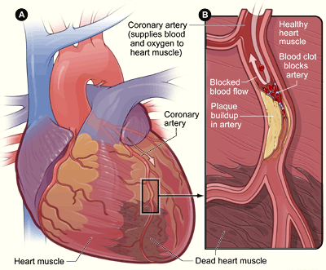
Heart Attacks
Myocardial Infarction
Flow of oxygen-rich, nutrient-rich blood is suddenly blocked.
Heart muscles (cardiomyocytes) start to die
If not treated quickly, can lead to death of heart muscles and be replaced by scar tissue
Can cause future problems
Mostly from atherosclerosis and associated thrombosis
https://www.nhlbi.nih.gov/health-topics/heart-attack

Slide 28
Diagnosis of Heart Attacks
Electrocardiogram
Blood test
Troponin tests
CK test
Serum myoglobin tests
Coronary angiography
https://www.amjmed.com/article/S0002-9343(08)01018-8/fulltext

Slide 29
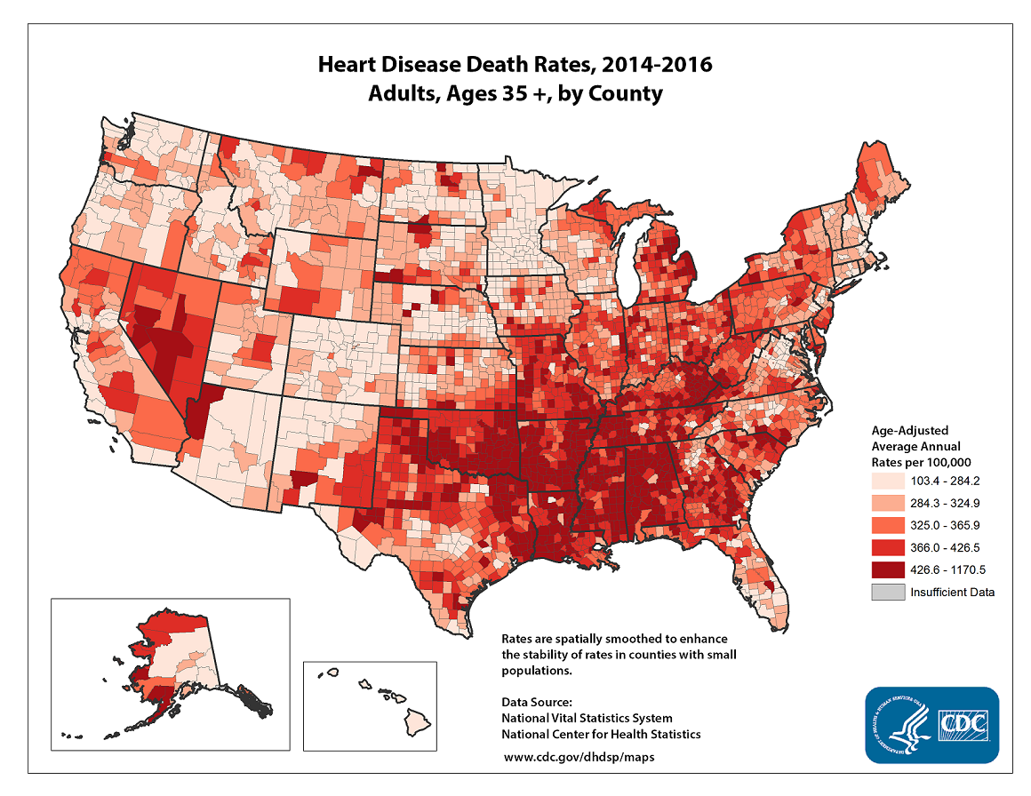
Prevalence of Heart Attacks
Someone has a heart attack every 40 seconds in US.
805 000 Americans have a heart attack each year.
605 000 are first time.
1 in 5 are silent.
Mortality: 108 610 (2018)

Slide 30
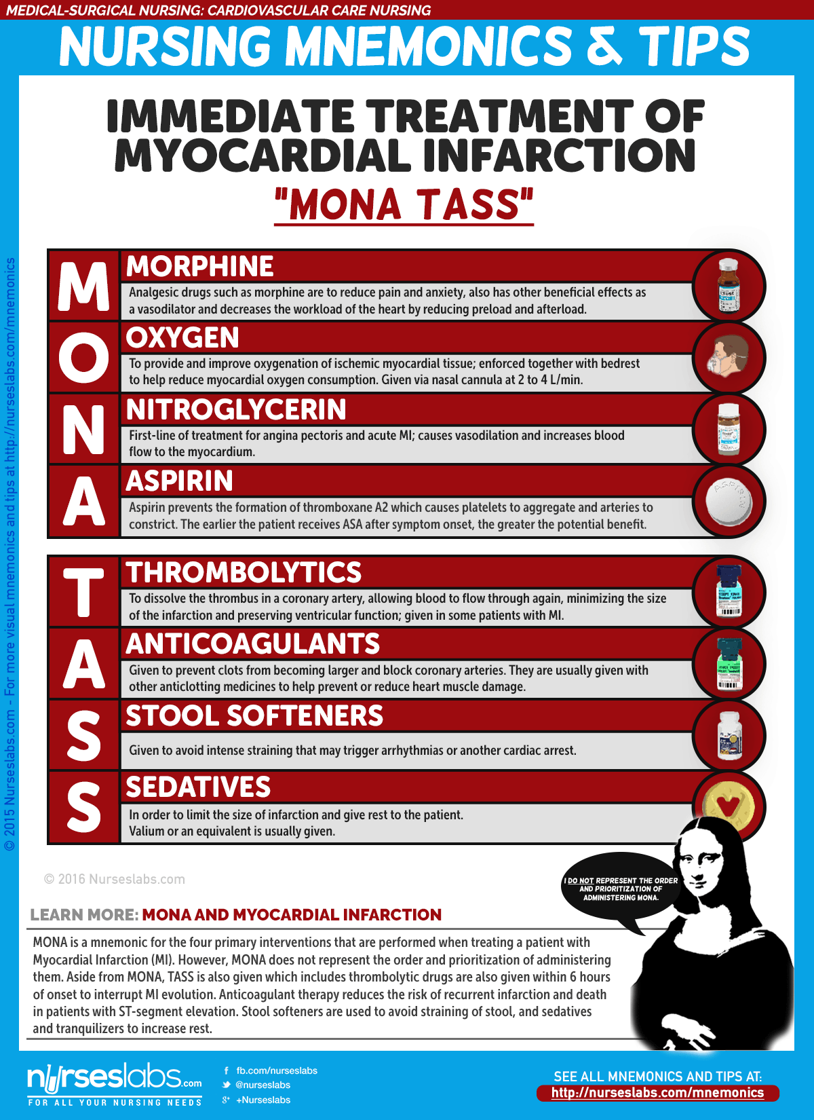
Treatment for Heart Attacks
Aspirin
Nitroglycerin
Beta blockers
Oxygen therapy
Thrombolysis
Anticoagulants
Coronary angioplasty
Notes:
Nitroglycerin is metabolized to nitric oxide → vasodiluant
Beta blockers inhibit epinephrine/adrenaline → beat slower

Slide 31
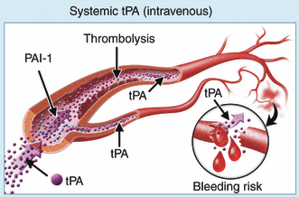
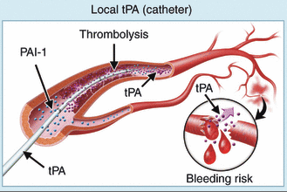
Thrombolytic Therapy
Administration of enzymes that degrade the blood clot.
Associated with increased risk of bleeding
Major bleeding (drop in hemoglobin, or transfusion)
Intracranial hemorrhages
https://onlinelibrary.wiley.com/doi/full/10.1111/j.1538-7836.2011.04370.x
Notes:
I tried to find out what causes the high incidence of intracranial hemorrhages, but I didn’t find anything.
Tissue plasminogen activator, streptokinase, urokinase, plasmin injection, etc…
Tightly regulated.

Slide 32
Ongoing Research for Heart Attacks
Identifying genetic and environmental risk factors
Improving treatments
Reversing scarred tissues
Qian et al., Nature, 2012

Slide 33
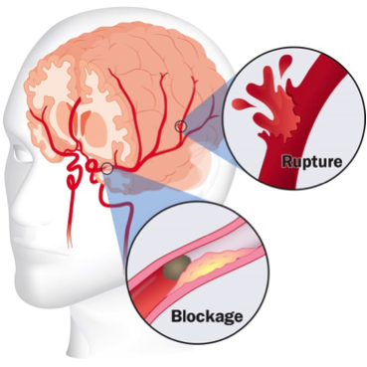
Stroke
When the brain does not receive sufficient oxygen and nutrients
2% of body weight, yet 20% of oxygen usage
2 types
Ischemic (80%)
Hemorrhagic (20%)
https://med.uth.edu/neurology/specialty-programs/ut-stroke/stroke-symptoms-prevention-and-background/

Slide 34
Prevalence of Stroke
1/6 CVD disease is due to stroke.
Someone suffers from stroke every 40 seconds and someone dies every 4 min.
185 000 stroke/year
Leading cause of long-term disability.
Risk of having the first stroke is twice as high for the Black population compared to the White population.

Slide 35
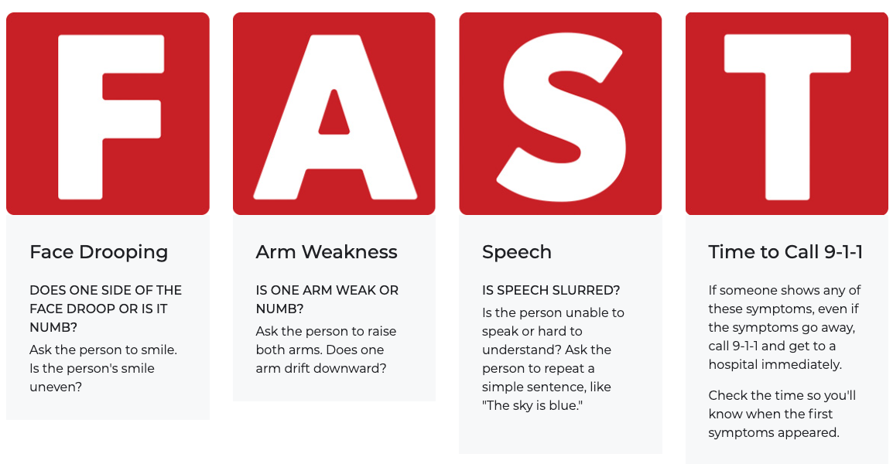
Symptoms and Diagnosis of Stroke
Blood tests
EKG
MRI/CT

Slide 36
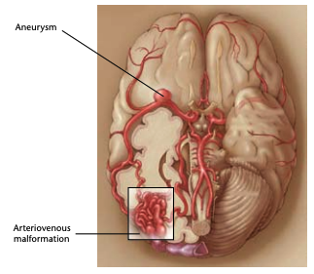
Treatment for Stroke
Ischemic stroke
Thrombolytic therapy
Anticoagulant/antiplatelet drugs
Thrombectomy
Hemorrhagic stroke
Surgery
Blood clotting reagents

Slide 37
Risk Factors for Stroke
Obesity
Diabetes
High blood pressure
High cholesterol
Smoking
Cerebral amyloid angiopathy
Build up of amyloid beta proteins along brain blood vessels
Risk factor for bleeding in thrombolytic therapy

Slide 38
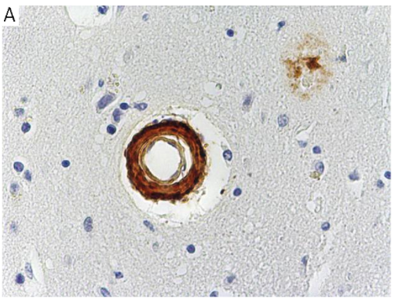
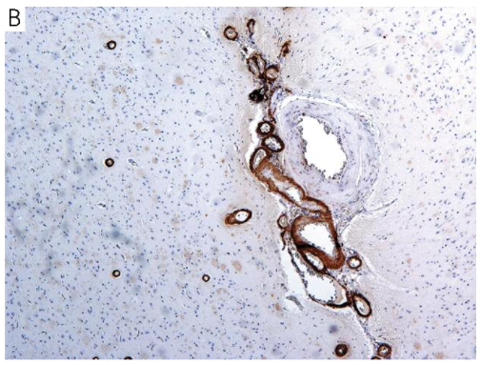
Cerebral Amyloid Angiopathy (CAA)
Build-up of amyloid beta proteins along the blood vessels of the brain
Highly associated with the development of Alzheimer’s disease (AD)
Genetic risk factors and environmental risk factors of CAA and AD
Risk factor for thrombolysis
https://www.semanticscholar.org/paper/The-development-of-cerebral-amyloid-angiopathy-in-A-Mendel-Wierzba-Bobrowicz/b2b17e4572384cd7bc779193e912636a12aa5df9

Slide 39
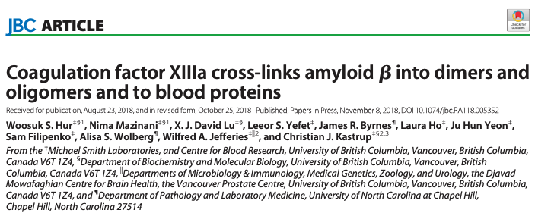
Cerebral Amyloid Angiopathy and Coagulation
Fibrin deposits are found in CAA
Co-localizes with sites of vascular damage
Fibrinogen worsens inflammation and subsequently AD and CAA development.
FXIIIa crosslinks amyloid beta proteins to itself and to fibrin.
https://www.jove.com/t/58475/analysis-amyloid-induced-abnormalities-on-fibrin-clot-structure

Slide 40
Ongoing Research for Stroke
Identify new genetic risk factors
Find new biomarkers of atherosclerosis
Improve thrombolytic therapy
Develop new drugs to prevent/reduce neurological damage

Slide 41
Cardiovascular Health in African Americans
Coronary Heart Disease:
-3.2%/y vs -6.5%/y (men) -4.0%/y vs -5.2%/y (women)
2.18 (men) and 1.63 (women) more likely of fatal CHD
Stroke
Mortality is higher in non-White population
Reduced from 4.5-fold in 1950s to ~2-fold in 1999.
Risk disparity decreases with increasing age
Obesity
58% in Black women, 38% in Black men, 34% in white men and 33% in white women
Diabetes
Prevalence: 21.8% in Blacks vs 11.3% in Whites
Black men are 1.5 times and women are 2.1 times more likely to develop diabetes.
Carnethon et al., Circulation, 2017

Slide 42
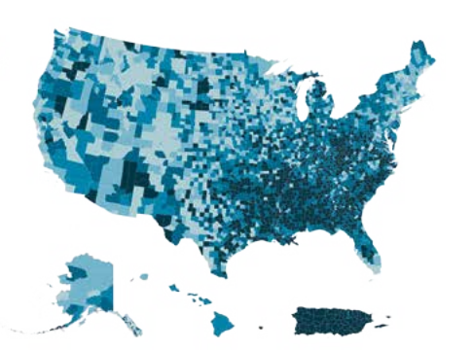
Obesity is a Major Risk Factor for CVD
Obesity
Heart Attack
Diabetes
Stroke
Notes:
Diabetes

Slide 43
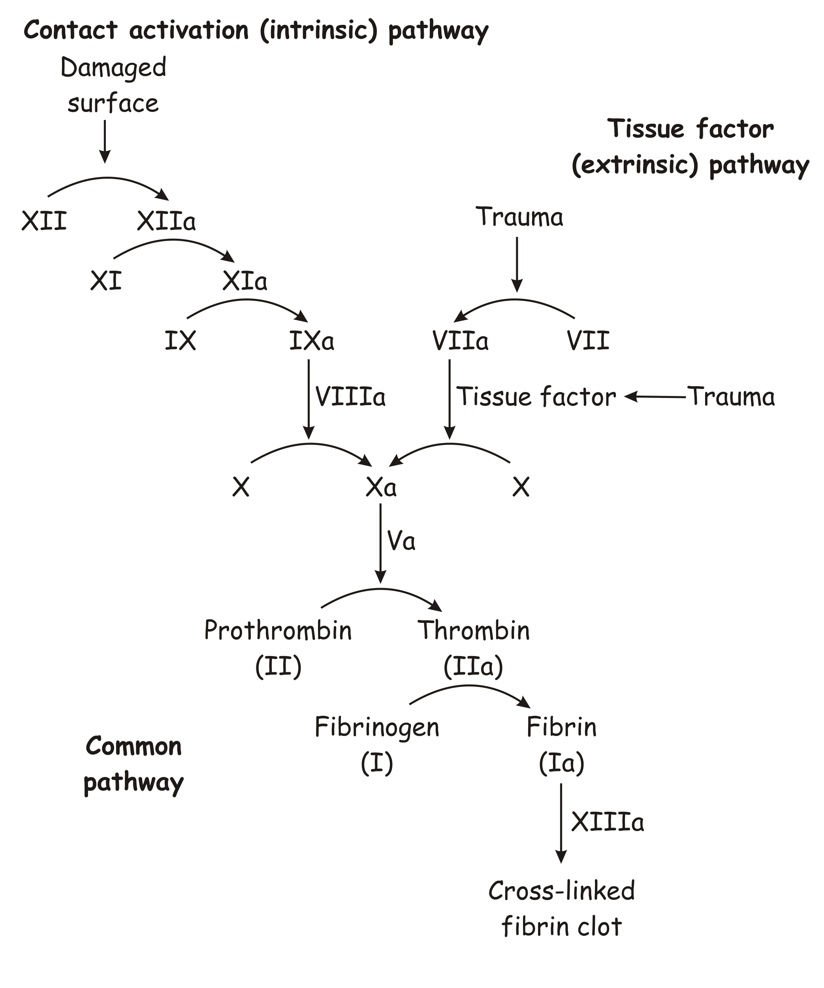
Obesity Leads to Dysregulation of Hemostasis
Enhanced platelet activation
Increased levels and activities of VWF, FVIII, FIX, FXI, FXII
Impaired fibrinolysis
Reduced plasmin generation
Reduced plasmin activity
Miszta et al., Blood, 2020; Celikbilek et al., Platelets, 2013; Tripodi et al., J Hepatol, 2014; Kotronen et al., Liver Int, 2011; Ajjan et al., Blood, 2013

Slide 44
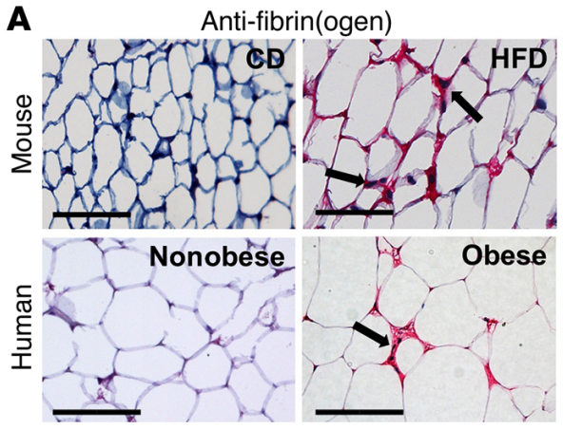
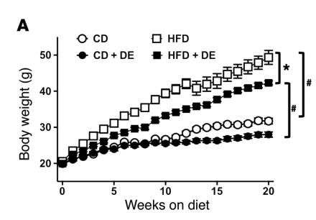
Inhibition of Coagulation Prevents Obesity
Fibrin deposits are found within livers and white adipose tissues of obese mice and men.
Fibrin increases the accumulation of pro-inflammatory macrophages in these tissues.
Inhibition of thrombin activity prevented weight gain.
Kopec et al., JCI, 2017

Slide 45
Questions?
steve_hur@med.unc.edu
Notes:
ste

