Slide 1
Hematologic Malignancies
Georgette A. Dent, MD
University of North Carolina School of Medicine

Slide 2
Objectives
To review normal peripheral blood, bone marrow, and lymph node pathology
To briefly review the categories of treatment used to treat these malignancies
To review the epidemiology, pathology, and clinical findings associate with the following three types of hematologic malignancies:
  Leukemia
  Lymphoma
  Multiple Myeloma

Slide 3
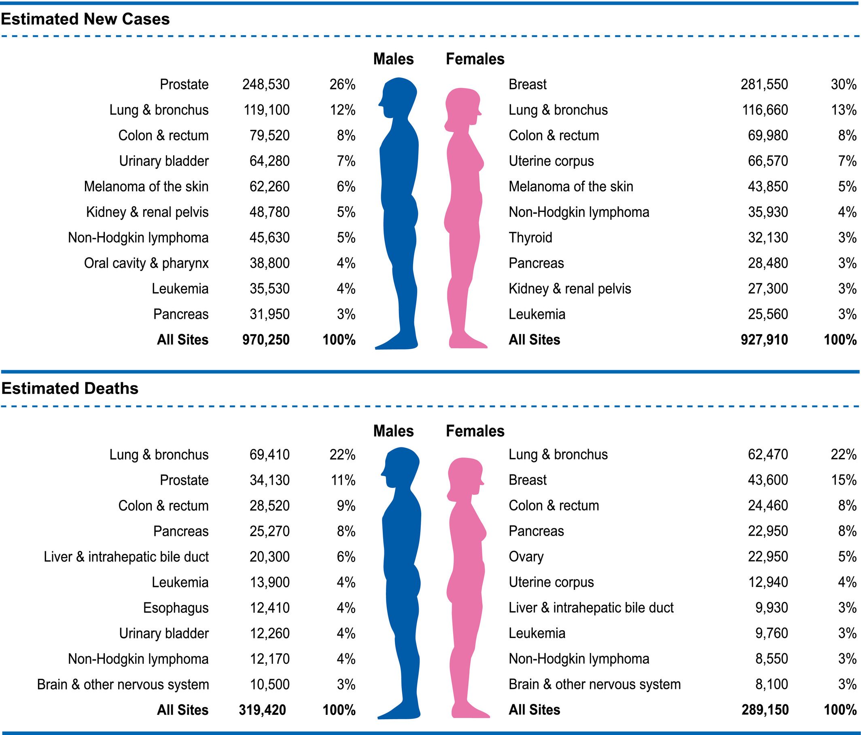
Hematologic Malignancies: Incidence
https://acsjournals.onlinelibrary.wiley.com/doi/full/10.3322/caac.21654

Slide 4
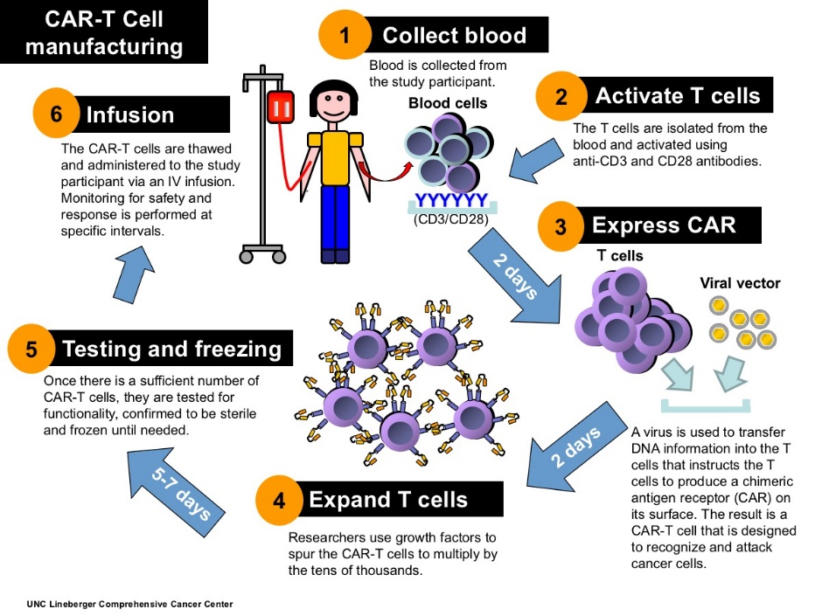
Treatment
We will not get into the details of treatment, but…
In general these disorders are treated with one or more of the following:
  Chemotherapy
  Radiation therapy
  Bone marrow transplantation
  Targeted therapy
  CAR-T
    Chimeric antigen receptor T-cell therapy
  Vaccines (experimental!)

Slide 5
Leukemia
Myeloid:
  Acute
  Chronic
Lymphoid:
  Acute
  Chronic

Slide 6
The Leukemias: An Overview
Leukemia is a neoplastic disease composed of malignant blood cells
They originate in the bone marrow and can involve the patient’s peripheral blood.
They can manifest clinically over weeks to months: acute leukemia
They can manifest clinically over months to years: chronic leukemia

Slide 7
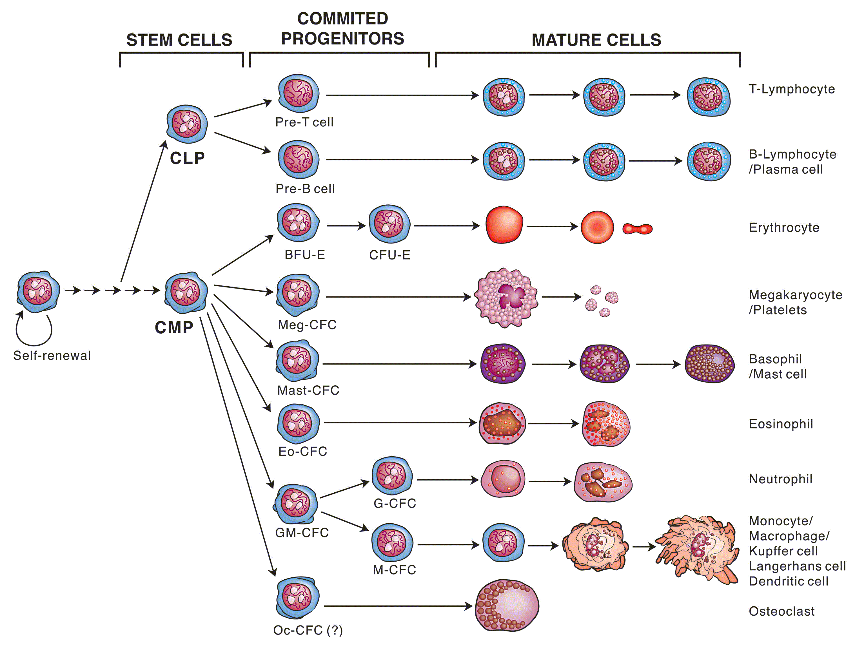
Normal Hematopoiesis

Slide 8
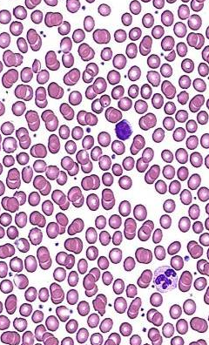
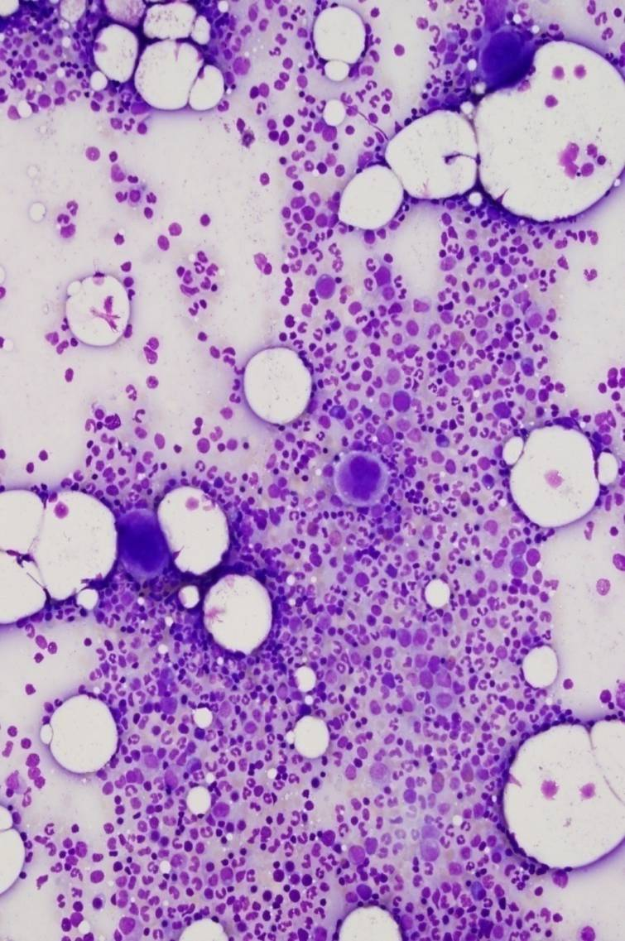
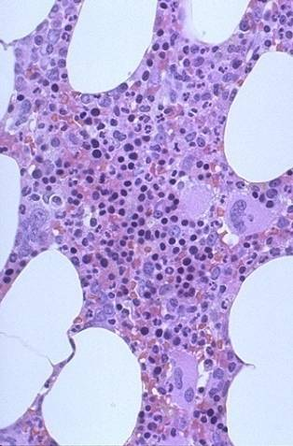
Normal
Peripheral Blood
Bone Marrow Aspirate
Bone Marrow Biopsy

Slide 9
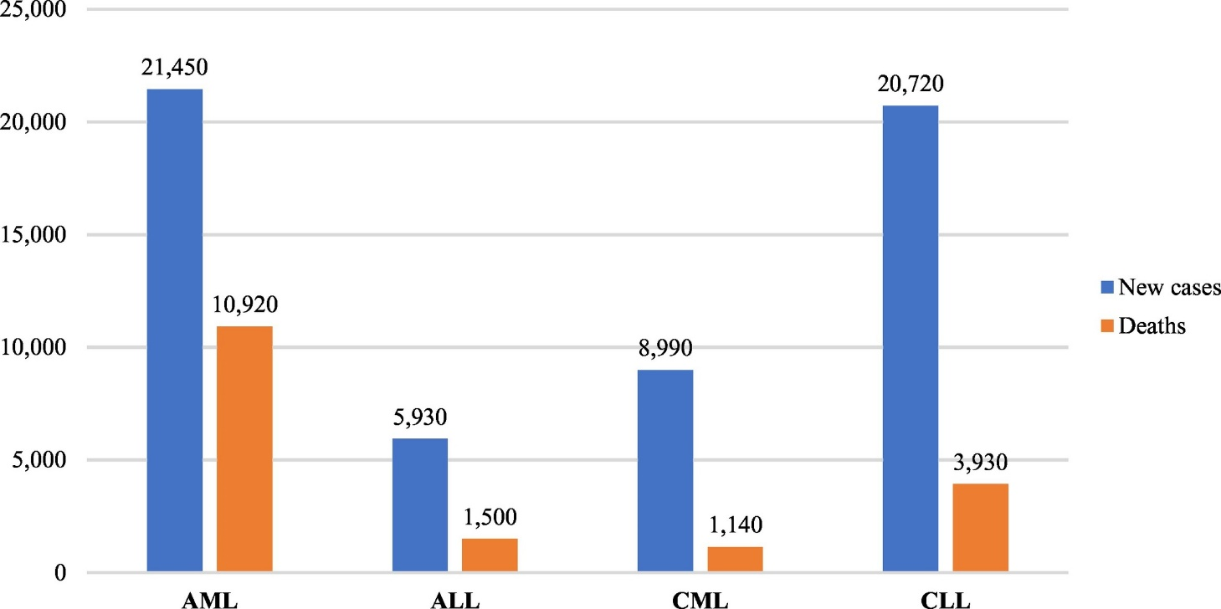
Leukemia: Epidemiology
https://www.sciencedirect.com/science/article/pii/S0268960X18301395?via%3Dihub

Slide 10
Acute Myeloid Leukemia

Slide 11
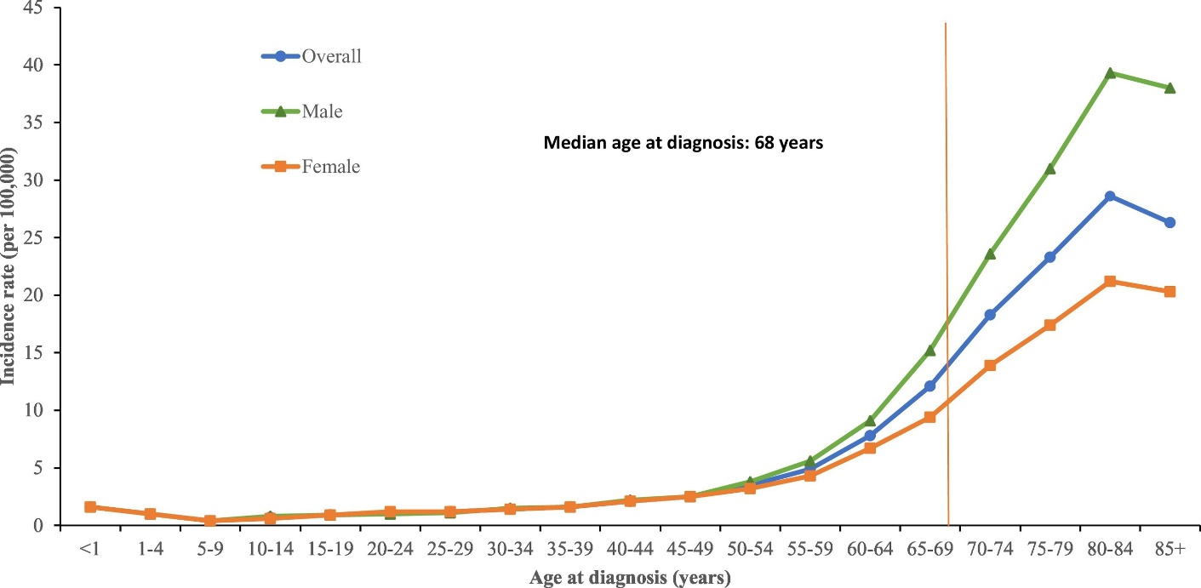
AML is a Disease Primarily of Adults

Slide 12
Origins of AML
AML is a malignancy of a committed myeloid progenitor cell.
In AML, the malignant cells largely lose the ability to differentiate.
  Morphologically homogeneous population of myeloblasts.

Slide 13
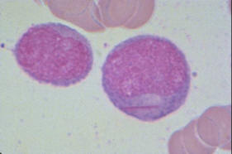
Acute Myeloid Leukemia
Clonal expansion of myeloid blasts
Can arise de novo or as a consequence of underlying disorder (such as: a bone marrow failure syndrome, myelodyplastic syndrome, myeloproliferative disorder)

Slide 14

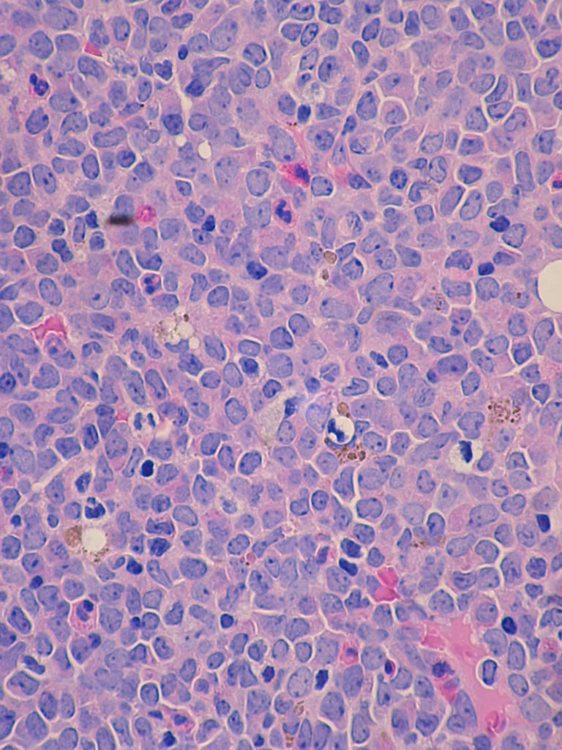
Bone Marrow Biopsy
NORMAL
  Trilineage hematopoiesis
ABNORMAL
  Monotonous population of mononuclear cells

Slide 15
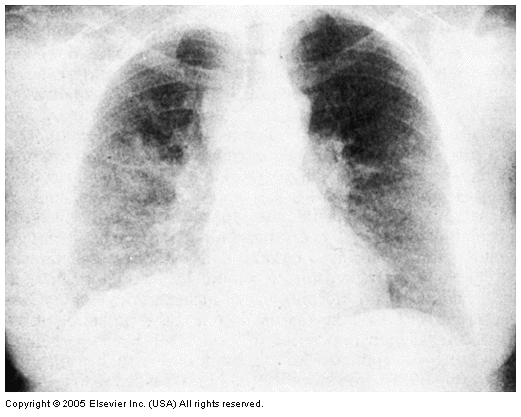
Clinical Manifestations
Anemia -- severe
  Fatigue, dyspnea
Neutropenia -- severe
  Infections
  Thrombocytopenia – severe (decreased platelets)
  brusing, petechiae, mucocutaneous bleeding
Hyperleukocytosis
  Increased white blood cells
  Mental status changes (somnolence).
  Dyspnea with bilateral infiltrates on CXR.
  Due to stasis of blood flow.
  More likely in AML.
Acute Disseminated intravascular coagulation (DIC)
Hyperleukocytosis in a patient with AML

Slide 16
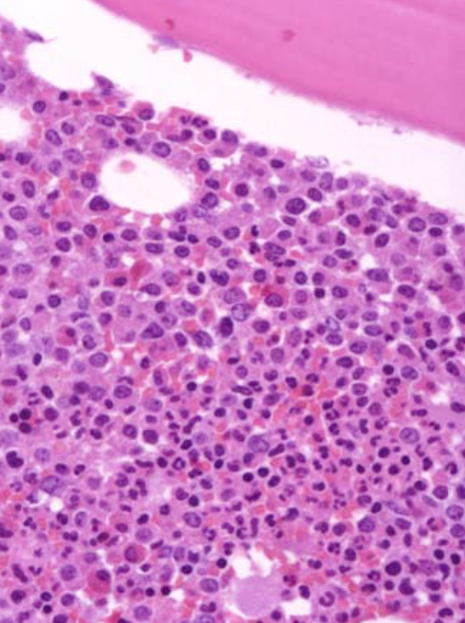
Bone Marrow Biopsy:
AML vs. CML
ABNORMAL:AML
  Monotonous population
ABNORMAL:CML
  Maturing granulocytes

Slide 17
Chronic Myelogenous Leukemia

Slide 18
Origins of CML
Neoplastic transformation of a hematopoietic progenitor cell (HPC).
The malignant cells maintain the ability to differentiate.

Slide 19
CML: Epidemiology
Incidence: 1 to 2 / 100,000
  4830 new cases in US in 2008.
  450 deaths.
Median age at diagnosis: 66 yrs.
Male/Female ratio: 1.4 / 1
Risk Factors
  Ionizing radiation exposure
Jemal A, et al. CA Cancer J Clin. 2008 Mar-Apr;58(2):71-96.

Slide 20
Clinical Presentation of CML
Common Symptoms
  Fatigue, sweats, fevers
  Weight loss/anorexia
  Abdominal fullness, early satiety
Physical Exam Findings
  Splenomegaly
  Hepatomegaly
Common Laboratory Findings
  Leukocytosis (high WBC count)
    Neutrophilia
    Basophilia
    Eosinophilia
  Anemia
  Thrombocytosis
*20-40% of patients are asymptomatic
Notes:
[slide 5]
Clinical Presentation of CML
The most common symptoms at presentation in the chronic phase of CML include fatigue, weight loss, abdominal fullness, and night sweats. In 50% of cases, the clinical presentation is asymptomatic.
Physical examination shows palpable splenomegaly in more than 50% of patients.
Typical laboratory results include leukocytosis with an abnormal differential, anemia, basophilia, and thrombocytosis.^{1,2}
References
1. Faderl S, Talpaz M, Estrov Z, et al. Chronic myelogenous leukemia: biology and therapy. Ann Intern Med. 1999;131:207-219.
2. Goldman JM. Chronic myeloid leukemia. Curr Opin Hematol. 1997;4:277-285.

Slide 21
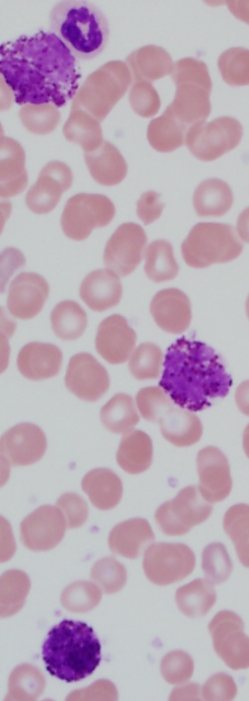
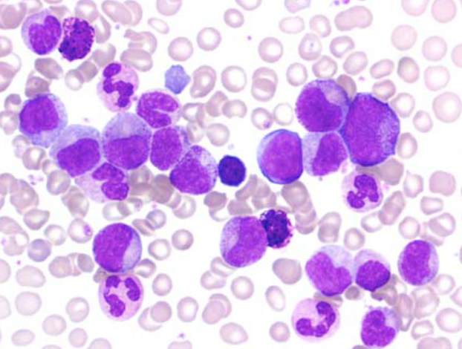
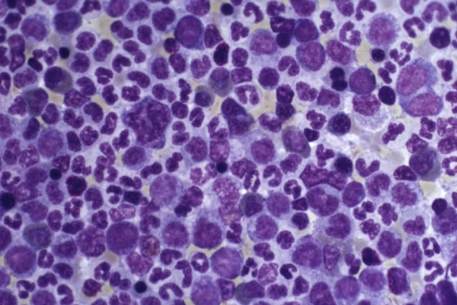
Chronic Myelogenous Leukemia
Peripheral blood
-Numerous immature
granulocytes
-Increased basophils*
Bone marrow aspirate
-Hypercellular
-Increased M:E

Slide 22
Bone Marrow Biopsy: Normal vs. CML
NORMAL
  Trilineage hematopoiesis
ABNORMAL: CML
  Maturing granulocytes

Slide 23
Bone Marrow Biopsy:
AML vs. CML
ABNORMAL:AML
  Monotonous population
ABNORMAL:CML
  Maturing granulocytes

Slide 24

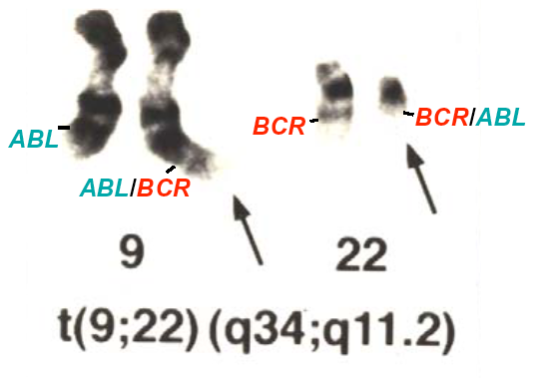
Pathogenesis: The Philadelphia Chromosome
FUSION PROTEIN
WITH CONSTITUTIVE TYROSINE
KINASE ACTIVITY

Slide 25
Acute Lymphoblastic Leukemia

Slide 26
Origins of ALL
ALL is a malignancy of a committed lymphoid progenitor cell (pre-T or –B cell).
In ALL, the malignant cells largely lose the ability to differentiate and from a morphologically homogeneous population of lymphoblasts.

Slide 27
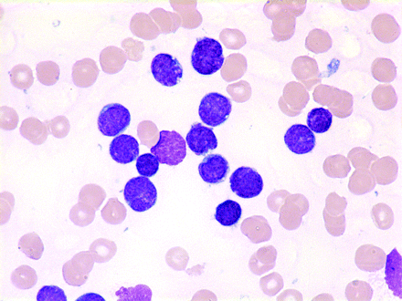
ALL: Epidemiology
  Most common cancer in children.
    Peak incidence between ages 2 to 5.
  Median age at diagnosis: 11.
  Risk factors
    Prior radiation
    Prior chemotherapy
    Familial syndromes
      (e.g. Down syndrome)

Slide 28
Clinical Manifestations
Anemia -- severe
  Fatigue, dyspnea
Neutropenia -- severe
  Opportunistic infections (staph, gram negatives, fungal)
Thrombocytopenia – severe (decreased platelets)
  bruising, petechiae, mucocutaneous bleeding
Hepatosplenomegaly
  Abdominal pain, early satiety

Slide 29

Summary
ALL Treatment
The great success story for cancer chemotherapy in the 21st century
Childhood ALL was a death sentence until the late 1960s
This story is beautifully told in The Emperor of All Maladies.
The majority of childhood ALL patients are cured but disparities exist impacting patients of color

Slide 30
Chronic Lymphocytic Leukemia

Slide 31
Origins of CLL
CLL is a malignancy of mature B-cells.
In CLL, the malignant cells are a morphologically homogeneous population of mature lymphocytes.

Slide 32
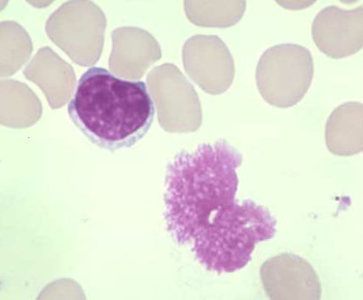
CLL: Epidemiology
The most common adult leukemia
  15,110 new US cases in 2008
  4,390 deaths from CLL
Median age at diagnosis: 72
Risk Factors
  Familial
  Environmental
    Agent Orange
“Smudge” cell
Jemal A, et al. CA Cancer J Clin. 2008 Mar-Apr;58(2):71-96.

Slide 33
Clinical Presentation of CLL*
Common Symptoms
  Fatigue, sweats, fevers
  Weight loss/anorexia
  Abdominal fullness, early satiety
  – Frequent infections
    Respiratory infections
    Encapsulated organisms
  – Incidental lab finding in ~20%
Common Physical Exam Findings
  Lymphadenopathy
  Splenomegaly
  Hepatomegaly
Common Laboratory Findings
  Leukocytosis (high WBC count)
    Lymphocytosis
  Anemia
  Thrombocytopenia
  Hypogammaglobulinemia
* CLL characterized by accumulation of mature, homogeneous, mature lymphocytes.
Notes:
[slide 5]
Clinical Presentation of CML
The most common symptoms at presentation in the chronic phase of CML include fatigue, weight loss, abdominal fullness, and night sweats. In 50% of cases, the clinical presentation is asymptomatic.
Physical examination shows palpable splenomegaly in more than 50% of patients.
Typical laboratory results include leukocytosis with an abnormal differential, anemia, basophilia, and thrombocytosis.^{1,2}
References
1. Faderl S, Talpaz M, Estrov Z, et al. Chronic myelogenous leukemia: biology and therapy. Ann Intern Med. 1999;131:207-219.
2. Goldman JM. Chronic myeloid leukemia. Curr Opin Hematol. 1997;4:277-285.

Slide 34
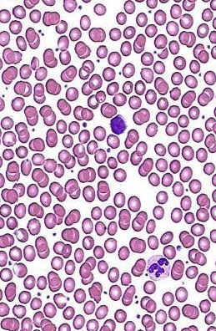
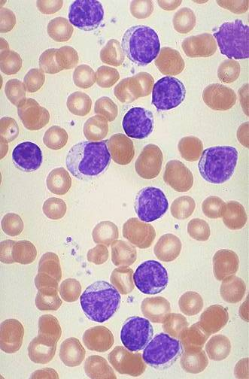
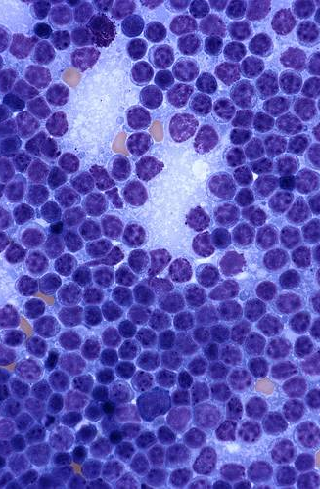
Morphology
Normal blood:
-mostly neutrophils
-scattered lymphs
Peripheral blood: CLL
-usually diagnostic
-lymphocytosis
Bone Marrow Aspirate: CLL
-variable involvement
-loss of heterogeneity

Slide 35
Lymphoma
To review the epidemiology, pathology, and clinical findings associate with the following three types of hematologic lymphomas:
  Low grade
  Intermediate grade
  High grade

Slide 36
Differential Diagnosis of an Enlarged Lymph Node
Causes of lymphadenopathy include:
  Reactive (benign such as seen with Strep throat, mononucleosis, etc)
  Lymphoma
    Hodgkin disease
    Non-Hodgkin lymphoma
  Metastatic disease

Slide 37
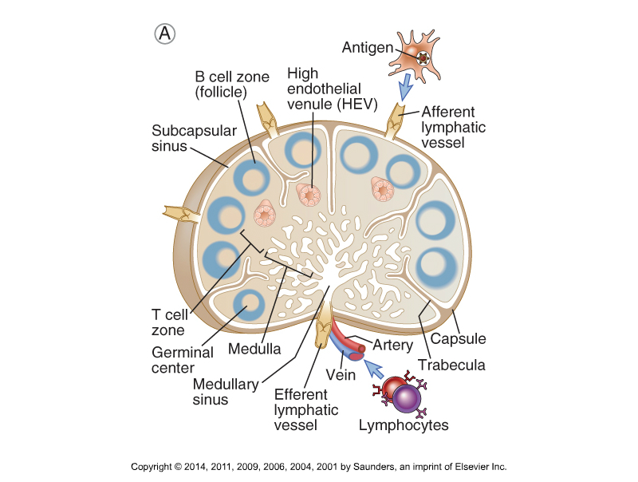
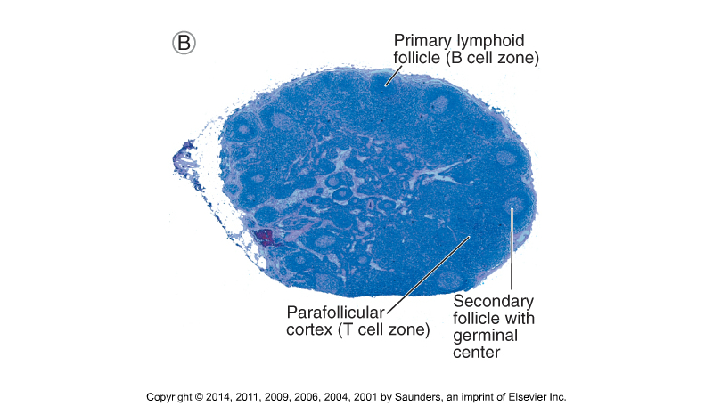
The Lymph Node

Slide 38
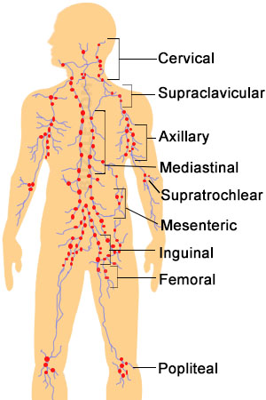
Lymph Node Groups
Buzzle.com

Slide 39
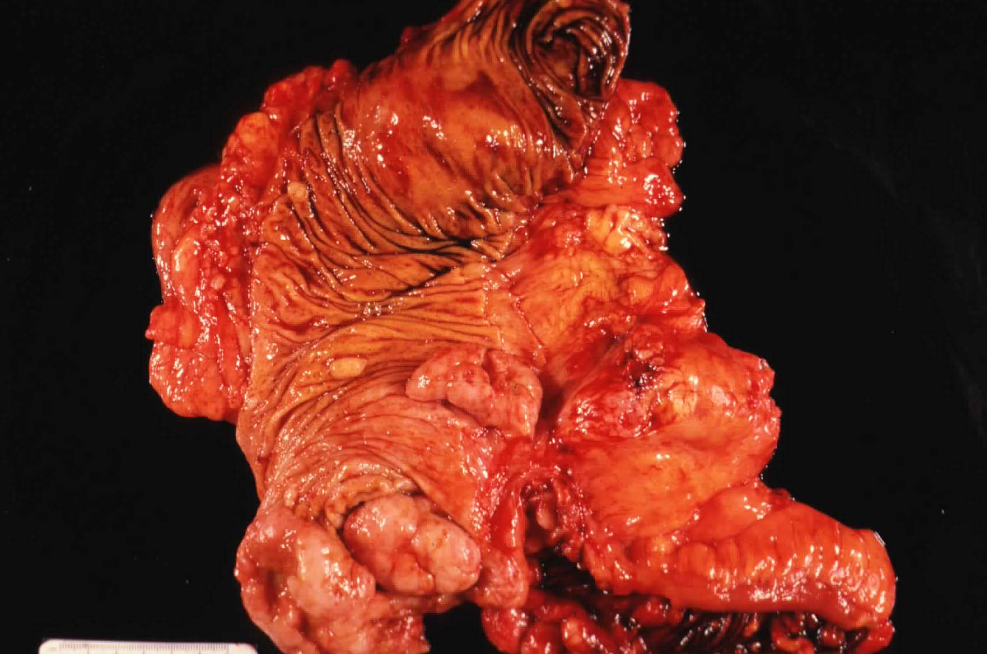
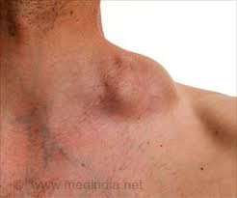
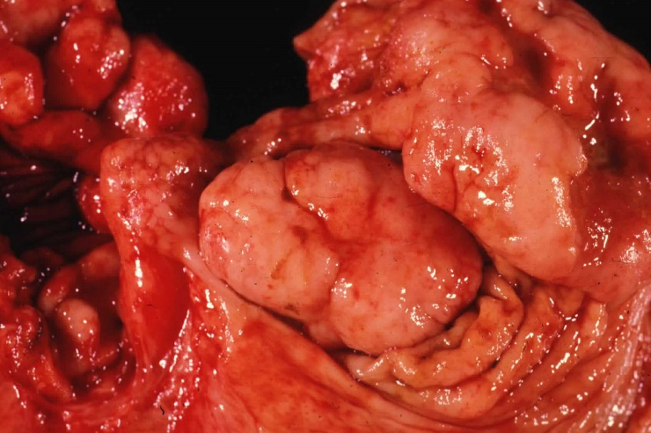
Lymphoma
Extra Nodal, Colon
Nodal

Slide 40
Lymphoma Epidemiology
Lymphoma definition: malignant neoplasm of lymphocytes associated with a solid mass or infiltrate
6th most common cancer in America
Approximately 77,000 new lymphoma cases diagnosed a year in US
  42,000 males
  35,00 females
  65,000 Non-Hodgkin
  9,000 Hodgkin
Approximately 20,000 deaths a year in US due to lymphoma (11,000 males, 9,000 females)
Approximately 1,000 people worldwide are diagnosed with lymphoma every day.

Slide 41
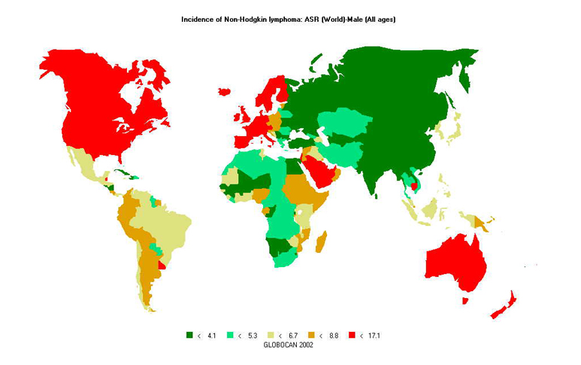
Incidence of Non-Hodgkin Lymphoma Varies Worldwide

Slide 42
Non-Hodgkin Lymphoma:
Risk Factors
Infections
  HIV
  Epstein-Barr virus (EBV), virus associated with mononucleosis
  Helicobacter pylori
  Hepatitis B
  Hepatitis C
  Human T-cell leukemia virus type 1 (HTLV-1)
  HHV-8
Medical conditions that compromise the immune system
  HIV
  Autoimmune disease (e.g. Hashimoto thyroiditis, Sjögren syndrome)
  Use of immune suppressive therapy (e.g. associated with organ transplant)
  Inherited immunodeficiency diseases (e.g. severe combined immunodeficiency, ataxia telangiectasia, IgA deficiency, many others)
Toxic chemicals
  Pesticides, herbicides, or benzene
  Hair dye use in patients who started to use the dyes before 1980
Age
While risk factors are important, most patients have no identifiable risk factor

Slide 43
Lymphoma Types:
WHO Classification
Non-Hodgkin
  B-cell (85% of North-American lymphomas)
  T-cell (15% of North-American lymphomas)
Hodgkin Disease

Slide 44
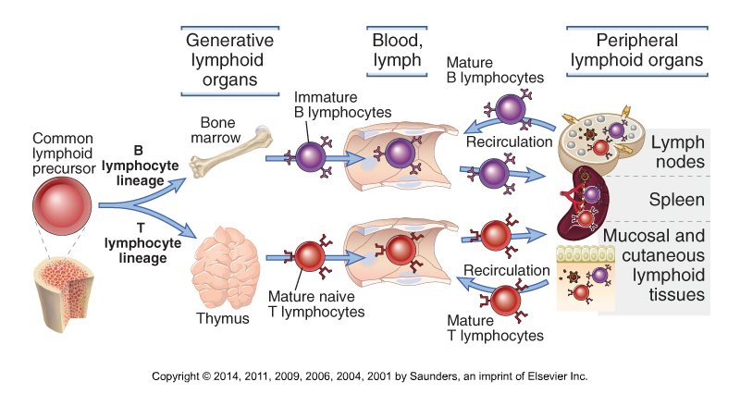
Maturation of Lymphocytes

Slide 45
Lymphoma Types:
WHO Classification
Non-Hodgkin
B-cell
  Precursor B-cell neoplasms
  Mature B-cell neoplasms
T-cell
  Precursor T-cell neoplasms
  Mature T-cell neoplasms

Slide 46
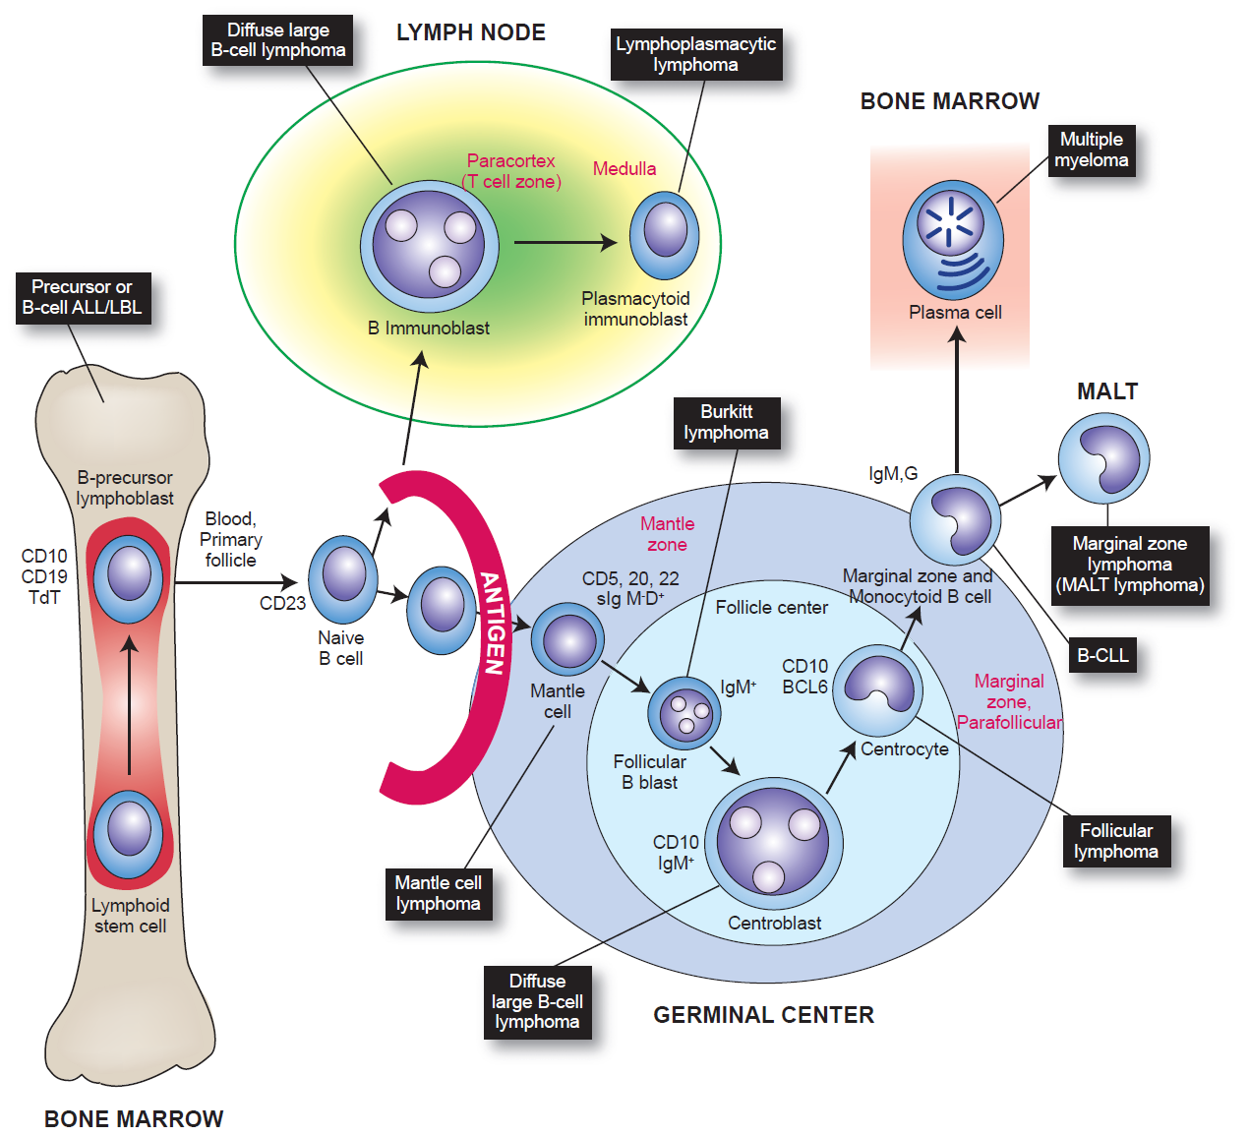
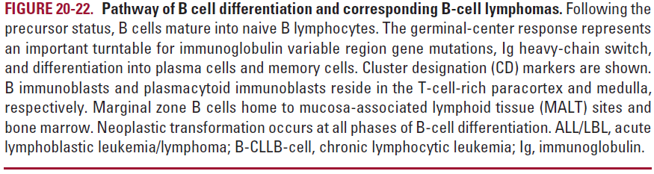
B-cell Malignancies
Cells of Origin

Slide 47
World Health Organization 2016
B-cell Neoplasms
  Precursor B-cell neoplasm
    Precursor B-cell acute lymphoblastic leukemia or lymphoma
  Mature B-cell neoplasms
    Chronic lymphocytic leukemia/small lymphocytic lymphoma
    Monoclonal B-cell lymphocytosis
    B-cell prolymphocytic leukemia
    Splenic marginal zone lymphoma
    Hairy-cell leukemia
    Lymphoplasmacytic lymphoma/Waldenström macroglobulinemia
    Monoclonal gammopathy of undetermined significance (IgM, IgG, IgA)
    Heavy chain diseases (Mu, Gamma, Alph)
    Plasma-cell myeloma
    Solitary plasmacytoma of bone
    Extraosseous plasmacytoma
    Monoclonal immunoglobulin deposition diseases
    Extranodal marginal-zone B-cell lymphoma of mucosa-associated lymphoid tissue (MALT lymphoma)
    Nodal marginal-zone B-cell lymphoma
    Follicular lymphoma
    Pediatric-type follicular lymphoma
    Primary cutaneous follicle center lymphoma
    Mantle-cell lymphoma
    Diffuse Large B-cell lymphoma (DLBCL)
    Primary mediastinal large B-cell lymphoma (DLBCL)
    T cell/histiocyte-rich large B-cell lymphoma
    Primary DLBCL of the CNS
    Primary cutaneous DLBCL, let type
    EBV positive DLBCL, NOS
    DLBCL associated with chronic inflammation
    Lymphomatoid granulomatosis
    Primary medicastinal (thynic) large B-cell lymphoma
    Intravascular large B-cell lymphoma
    ALK positive large B-cell lymphoma
    Plasmablastic lymphoma
    Primary effusion lymphoma
    Burkitt's lymphoma
    B-cell lymphoma, unclassifiable, with features intermediate between DLBCL and Burkitt lymphoma
    High grade B-cell lymphoma, with MYC and BCL2 and/or BCL6 rearrangements
    High grade B-cell lymphoma, NOS
    B-cell lymphoma, unclassifiable with features intermediate between DLBCL and Hodgkin lymphoma

Slide 48
T-cell Malignancies
Cells of Origin

Slide 49
World Health Organization 2016
T-cell Neoplasms
  Precursor T-cell neoplasm
    Precursor T-cell acute lymphoblastic leukemia or lymphoma
  Mature (peripheral) T-cell neoplasms
    T-cell prolymphocytic leukemia
    T-cell granular lymphocytic leukemia
    Aggressive natural-killer cell leukemia
    Systemic EBV+ T-cell lymphoma of childhood
    Hyroa vacciniforme-like lymphoproliferative disorder
    Adult T-cell leukemia/lymphoma
    Extranodal natural-killer/T-cell lymphoma, nasal type
    Enteropathy-type T-cell lymphoma
    Monomorphic epitheliotropic intestinal T-cell lymphoma
    Hepatosplenic T-cell lymphoma
    Subcutaneous panniculitis-like T-cell lymphoma
    Mycosis fungoides
    Sezary syndrome
    Primary cutaneous CD30 positive T-cell lymphoproliferative disourders
    Primary cutaneous gamma-delta T-cell lymphoma
    Peripheral T-cell lymphoma, not otherwise characterized
    Angioimmunoblastic T-cell lymphoma
    Anaplastic large-cell lymphoma, ALK positive
    Anaplastic large-cell lymphoma, ALK negative

Slide 50
The Lymph Node

Slide 51
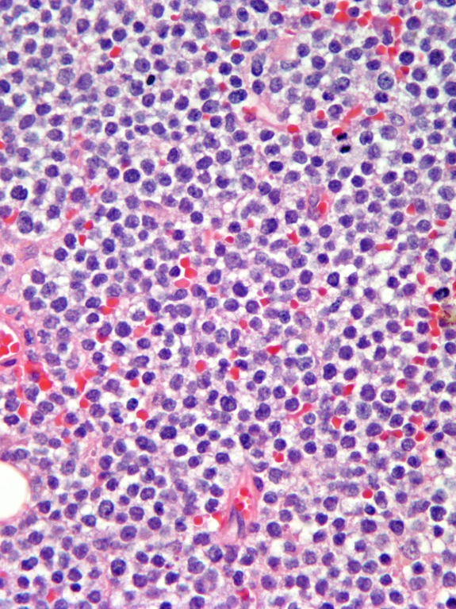
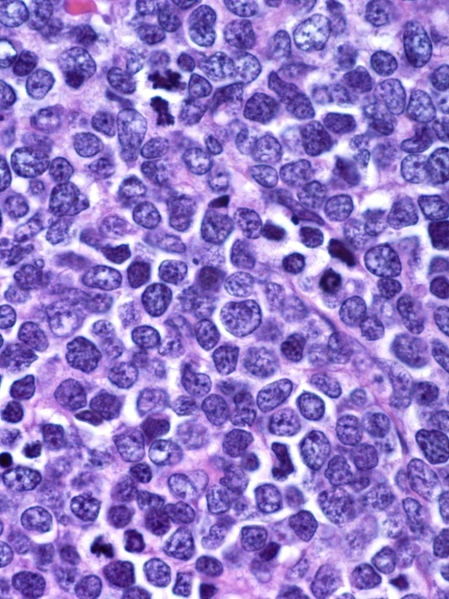
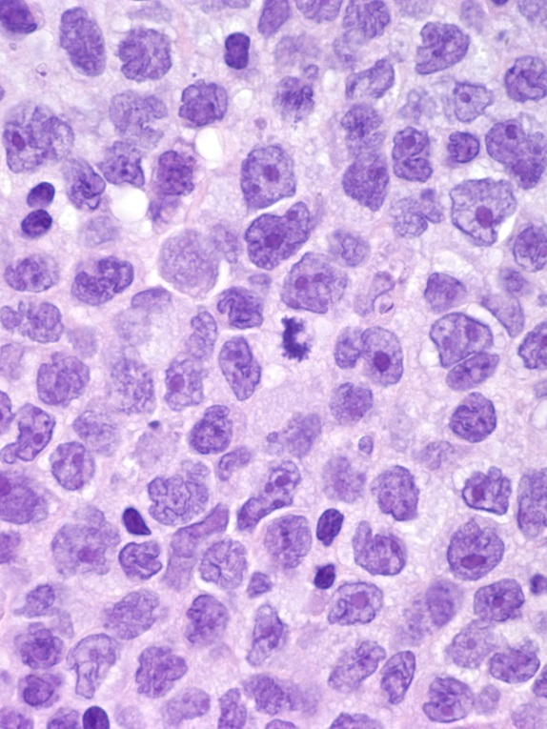
Histologic Classification:
Cell Size
Small
Intermediate
Large

Slide 52
Lymphoma Grades
Low Grade (indolent, slow growing)
  Small lymphocytic lymphoma
  Follicular small cleaved lymphoma
Intermediate Grade (in between, prognosis depends on stage)
  Diffuse large cell lymphoma
High Grade (aggressive, fast growing)
  Burkitt lymphoma
  Lymphoblastic lymphoma

Slide 53
The Working Formulation
 | Natural History | Cure Rate
Low Grade (Follicular, Small lymphocytic) | Many years | Incurable
Intermediate Grade (Diffuse Large B-Cell) | A few years | Curable (20 to 80%)
High Grade (Burkitt, Lymphoblastic) | Months | Curable (> 80%)
Hodgkin’s Disease is similar to intermediate grades
with 60 to 95% cure
Notes:
Here’s why the Working Formulation has stayed around – it is a clinical description of how these diseases act. As you go from Low to High grade, the lymphomas become more aggressive and will kill you quicker (if you don’t treat). However, they also become easier to cure.
Again, these are very broad characterizations. Some low grade lymphomas act very aggressively; others are more indolent. Remember, if this system was so good, we wouldn’t be looking for new systems. For example, many adults with Burkitt’s like lymphoma have a significantly poorer prognosis.
In some ways, this slide and the next one are the most important of the lecture. Don’t worry if you haven’t memorized it all just yet. We will emphasize this over and over and over …
Note: MS = Median survival.

Slide 54
Small Lymphocytic
Follicular
Diffuse Large B-Cell
Mantle Cell
Burkitt’s,
Lymphoblastic
Low/Intermediate Grade
Intermediate Grade
High Grade
Low Grade
Hodgkin’s Disease
Presents like an intermediate grade
Asymptomatic
B Symptoms
Masses
Notes:
Here is a summary of symptoms and the diseases that one should think of. The gray bars are my rough approximation of the likelihood of each presentation (the larger the bar … the more likely it present with that symptom)
Bottom line – the higher the grade the more likely it will present with symptoms.

Slide 55
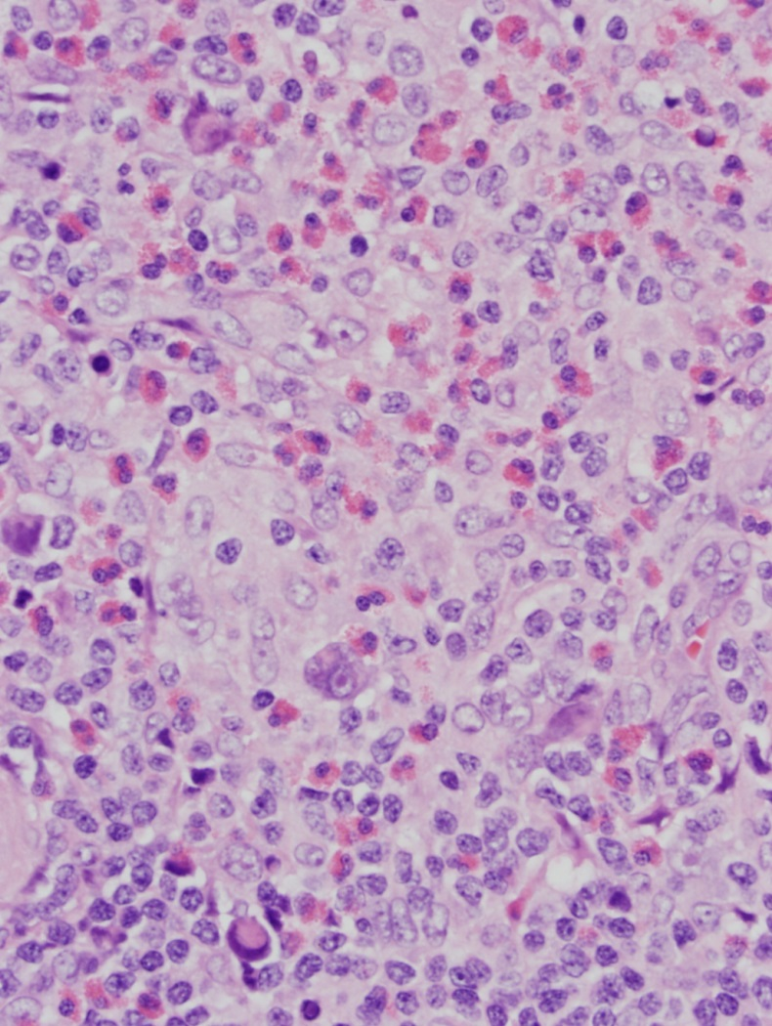
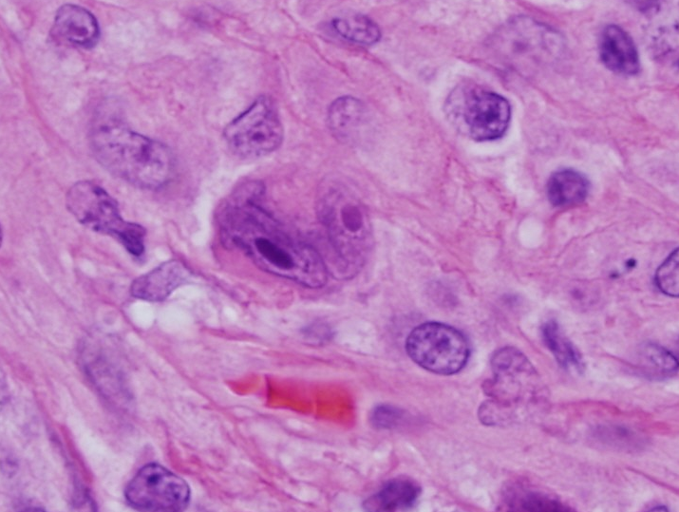
Hodgkin Lymphoma
Reed-Sternberg Cell
Tumor is primarily composed of benign reactive cells with rare malignant Reed-Sternberg Cell

Slide 56
Multiple Myeloma
To review normal peripheral blood, bone marrow, and lymph node pathology of multiple myeloma

Slide 57
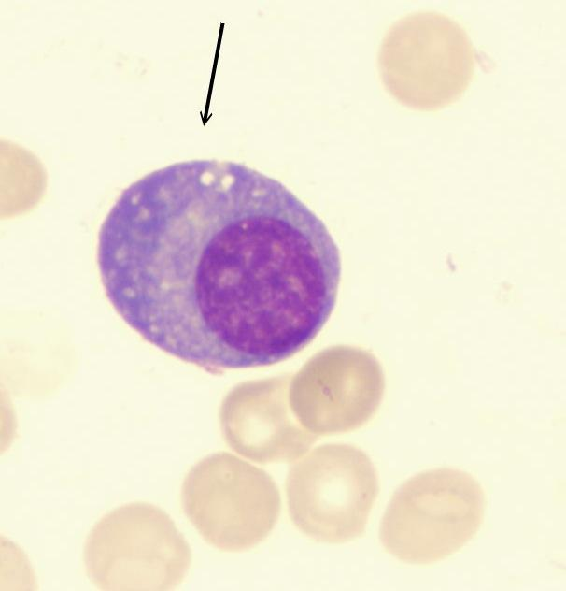
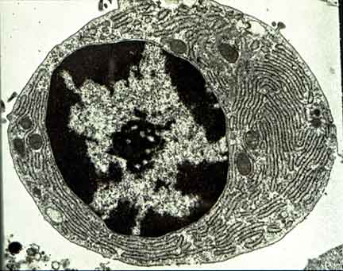
Multiple Myeloma is a Malignancy of Plasma cells

Slide 58
Cells of origin of
B-cell malignancies

Slide 59
Multiple Myeloma: Epidemiology
Approximately 1% of all malignancies
Approximately 10% of hematological malignancies
Approximately 20,000 cases a year
Primarily incurable, but survival has increased in the past decade

Slide 60
Multiple Myeloma: Risk factors
Risk factors include:
  Age (peak incidence between 65 and 70)
  Gender (males>females)
  Genetic ancestry (Blacks>Whites>Hispanic>Asian)
  Family history
  Radiation exposure
  Chronic antigenic stimulation

Slide 61
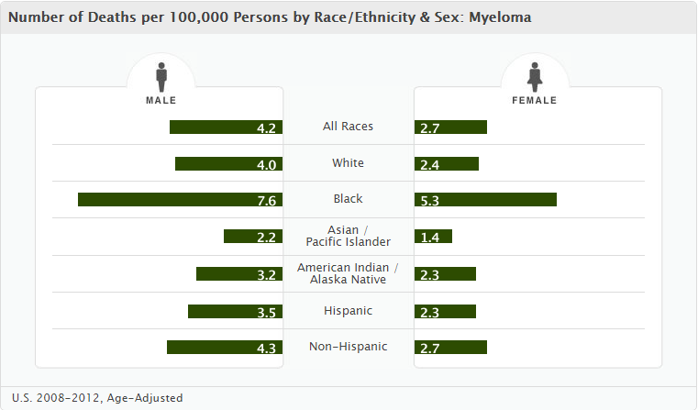
Demographics*
*Substitute genetic ancestry for race

Slide 62
Multiple Myeloma
The clinical and pathologic findings associated with multiple myeloma are in large part a consequence of:
  Tumor mass effect of the malignant plasma cells proliferating in the bone marrow or from:
  Abnormal secretory products from the malignant plasma cells including monoclonal immunoglobulins and cytokines

Slide 63
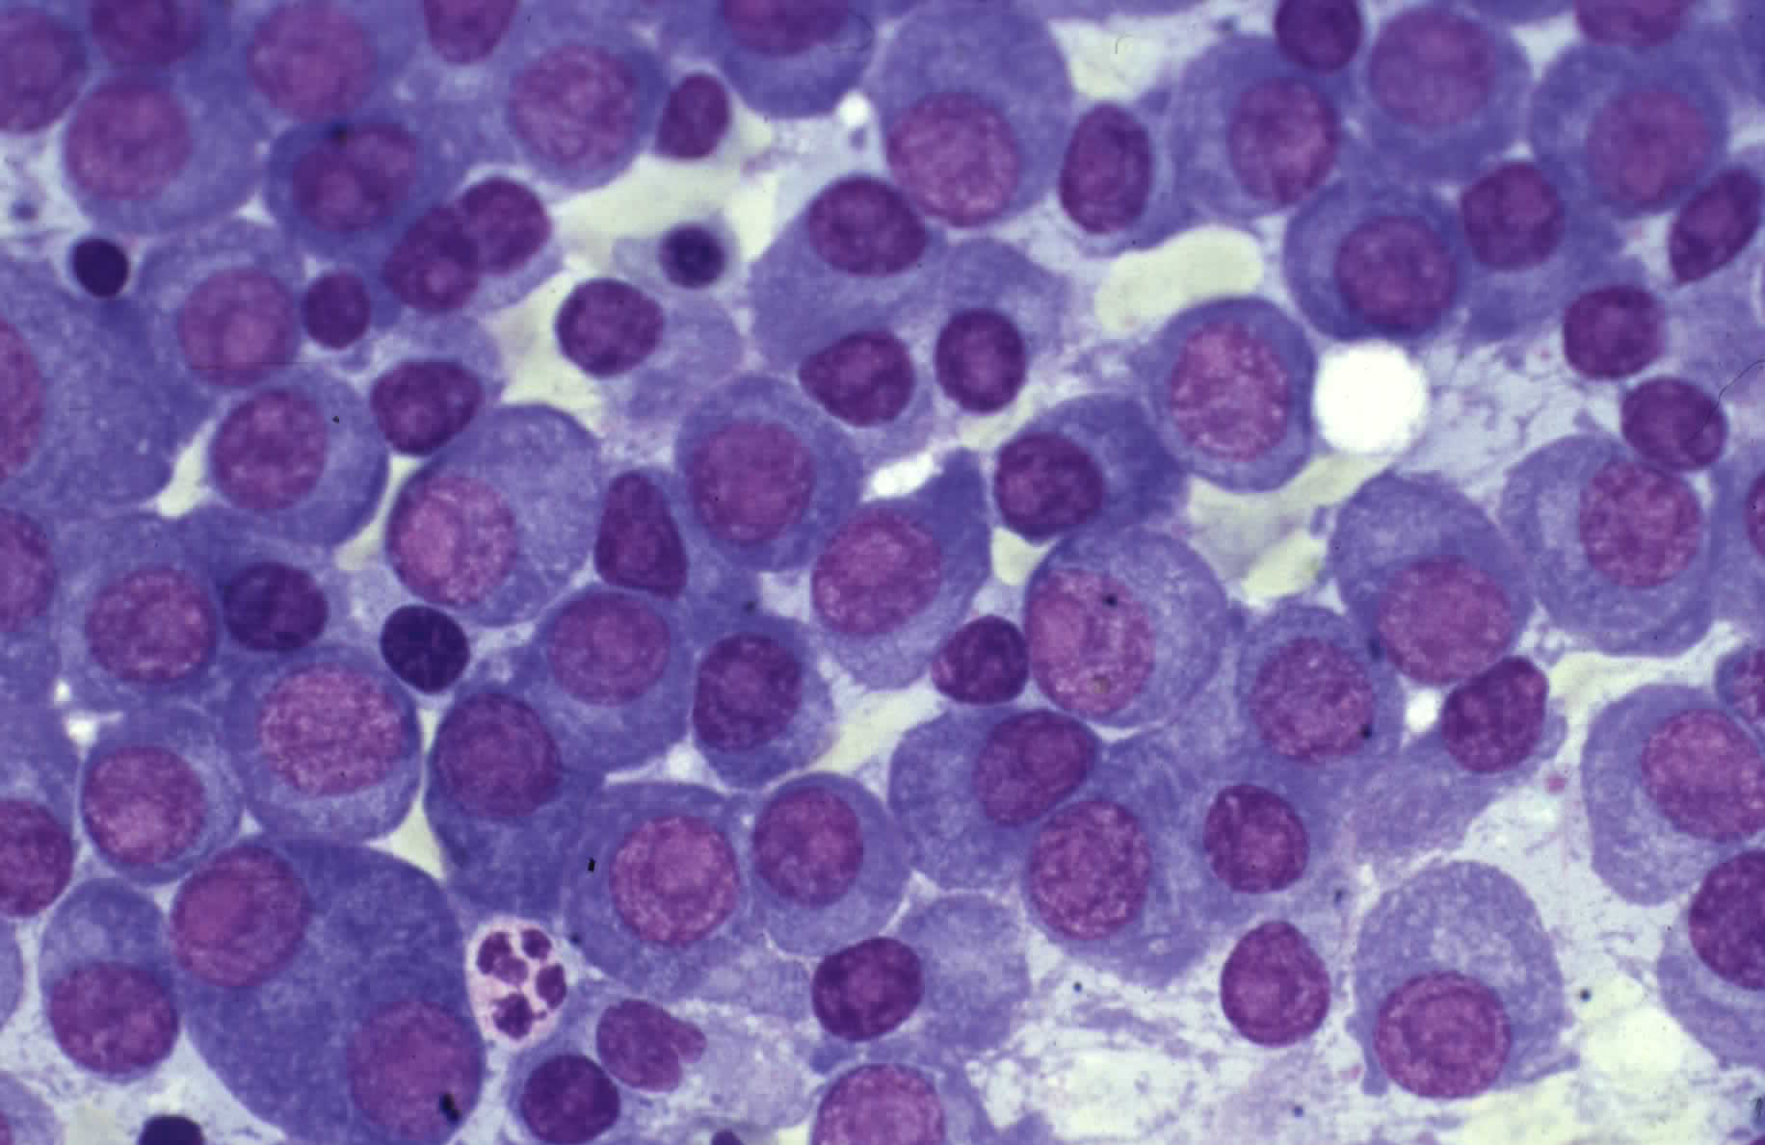
Bone Marrow Clonal Plasmacytosis

Slide 64
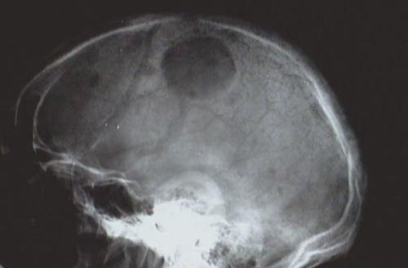
Lytic Skull Lesion
Lytic lesions see on skeletal survey, but not bone scans

Slide 65
Lytic Skull Lesion
Lytic lesions see on skeletal survey, but not bone scans

Slide 66
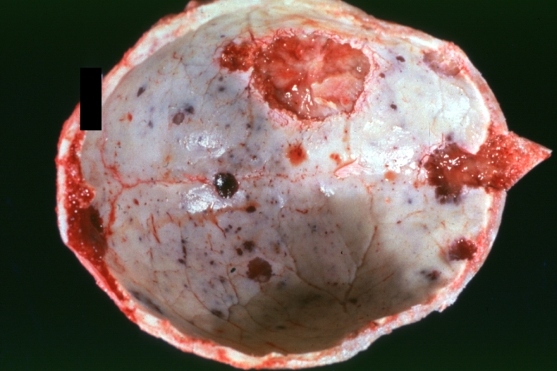
Multiple Myeloma – Lytic lesions in skull

Slide 67
Multiple Myeloma
Laboratory Studies
Complete blood count (CBC)
Chemistries, especially calcium and creatinine
Serum and urine protein electrophoresis and immunofixation
Bone marrow for morphology, immunophenotyping and cytogenetics
Bone imaging studies (skeletal radiography, CT, or PET-CT)

Slide 68
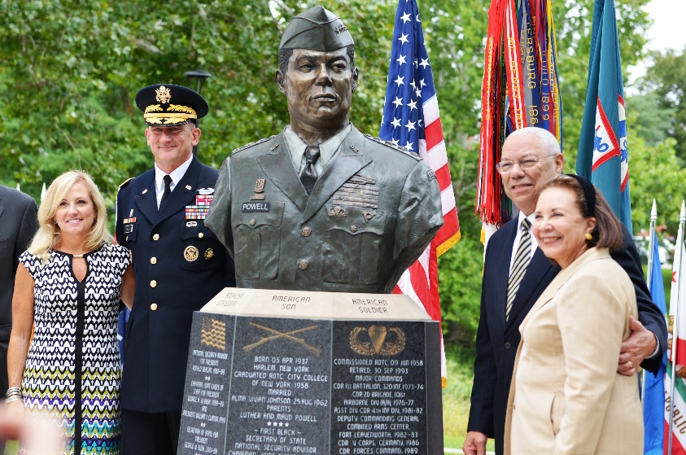
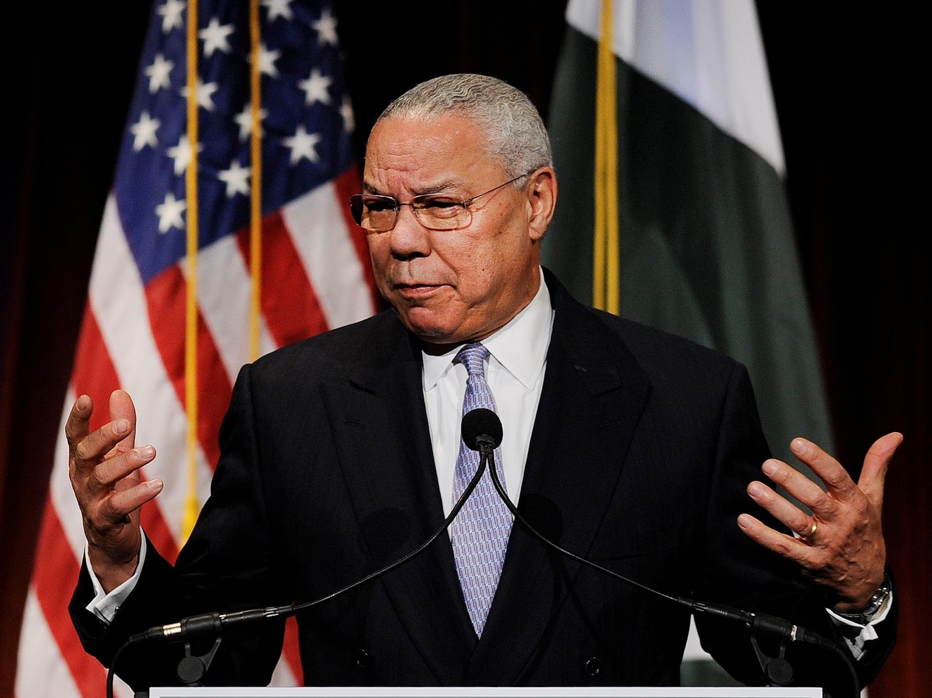
Colin Powell & Multiple Myeloma
Multiple myeloma is associated with suppression of normal immunoglobulins
This causes patients to be more vulnerable to infections
They do not make normal immunoglobulins like people with normal immune systems
They might not make antibodies in response to a vaccine
https://www.cbsnews.com/news/colin-powell-covid-vaccine-multiple-myeloma-cancer-risk/

Slide 69

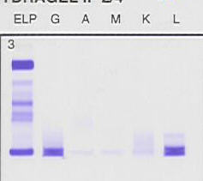
Serum protein electrophoresis and immunofixation – IgG Lambda
SPEP
P N
Immunofixation
Albumin
Band indicating monoclonal
immunoglobulin in gamma globulin region
P=Patient
N=Normal

Slide 70
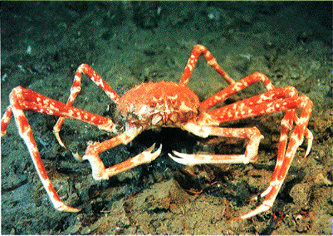
Myeloma Defining Events (MDE)
Evidence of end organ damage (CRAB)
  Hypercalcemia
  Renal disease
  Anemia
  Bone disease
Biomarkers
  Extreme bone marrow clonal plasmacytosis
  Elevated free serum light chain level (FLC)
  More than one focal lesion on MRI

Slide 71
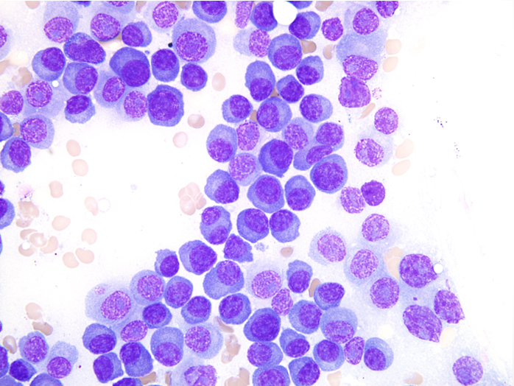
Bone marrow plasmacytosis

Slide 72
Summary
Hematologic neoplasms include leukemia, lymphoma, and multiple myeloma
These diseases occur throughout life
Disparities exist based on socioeconomics and genetic ancestry
There have been many advances in therapy in the last decades but more work needs to be done

