Slide 1
Department of Pathology
and Laboratory Medicine
Introduction to Pathology of Disease
NCA&T Biol 342, NCCU Special Course
Module 1: The Basics of Pathology
Introduction to Mechanisms of Disease
J. Charles Jennette, M.D.
Professor of Pathology and Laboratory Medicine
Professor of Medicine
School of Medicine
University of North Carolina at Chapel Hill

Slide 2
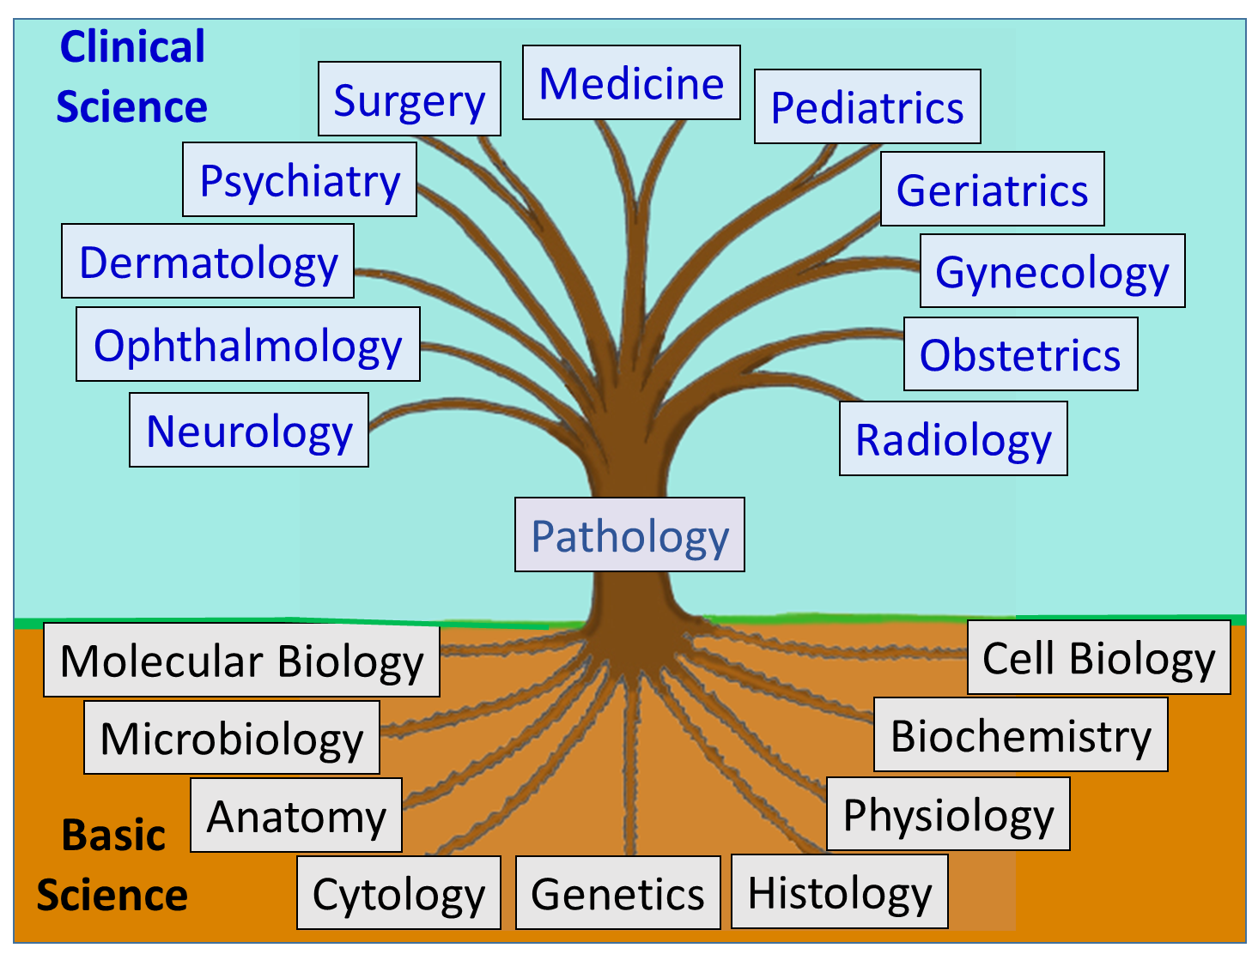
Department of Pathology
and Laboratory Medicine
Module 1: The Basics of Pathology
Pathology Bridges Science and Medicine

Slide 3
Principles of Pathology
Department of Pathology
and Laboratory Medicine
Introduction to Mechanisms of Disease
What is pathology?
The term “pathology” is used in three different ways:
The scientific and medical discipline that studies the structural, molecular and functional manifestations of disease, and the mechanisms that cause disease.
(A physician or scientist who knows and applies pathology is a pathologist.)
The structural and functional manifestations of a disease. (The lung pathology is acute inflammation.)
A disease. (The lung pathology is pneumonia.)

Slide 4
Department of Pathology
and Laboratory Medicine
Introduction to Mechanisms of Disease
What is a disease?
Oxford Dictionary: A disorder of structure or function in a human, animal, or plant.
Biomedical Terminology: Molecular, cellular, tissue, organ or organismic disorder caused by an etiology and mediated by pathogenic mechanisms

Slide 5
Department of Pathology
and Laboratory Medicine
Introduction to Mechanisms of Disease
What a mechanism of disease?
Pathogenesis (Mechanism of Disease)
Pathogenesis
(Mechanism of Disease)
Etiology
(Cause)
Disease
Targets for prevention and treatment

Slide 6
Department of Pathology
and Laboratory Medicine
Introduction to Mechanisms of Disease
To discuss and understand mechanisms of disease one must know pathology terminology (terms and definitions) that are vital elements of the language of biomedical science and clinical medicine.
You will encounter these terms and concepts repeatedly in any vocation or avocation involving biomedical science or clinical medicine.
Learning and understanding pathology terminology helps learn and understand mechanisms of disease.
This is the goal of this presentation

Slide 7
DEFINITIONS
Department of Pathology
and Laboratory Medicine
Disease: molecular, cellular, tissue, organ and organismic disorder caused by an etiology and mediated by pathogenic mechanisms
Diagnosis: the name for a disease
Etiology: the cause of disease (many categories: infectious, physical, chemical, genetic, immune, etc.)
Pathogenesis: the sequence of events that leads from the etiology to the manifestations of disease
Symptom: disease manifestation perceived and reported by the patient
Sign: manifestation of disease that can be identified by physical examination, laboratory tests, imaging studies, and other methods.
Differential Diagnosis: A ranked list of the most likely diagnoses based on the signs and symptoms of disease in a patient.

Slide 8
Department of Pathology
and Laboratory Medicine
The name used for a disease (diagnosis) can contain more or less information based on what is known about the etiology, pathology, and pathogenesis
Myocarditis
Viral myocarditis
Coxsackievirus myocarditis
Acute coxsackievirus myocarditis

Slide 9
Department of Pathology
and Laboratory Medicine
Pathogen/infection
Toxin
Trauma
Autoimmunity
Carcinogen
Teratogen
Etc.
Etiology (cause)
Injury
Disease
Response to injury
Pathogenesis (mechanism of disease)

Slide 10
Department of Pathology
and Laboratory Medicine
Mechanisms of Disease
Numerous etiologies initiate a limited number of pathogenic mechanisms that produce a wide variety of diseases.
Thus, a thorough understanding of the limited number of pathogenic mechanisms allows insight into myriad numbers of diseases, even ones you have never seen before.

Slide 11
Department of Pathology
and Laboratory Medicine
Mechanisms of Disease
Cellular responses to injury
Intracellular response
Cell death
Hypertrophy
Hyperplasia
Atrophy
Metaplasia
Dysplasia
Neoplasia
Tissue response to injury
Inflammation
Repair
Hemostasis/thrombosis
Ischemia
Abnormal morphogenesis
Genetic
Teratogenic
Biochemical disorder
Genetic
Acquired

Slide 12
Department of Pathology
and Laboratory Medicine
Mechanisms of Disease
Cellular responses to injury
Intracellular response
Cell death
Hypertrophy
Hyperplasia
Atrophy
Metaplasia
Dysplasia
Neoplasia
Tissue response to injury
Inflammation
Repair
Hemostasis/thrombosis
Ischemia
Abnormal morphogenesis
Genetic
Teratogenic
Biochemical disorder
Genetic
Acquired

Slide 13
Subcellular responses to injury
Department of Pathology
and Laboratory Medicine
Intracellular Changes Occur and May be Reversible
From Essentials of Rubin’s Pathology, 6th Edition, Lippincott Williams & Wilkins, Philadelphia, 2014

Slide 14
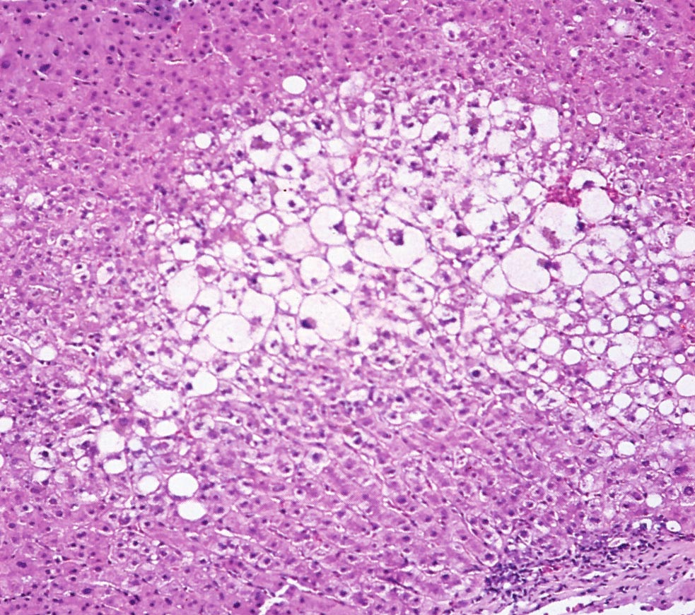
Hydropic Degeneration
Department of Pathology
and Laboratory Medicine
Normal-appearing hepatocyte
Hepatocytes with abnormal swelling because of increased water within organelles (hydropic change) caused by injury by a toxin
Biopsy of liver with acute drug toxicity
From Essentials of Rubin’s Pathology, 6th Edition, LWW, 2014

Slide 15
Cell Death
Department of Pathology
and Laboratory Medicine
Major pathways to cells death:
Apoptosis: regulated cell death caused by activation of internal molecular pathways leading to cell death (e.g., physiological tissue remodeling during embryonic development, renewal of epithelial layers).
Necrosis: unregulated cell death caused by pathological lethal injury that often originates outside the cell (e.g., injury by hypoxia, inflammation, molecular toxin, burn, etc.).
Necroptosis: regulated necrosis caused by activation of internal molecular pathways leading to cell death (e.g., resulting from intracellular viral infections or inflammatory disease).

Slide 16
Cell Death
Department of Pathology
and Laboratory Medicine
Cell death is demonstrated histologically by nuclear changes
Normal nucleus: Dispersed chromatin and intact nuclear membrane.
Nuclei of Necrotic Cells
Pyknosis: The nucleus becomes smaller and stains deeply basophilic because of chromatin clumping.
Karyorrhexis: The pyknotic nucleus breaks up into many smaller fragments.
Karyolysis: The nucleus may be extruded from the cell or have progressive loss of chromatin staining resulting in the disappearance of the nucleus.
Normal viable hepatocytes with normal nuclei
Necrotic hepatocytes with absent or abnormal nuclei

Slide 17
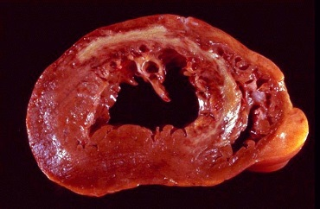
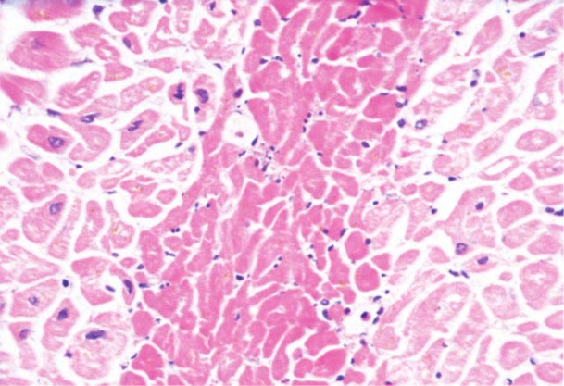
Infarction
Department of Pathology
and Laboratory Medicine
Necrosis caused by ischemia (low blood flow):
Nuclei disappear (karyolysis) and cytoplasm becomes more homogeneous resulting in residual ghosts of cells with no nuclei.
Infarct
Viable
Necrotic
Myocardial infarction (“heart attack”) with ischemic necrosis

Slide 18
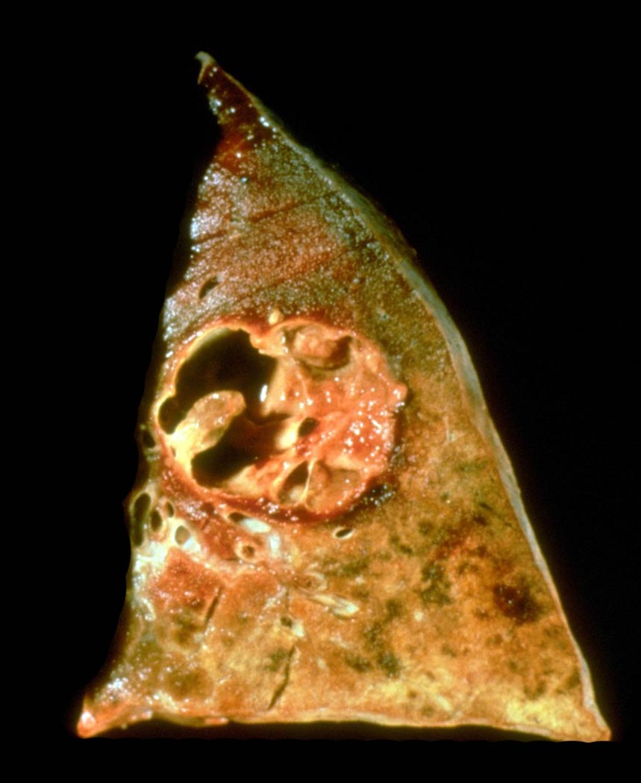
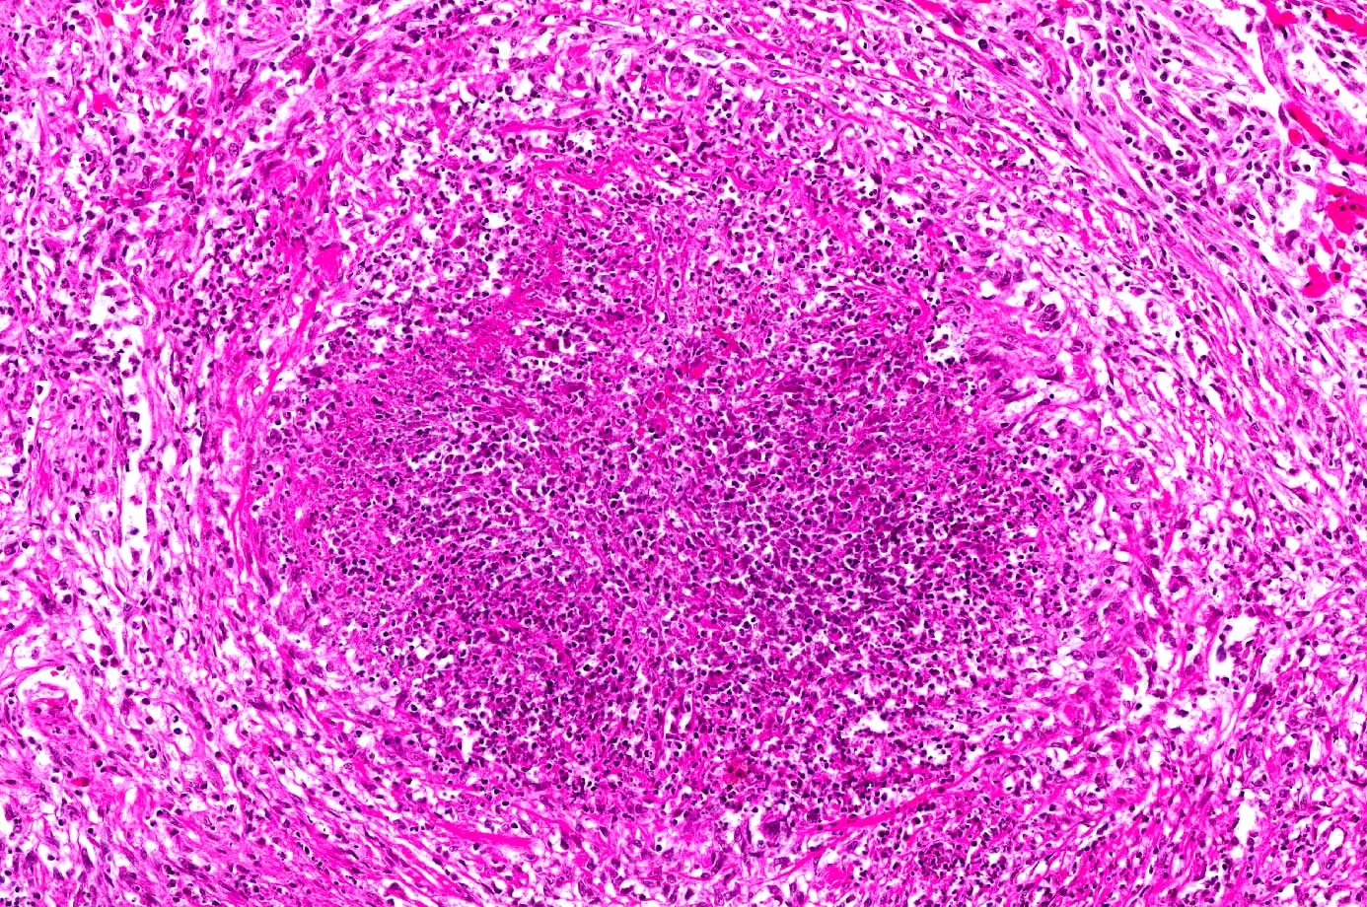
Liquefactive Necrosis
Department of Pathology
and Laboratory Medicine
Liquifactive necrosis caused by intense localized infiltration of neutrophilic polymorphonuclear leukocytes (neutrophils) at sites of severe acute inflammation (e.g. caused by bacterial infection). Localized acute inflammation with liquifactive necrosis is called an abscess.
Abscess with partial cavitation
Abscess containing numerous neutrophils (pus, purulence) that have liquefied the tissue
Liver abscess with liquifactive necrosis and cavitation caused by infection
Bacterial infection abscess with intense infiltration of neutrophils

Slide 19
Cellular responses to injury
Department of Pathology
and Laboratory Medicine
Cellular responses to injury (adaptation/maladaptation)
HYPERTROPHY is increased size of cells.
HYPERPLASIA is non-neoplastic increase in the number of cells in an organ or tissue.
ATROPHY is reduced size of cells or organs.
METAPLASIA is conversion of one differentiated cell type to another.
DYSPLASIA is disordered growth and maturation of the cellular components of a tissue. Dysplasia may be a precursor to malignant neoplasia.
NEOPLASIA is the autonomous growth of cells that have escaped normal
regulation of cell proliferation. Neoplasms that remain localized are termed benign, whereas those that spread (or are capable of spreading) to distant sites (metastasize) are termed malignant (aka cancer).

Slide 20
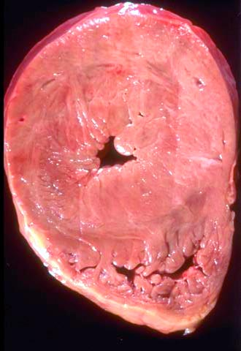
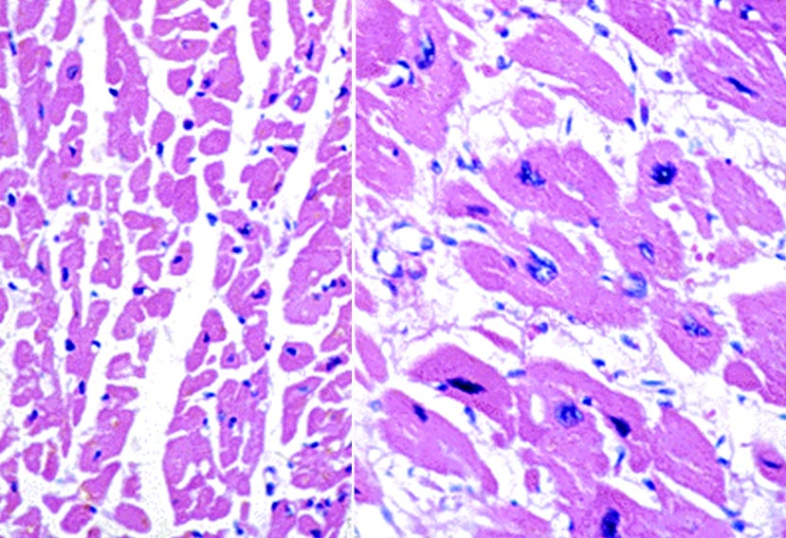
Hypertrophy
Department of Pathology
and Laboratory Medicine
HYPERTROPHY is increased size of cells, which also results in increased organ or tissue size.
Expected normal thickness
Abnormal increase in thickness thickness
Myocardial hypertrophy
Normal cardiomyocytes
Hypertrophied cardiomyocytes
From Essentials of Rubin’s Pathology, 6th Edition, LWW, 2014

Slide 21
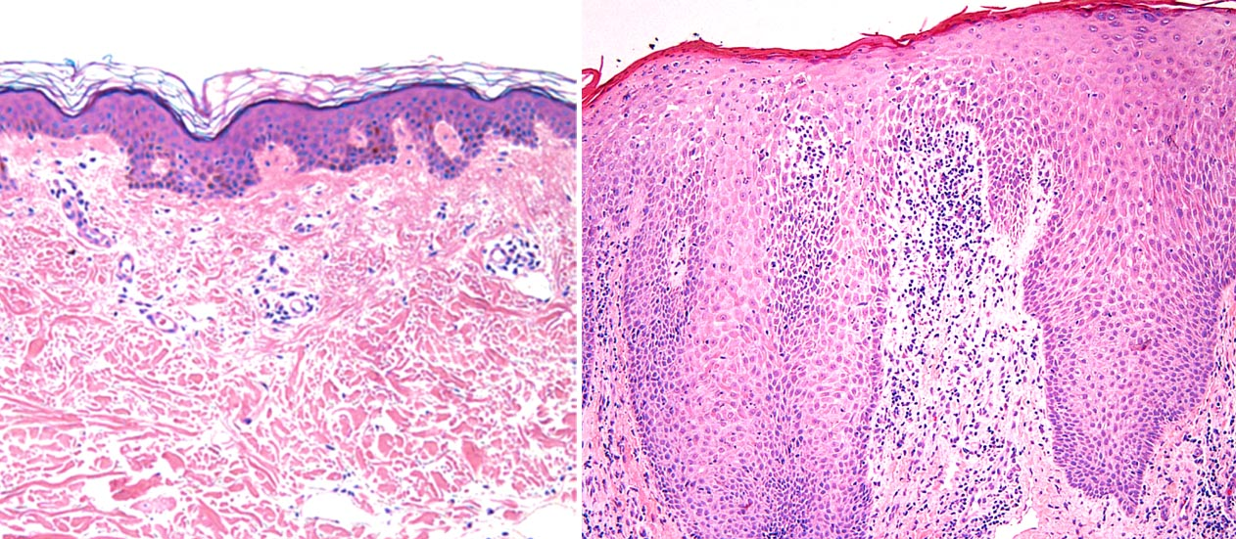
Hyperplasia
Department of Pathology
and Laboratory Medicine
HYPERPLASIA is non-neoplastic increase in the number of cells in an organ or tissue.
Normal epidermis
Epidermal hyperplasia in psoriasis
From Essentials of Rubin’s Pathology, 6th Edition, LWW, 2014

Slide 22
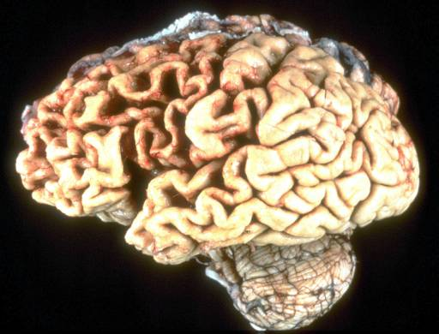
Atrophy
Department of Pathology
and Laboratory Medicine
ATROPHY is reduced size of cells or organs.
Frontal lobe atrophy with thinned gyri and widened sulci
Normal gyri and sulci
From Essentials of Rubin’s Pathology, 6th Edition, LWW, 2014

Slide 23
Atrophy
Department of Pathology
and Laboratory Medicine
Causes (etiologies) of Atrophy:
Reduced Functional Demand (e.g. skeletal muscle atrophy caused by denervation)
Inadequate Oxygen Supply (e.g. kidney atrophy caused by renal artery stenosis)
Insufficient Nutrients (e.g. skeletal muscle and fat atrophy caused by starvation)
Interrupted Trophic Signals (e.g. endometrial atrophy after menopause)
Persistent Cell Injury (e.g. gastric mucosal atrophy caused by chronic gastritis)
Increased Pressure (e.g. localized skin atrophy caused by prolonged bed rest)
Chronic Disease (e.g. cachexia caused by chronic disease)

Slide 24
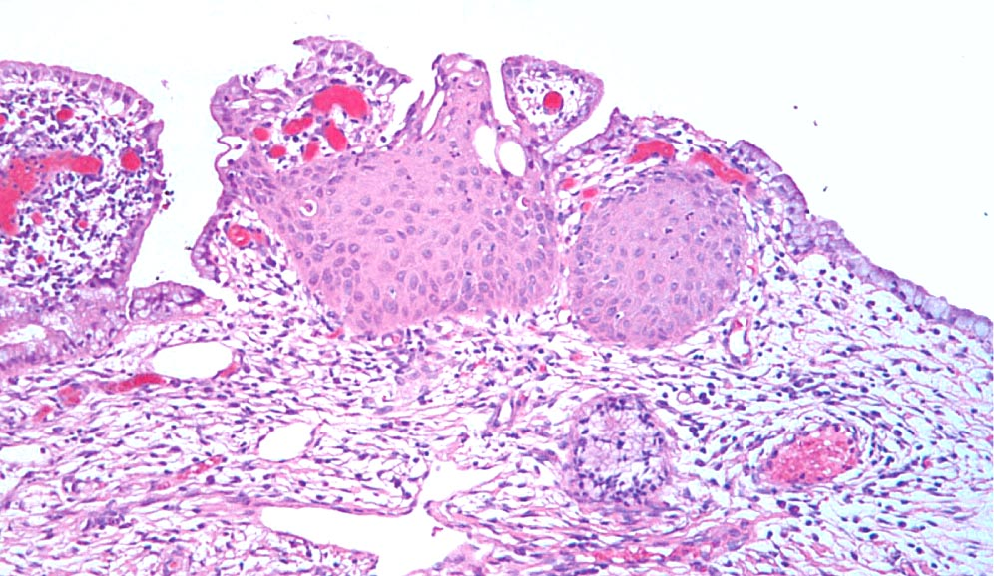
Metaplasia
Department of Pathology
and Laboratory Medicine
METAPLASIA is conversion of one differentiated cell type to another.
Squamous metaplasia
Normal columnar epithelium
From Essentials of Rubin’s Pathology, 6th Edition, LWW, 2014
Squamous metaplasia in the endocervix with normal columnar epithelium at both margins and squamous metaplasia in the center.

Slide 25
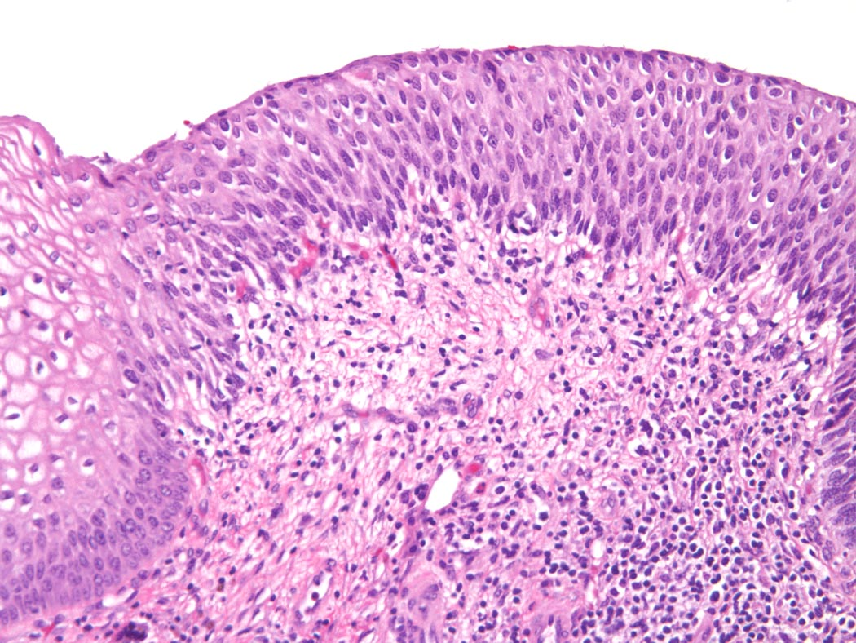
Dysplasia
Department of Pathology
and Laboratory Medicine
DYSPLASIA is disordered growth and maturation of the cellular components of a tissue. Dysplasia may be a precursor to malignant neoplasia.
Unpolarized dysplastic epithelium
Normal polarized epithelium
From Essentials of Rubin’s Pathology, 6th Edition, LWW, 2014
Dysplastic epithelium of the uterine cervix lacks normal polarity, and cells have large hyperchromatic nuclei.

Slide 26
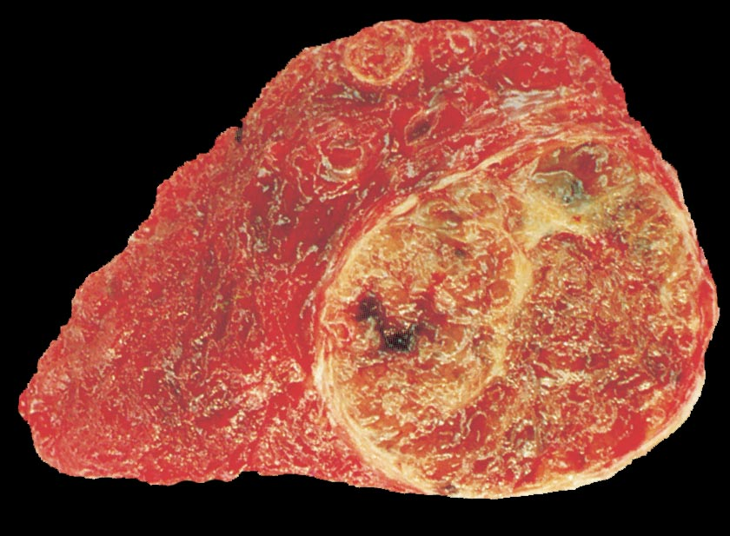
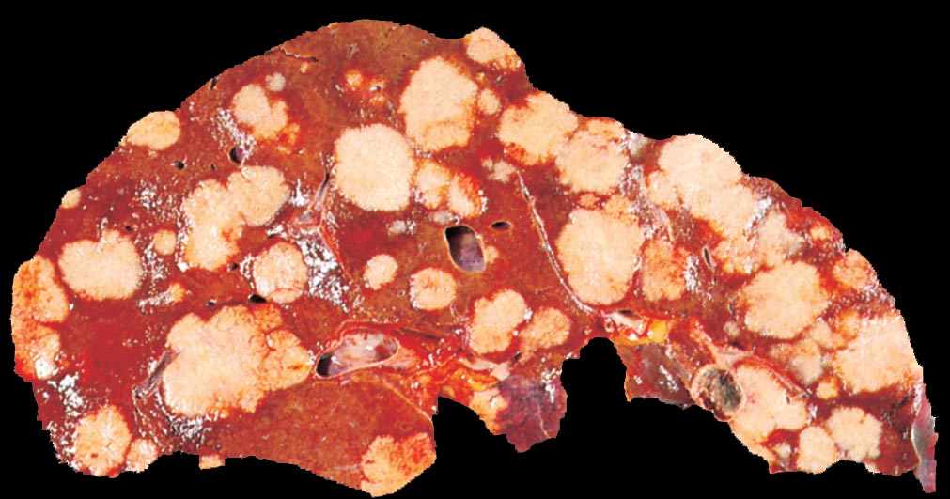
Neoplasia
Department of Pathology
and Laboratory Medicine
NEOPLASIA is the autonomous growth of cells that have escaped normal regulation of cell proliferation.
Benign neoplasm: localized and unable to spread (metastasize)
Malignant neoplasm (aka cancer): invasive and capable of spreading (metastasizing)
Thyroid follicular adenoma
Colonic adenocarcinoma metastatic to liver
Tumor: swelling or mass

Slide 27
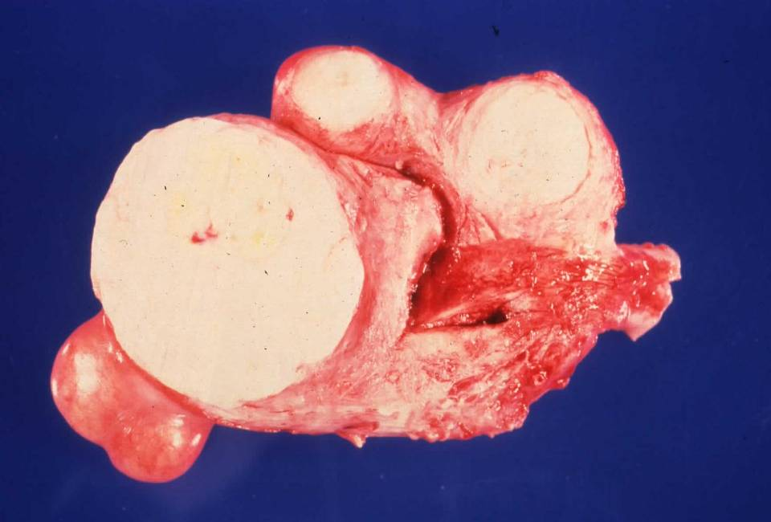
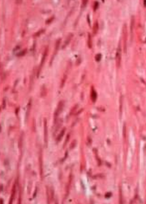
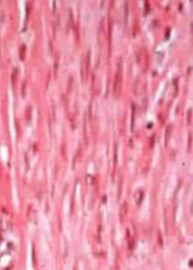
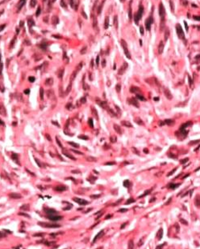
Neoplasia
Department of Pathology
and Laboratory Medicine
Uterus with multiple leiomyomas
In general, malignant neoplasms have less well differentiated cells that have larger nuclei that are pleomorphic, atypical, hyperchromatic and more often undergoing mitosis.
Normal
myometrium
Leiomyoma
(benign)
Leiomyosarcoma
(malignant)

Slide 28
Department of Pathology
and Laboratory Medicine
Mechanisms of Disease
Cellular responses to injury
Intracellular response
Cell death
Hypertrophy
Hyperplasia
Atrophy
Metaplasia
Dysplasia
Neoplasia
Tissue response to injury
Inflammation
Repair
Hemostasis/thrombosis
Ischemia
Abnormal morphogenesis
Genetic
Teratogenic
Biochemical disorder
Genetic
Acquired

Slide 29
Tissue Response to Injury
Department of Pathology
and Laboratory Medicine
Etiology
Note: Not ever injury results in the full spectrum of responses
Cell/Tissue Injury
Note: The response to injury phases overlap
Acute Inflammation
time
Chronic Inflammation
Repair (Regeneration and/or fibrosis)
time

Slide 30
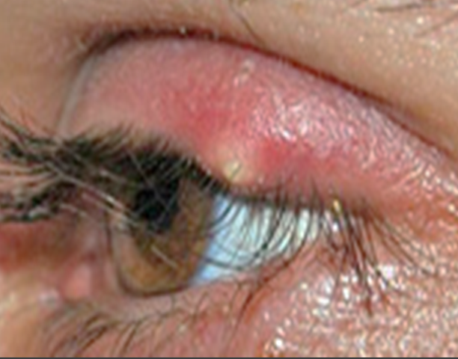
Inflammation
Department of Pathology
and Laboratory Medicine
Inflammation is a reaction of tissue to a pathogenic insult.
Inflammation is mediated by extracellular molecular signals that activate humoral and cellular inflammatory pathways and cause the movement of fluid and leukocytes from blood into the extravascular compartment.
Stye
redness
swelling
heat
pain
dysfunction
Inflammation:
Localizes or eliminates the cause of injury
Removes injured tissue components
Leads to repair
Inflammation is a double-edged sword that usually is beneficial but can cause morbidity (disease) and mortality (death).

Slide 31
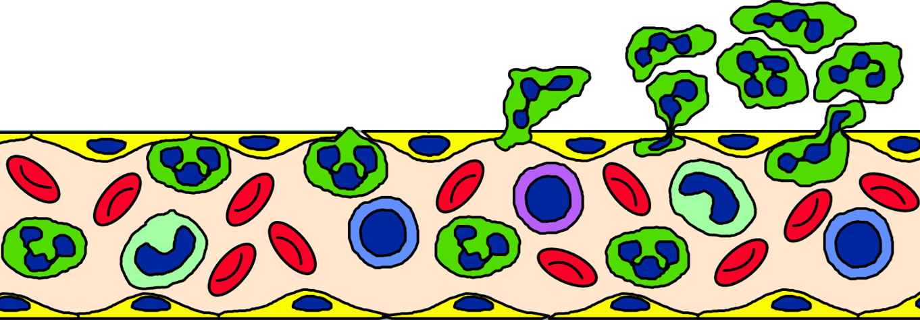
Inflammation
Department of Pathology
and Laboratory Medicine
Neutrophil
Monocyte
Macrophage
Lymphocyte
Inflammation is mediated by extracellular molecular signals that activate humoral and cellular inflammatory pathways and cause the movement of fluid and leukocytes from blood into the extravascular compartment.

Slide 32
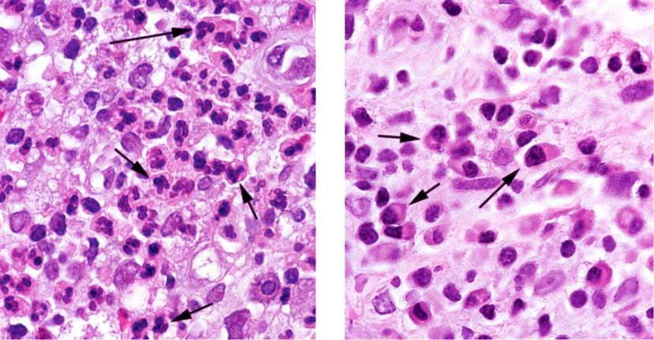
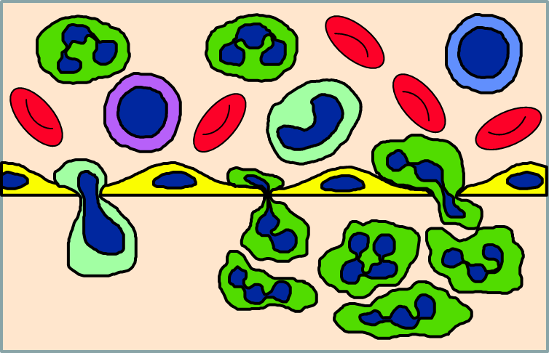
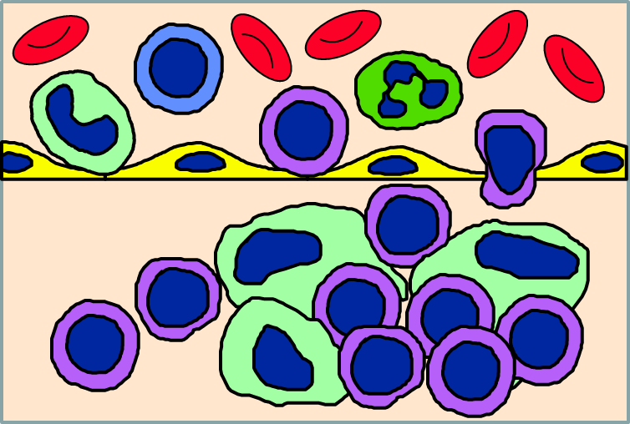
Inflammation
Department of Pathology
and Laboratory Medicine
Acute inflammation has tissue infiltrating of predominantly polymorphonuclear neutrophils (PMNs) with multilobed nuclei.
Chronic inflammation has predominantly mononuclear leukocytes including lymphocytes, monocytes, and macrophages.

Slide 33
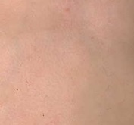
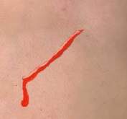
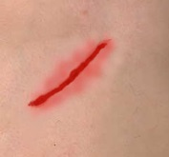
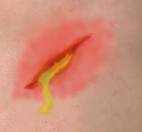
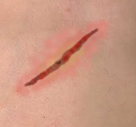
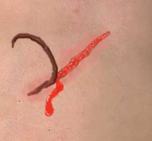
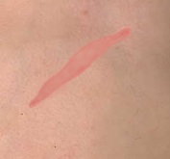
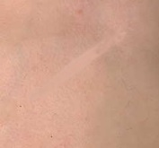
Response to injury is biologically similar in all tissues, and in response to injury caused by many etiologies. Knowing one example informs all examples.
Tissue Response to Injury
Erythema and purulent exudate
Normal skin
Incised wound
Erythema and scab
Scab with erythema and hemosiderin staining
Separated scab, hemorrhage and granulation tissue
Re-epitheliazed granulation tissue (young scar)
Scar
Department of Pathology
and Laboratory Medicine

Slide 34
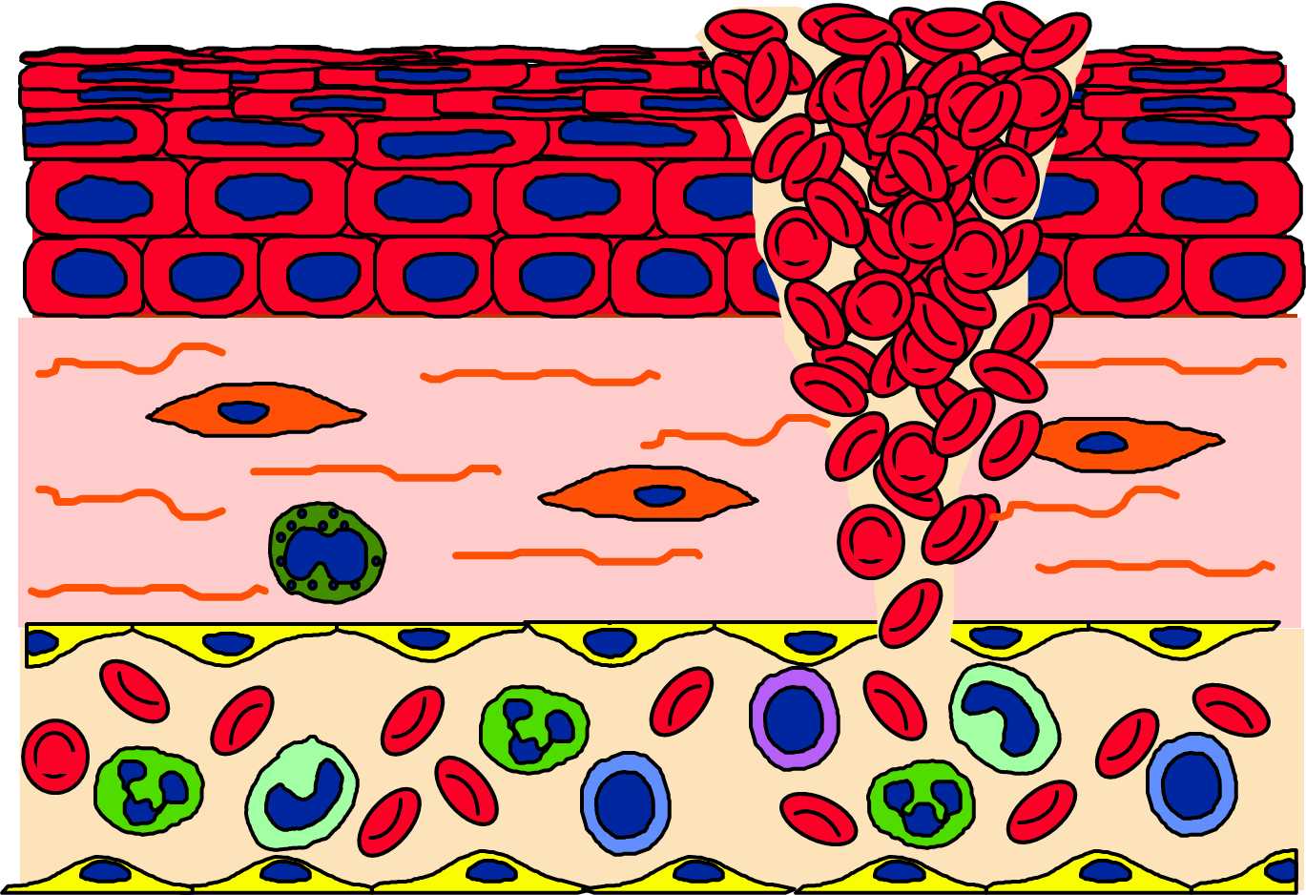
UNC School of Medicine
Incision with hemorrhage

Slide 35
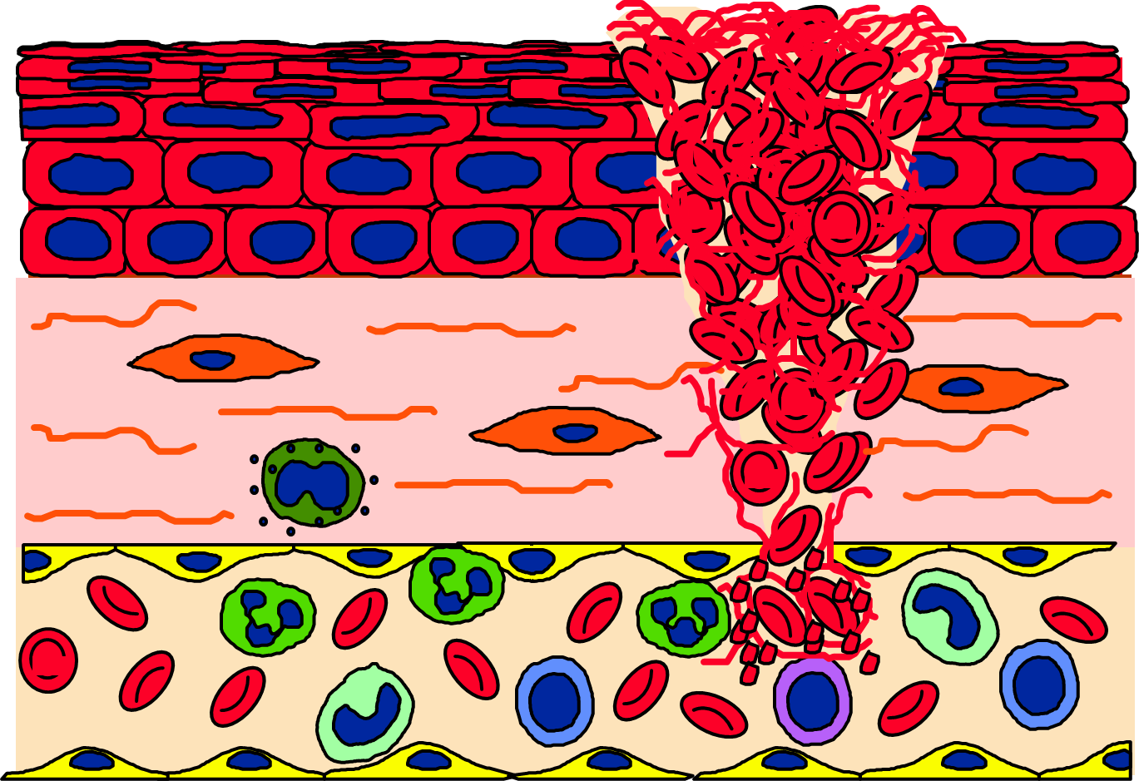
UNC School of Medicine
Coagulation stops hemorrhage

Slide 36
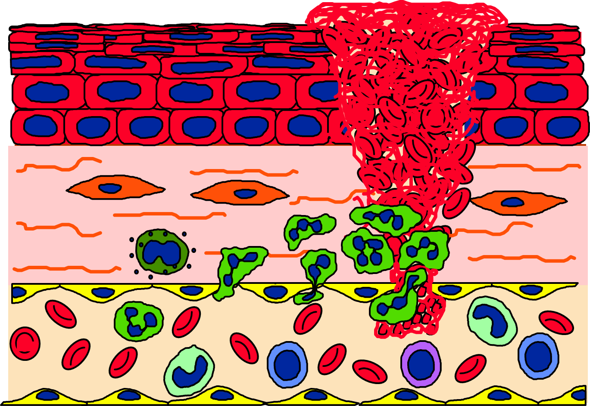
Neutrophils are attracted to the injury
UNC School of Medicine
Neutrophil

Slide 37
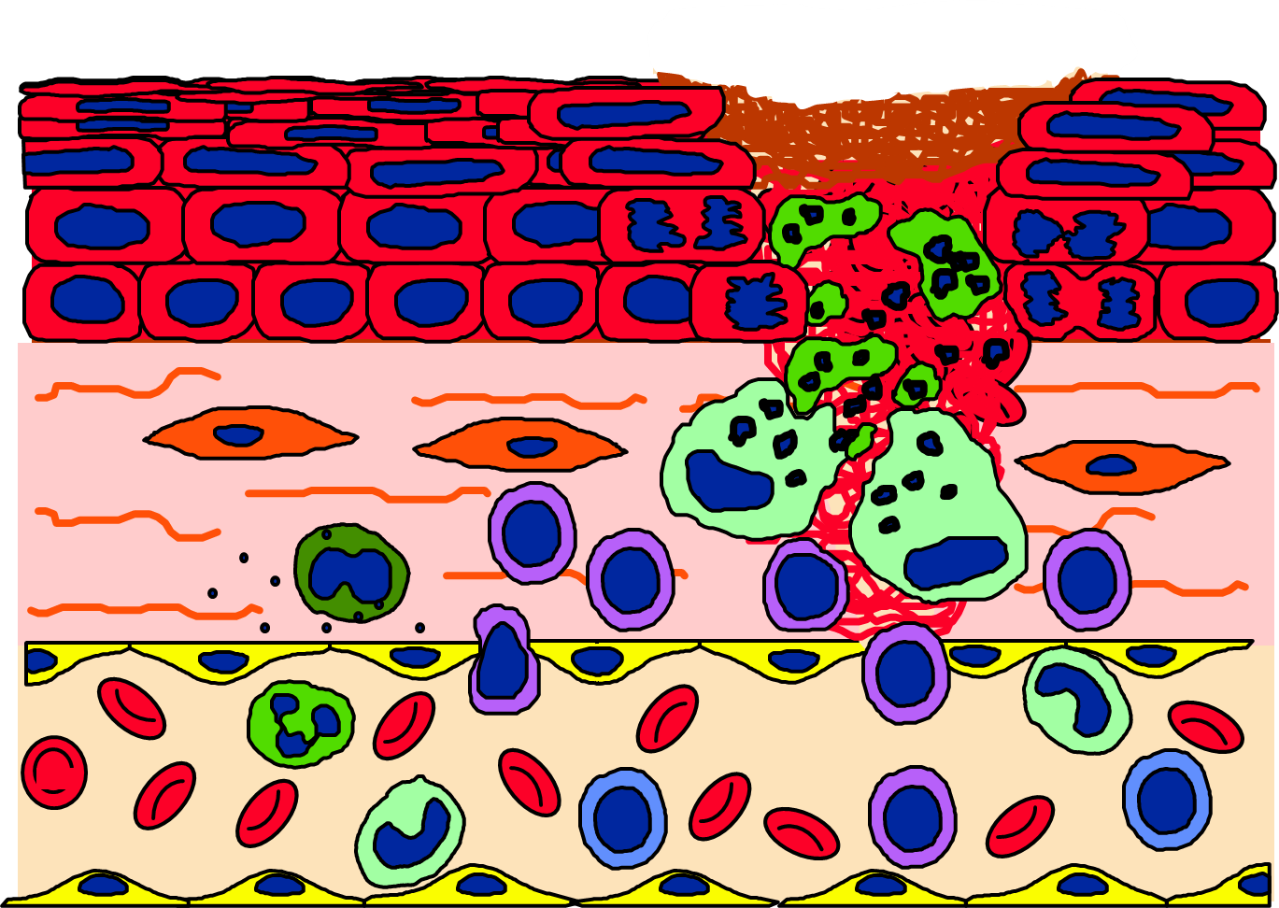
Mononuclear leukocytes become predominant
UNC School of Medicine
Neutrophil Apoptosis
Scab (eschar)
Mitosis
Macrophage
Monocyte
Lymphocyte

Slide 38
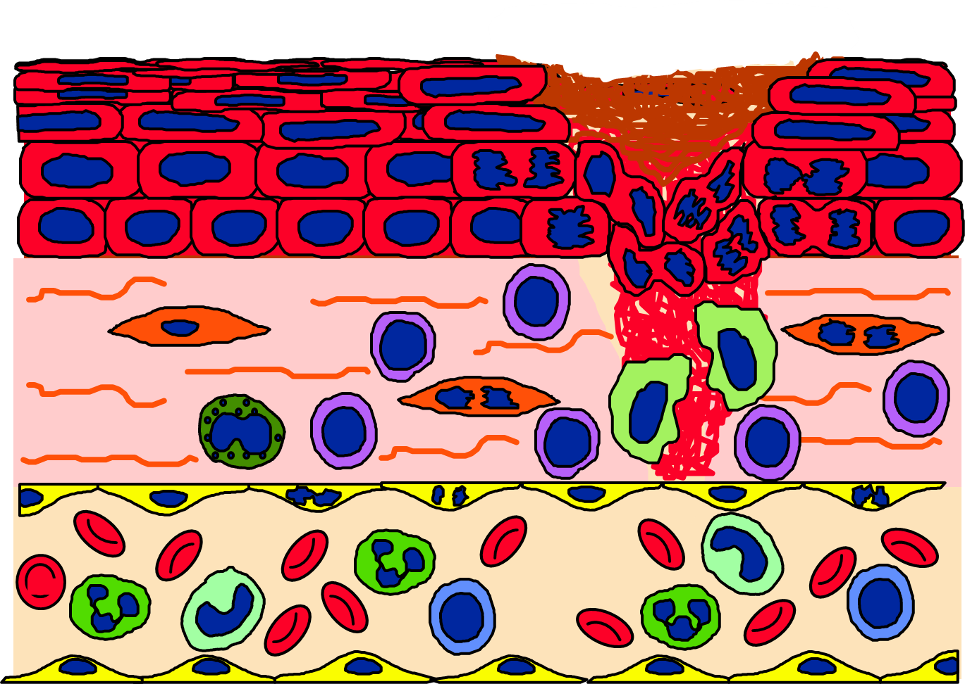
UNC School of Medicine
Fibroblasts proliferate
Epithelial cells proliferate

Slide 39
New small vessel grow into the tissue (granulation tissue)
The epithelium regenerates

Slide 40
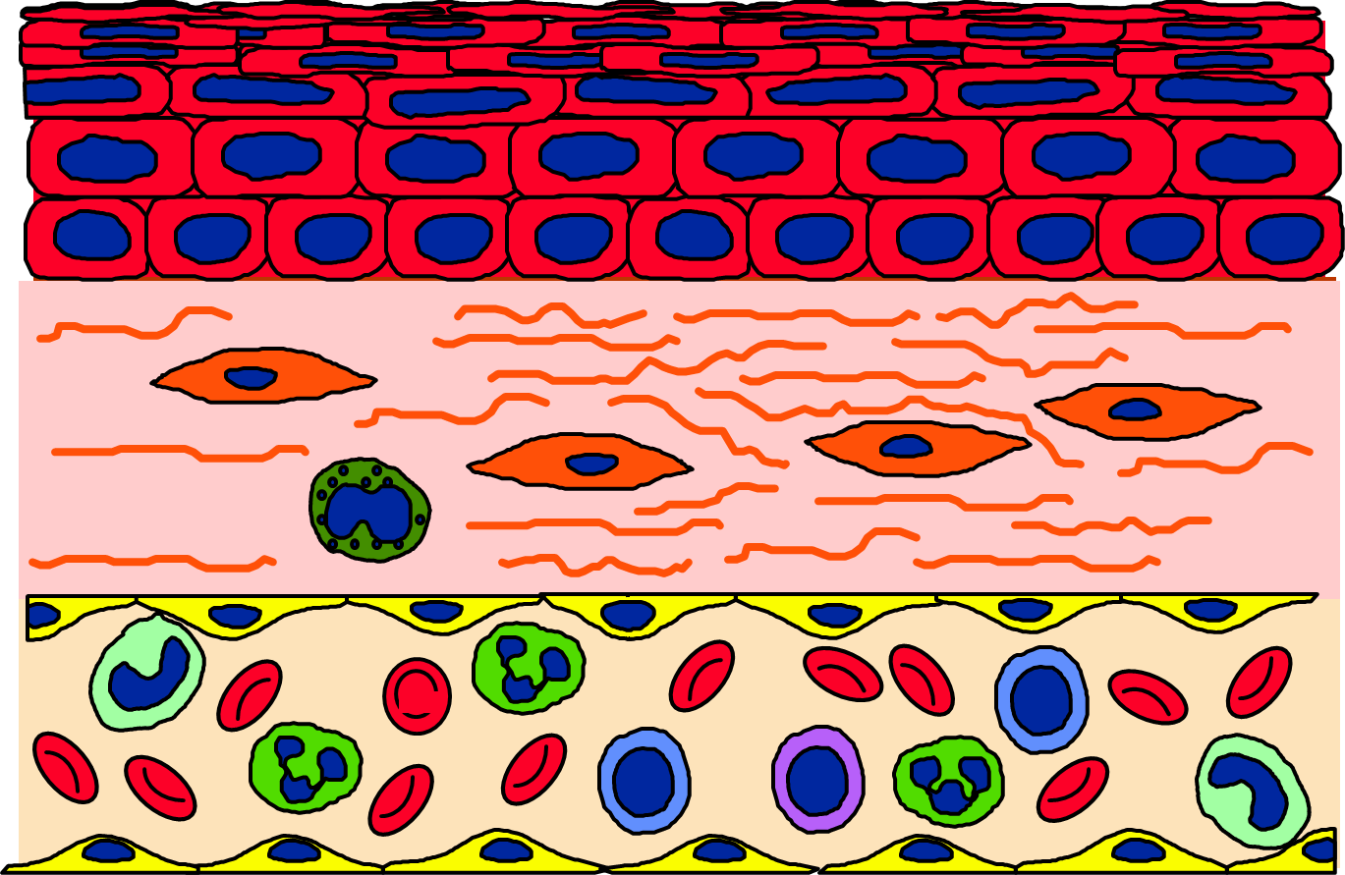
After the repair excess fibroblasts and collagen may remain as fibrosis (scar)
UNC School of Medicine
Fibroblast

Slide 41
UNC School of Medicine
Tissue Response to Injury
Department of Pathology
and Laboratory Medicine
Response to injury is biologically similar in all tissues, and in injury caused by many etiologies. Knowing one example informs all examples.
Incised wound
Erythema and eschar
Re-epitheliazed granulation tissue
Scar

Slide 42
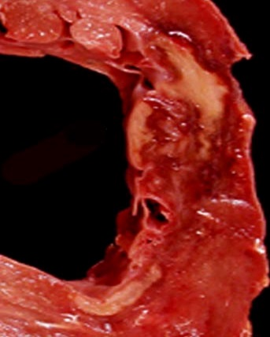
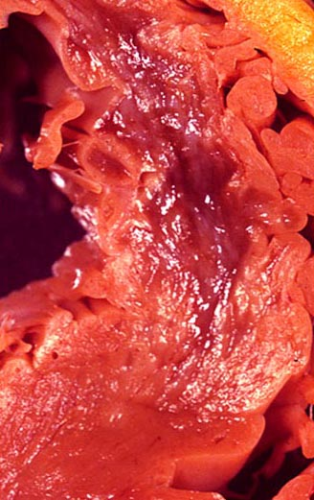
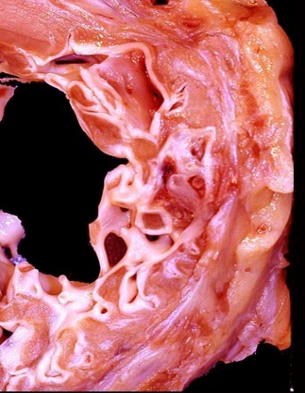
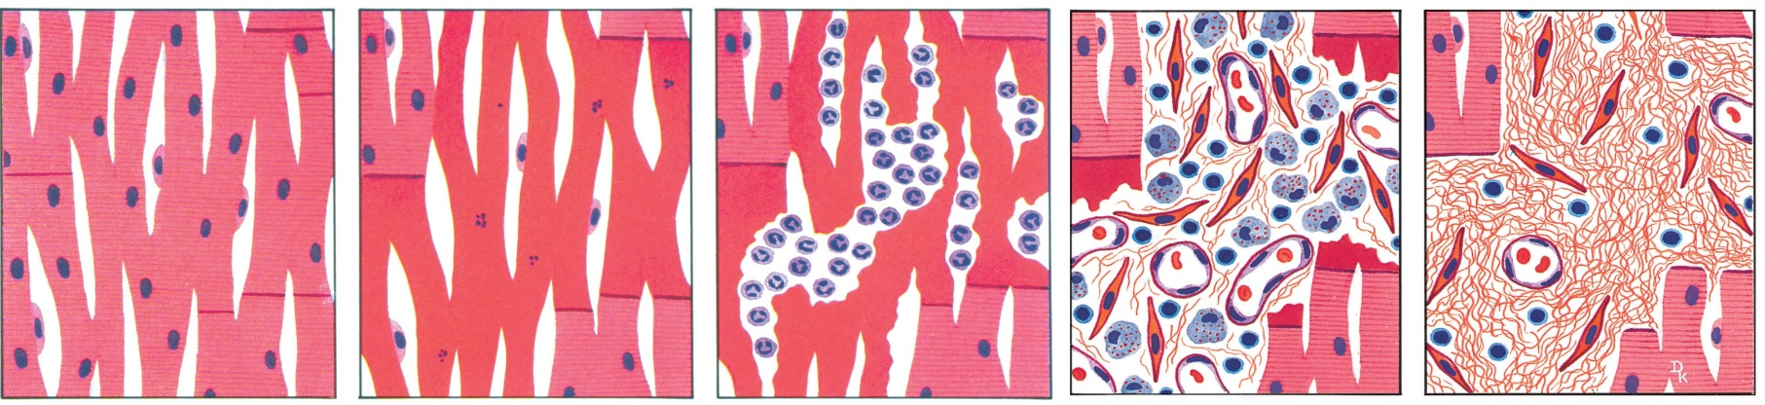
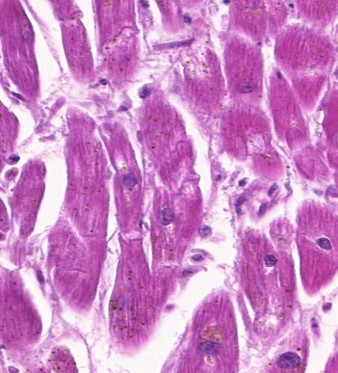
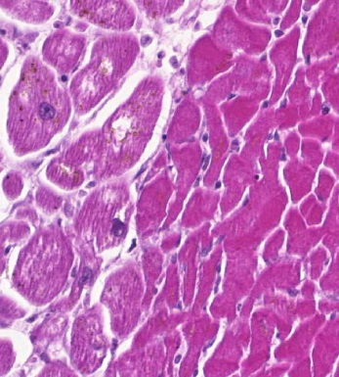
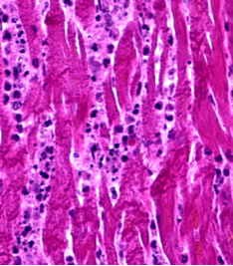
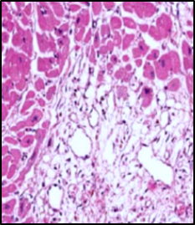
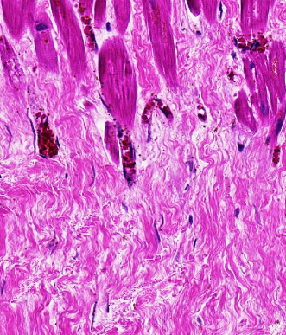
UNC School of Medicine
24 hours
3 weeks
3 months
Acute Myocardial Infarction
Normal
12 hours
Normal
Coagulative necrosis
Acute inflammation
Granulation tissue
Fibrous tissue (scar)
Acute response to injury
Repair

Slide 43
Department of Pathology
and Laboratory Medicine
Mechanisms of Disease
Cellular responses to injury
Intracellular response
Cell death
Hypertrophy
Hyperplasia
Atrophy
Metaplasia
Dysplasia
Neoplasia
Tissue response to injury
Inflammation
Repair
Hemostasis/thrombosis
Ischemia
Abnormal morphogenesis
Genetic
Teratogenic
Biochemical disorder
Genetic
Acquired

Slide 44
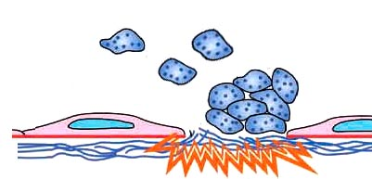
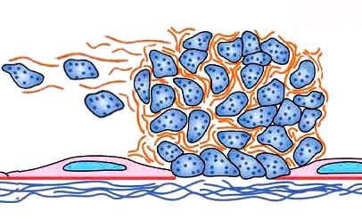
UNC School of Medicine
Platelet
Platelet aggregation
Thrombosis and Hemostasis
Thrombosis involves activation of circulating platelets and coagulation factors.
Thrombosis occurs when endothelial function is altered, endothelial continuity is lost, or blood flow is reduced.
Endothelial injury
Fibrinogen
Thrombin
Fibrin
Thrombus

Slide 45
UNC School of Medicine
Platelet
Platelet aggregation
Thrombosis and Hemostasis
Mechanisms of Disease
Inadequate thrombosis causes hemorrhagic diseases.
Thrombosis that obstructs adequate flow causes ischemic diseases
Embolization causes thromboembolic disease.
Endothelial injury
Fibrinogen
Thrombin
Fibrin
Thrombus

Slide 46
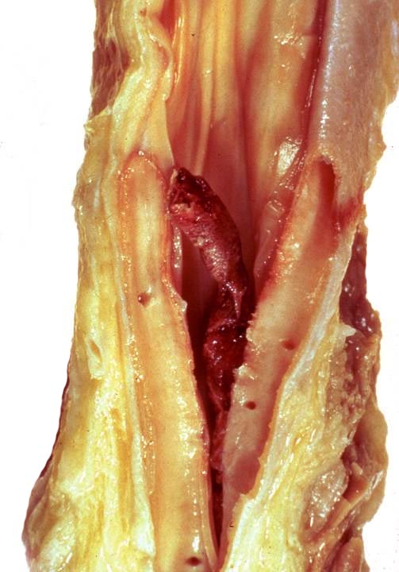
Department of Pathology
and Laboratory Medicine
Lower Extremity Deep Vein Thrombosis (DVT)
A fragment (embolus) could break away from the thrombus and move through veins (embolize) to reach the lungs and occlude a renal artery causing localized ischemia and pulmonary infarction
Thrombus in a cut open vein

Slide 47
Department of Pathology
and Laboratory Medicine
Mechanisms of Disease
Cellular responses to injury
Intracellular response
Cell death
Hypertrophy
Hyperplasia
Atrophy
Metaplasia
Dysplasia
Neoplasia
Tissue response to injury
Inflammation
Repair
Hemostasis/thrombosis
Ischemia
Abnormal morphogenesis
Genetic
Teratogenic
Biochemical disorder
Genetic
Acquired

Slide 48
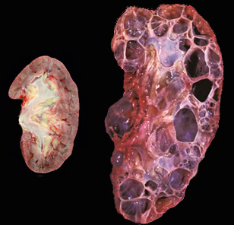
Department of Pathology
and Laboratory Medicine
Genetic Abnormal Morphogenesis
Autosomal dominant polycystic kidney disease
Normal Kidney
ADPKD is caused by genetic mutations that disrupt kidney structure and function.

Slide 49
Department of Pathology
and Laboratory Medicine
Abnormal Morphogenesis
Agenesis: complete absence of an organ or component of an organ
Aplasia: persistence of an undeveloped organ anlage without the mature organ
Hypoplasia: reduced size caused by incomplete development
Dysplasia: abnormal tissue differentiation during development (distinct from dysplasia developing in a previously normally developed tissue)
Ectopia: normally formed organ that is outside its normal anatomic location

Slide 50

Department of Pathology
and Laboratory Medicine
Teratogenic Abnormal Morphogenesis
Teratogen: a factor (e.g., chemical, drug, infection) that causes malformation of an embryo or fetus.
Microcephaly
(hypoplasia)
Pathogenesis: Zika virus infection of fetal neural stem cells causes defective neurogenesis
(Cell Stem Cell. 2016, S1934-5909(16)30214-4).

Slide 51
Department of Pathology
and Laboratory Medicine
Mechanisms of Disease
Cellular responses to injury
Intracellular response
Cell death
Hypertrophy
Hyperplasia
Atrophy
Metaplasia
Dysplasia
Neoplasia
Tissue response to injury
Inflammation
Repair
Hemostasis/thrombosis
Ischemia
Abnormal morphogenesis
Genetic
Teratogenic
Biochemical disorder
Genetic
Acquired

Slide 52
Department of Pathology
and Laboratory Medicine
Cystic Fibrosis
Cystic fibrosis (CF) is an autosomal recessive genetic disease that results from a defective chloride channel, that results in thick mucus in lungs and other tissues.
Characterized by chronic pulmonary disease caused by thick mucus and infectins.
  Thick mucus causes disease in multiple other organs, including small intestine, liver, pancreas and reproductive tract.
Cystic Fibrosis Lung
Cyst
Fibrosis

Slide 53



Department of Pathology
and Laboratory Medicine
Cystic Fibrosis
Cystic Fibrosis Lung
Normal Pancreas
Thick mucus plug in bronchial airway
Cystic Fibrosis Pancreas
Cystic Fibrosis Lung
Cyst
Cyst
Fibrosis
Fibrosis

Slide 54
Department of Pathology
and Laboratory Medicine
Case Study
A 67-year-old man presented to the emergency department with acute abdominal pain and chest pain. On physical examination he had tenderness in the upper-left-quadrant of his abdomen. His medical history was remarkable for a myocardial infarction one month earlier.
Laboratory studies revealed elevated circulating fibrin fragments (D-dimers) indicating thrombosis, and elevated lactate-dehydrogenase (intracellular enzyme) indicating tissue necrosis.
Abdominal CT scan revealed multiple wedged-shaped areas of decreased density in the spleen, consistent with multiple infarcts. Echocardiogram demonstrated a large thrombus in the left ventricle of the heart.
Symptoms: abdominal pain and chest pain
Signs: abdominal tenderness, elevated blood fibrin fragments and intracellular enzymes, and intracardiac thrombus by imaging
Diagnosis: cardiac thrombus and splenic infarcts secondary to thromboembolism

Slide 55



Department of Pathology
and Laboratory Medicine
Case Study
Pathogenesis: thrombosis in the heart overlying a myocardial infarct scar released emboli that lodged in splenic arteries resulting in ischemic necrosis (infarction).
Left ventricular lumen
Acute thrombus
Atrophic and fibrotic myocardium caused by repair of infarct
Normal myocardium
Spleen
Normal spleen with normal staining of nuclei
Necrotic spleen with loss of nuclear staining
Ischemic infarct with necrosis
Not an actual patient case

Slide 56
Department of Pathology
and Laboratory Medicine
Module 1: The Basics of Pathology
Introduction to Mechanisms of Disease
Learning and understanding pathology terminology helps learn and understand mechanisms of disease.
This was the goal of this presentation
J. Charles Jennette, M.D.
Professor of Pathology and Laboratory Medicine
Professor of Medicine
School of Medicine
University of North Carolina at Chapel Hill

