Slide 1
How to Model Disease in the Lab
Andrew B. Gladden, PhD
Associate Professor
Department of Pathology & Laboratory Medicine
University of North Carolina at Chapel Hill
Introduction to Pathology of Disease
October 5, 2021

Slide 2
Goals for today’s class!
Understand the intrinsic cellular response used in genetic engineering.
Understand why the mouse is used as a disease model in the lab.
Learn how to overexpress a gene in a specific mouse tissue.
Identify how to disrupt an endogenous gene in mice or cells.
Become familiar with how human cells or tissue are studied in the lab.
Learn what type of mice are used to grow human tissue.
#1 GOAL!! Participate in class, ask questions as we move through different topics!

Slide 3
How Does One Gene Make a Large Amount of Protein?
Molecular Biology of the Cell, Taylor & Francis 2014

Slide 4
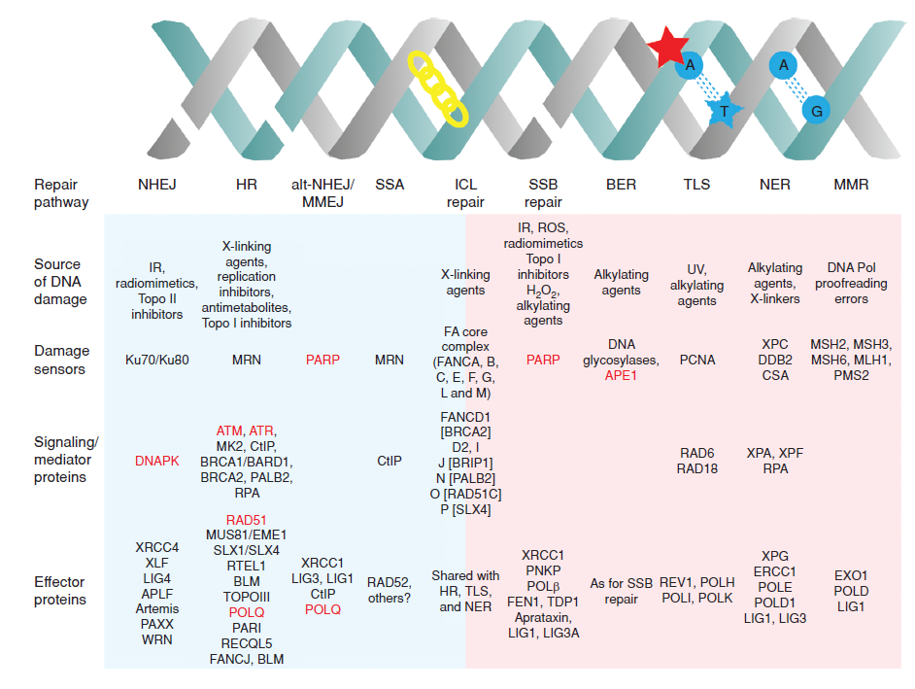
Poll Question 1: Yes or No
Poll Question 2: Yes or No
NHEJ =
Non-homologous
End Joining
HR =
Homologous
Recobination
Brown et al.,
Cancer Discovery 7, p20 (2017)
Notes:
Poll Question #1: Have you heard of the DNA Damage Response? Yes or No
Poll Question #2: Have you heard of CRISPR/Cas9? Yes or no

Slide 5
Recombination repair DNA breaks by retrieving sequence information from undamaged DNA
Remember:
DNA is double
Stranded (red bars).
Each mammalian gene
2 alleles (sisters) in
the genome.

Slide 6
Goals for today’s class!
Understand the intrinsic cellular response used in genetic engineering.
Understand why the mouse is used as a disease model in the lab.
Learn how to overexpress a gene in a specific mouse tissue.
Identify how to disrupt an endogenous gene in mice or cells.
Become familiar with how human cells or tissue are studied in the lab.
Learn what type of mice are used to grow human tissue.
#1 GOAL!! Participate in class, ask questions as we move through different topics!

Slide 7
Are we all just a bag of cells?
Way down
the tree!
Drosophila
From: The Laboratory Mouse 2012
Notes:
d

Slide 8
The Lab Mouse Developmental Timeline
Fertilization
Implantation
Gastrulation
Sexual
Mature
Lifespan
Birth
Weaning
Days:
0
e4.5
e6.5-e9.5
e21=P0
P21
P42-P49
18-24
months
Embryo
Juvenile
Adult

Slide 9
The Mouse Genetic Toolbox
Transgenic Mice
Relatively fast way to generate mice.
Random integration, does not target endogenous gene (generally)
Can be used to overexpress genes or genes that make enzymes in specific tissues.
Drosophila (fly)
Embryo
Regulatory Segment = Promoter
DNA Sequences that promote transcription
Molecular Biology of the Cell, Taylor & Francis 2014

Slide 10
The Mouse Genetic Toolbox
Transgenic Mice
Relatively fast way to generate mice.
Random integration, does not target endogenous gene (generally)
Can be used to overexpress genes, examples: Eu-Myc (Lymphoma)
Can be used to drive expression of enzymes utilized in site-specific mutagenesis, examples:
MMTV-Cre, Wnt7a-Cre, B-actin-Flp.

Slide 11
Goals for today’s class!
Understand the intrinsic cellular response used in genetic engineering.
Understand why the mouse is used as a disease model in the lab.
Learn how to overexpress a gene in a specific mouse tissue.
Identify how to disrupt an endogenous gene in mice or cells.
Become familiar with how human cells or tissue are studied in the lab.
Learn what type of mice are used to grow human tissue.
#1 GOAL!! Participate in class, ask questions as we move through different topics!

Slide 12
How Can You as a Researcher Hijack the Cells Intrinsic Responses to Disrupt a Gene?
Remember:
DNA is double
Stranded (red bars).
Each mammalian gene
2 alleles (sisters) in
the genome.
What if you
substitute the
template for
repair?

Slide 13
How Can You as a Researcher Hijack the Cells Intrinsic Responses to Disrupt a Gene?
Targeting
Template

Slide 14
How Do You Get Your Targeting Template Into a Mouse?

Slide 15
The Mouse Genetic Toolbox
Homologous Recombineering in Mice Using Cre
Targeting
Template
Not a fast may to generate mice includes multiple crosses.
Integration into the endogenous locus and uses endogenous promoter.
Can be used to knockout one or both alleles of a gene.
Can be used to knockin an altered allele (mutant, tagged etc.)
LoxP site contains internal
8bp non-palindromic sequence
surrounded by 13bp inverted
repeat.
**Cre is an enzyme, specifically,
a DNA recombinase that
identifies LoxP sites.

Slide 16
The Mouse Genetic Toolbox
Homologous Recombineering in Mice Using Cre
Transgene
Overexpressing
Cre
Targeted
Endogenous
Gene

Slide 17
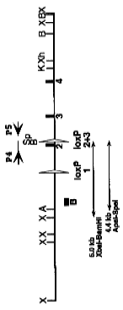
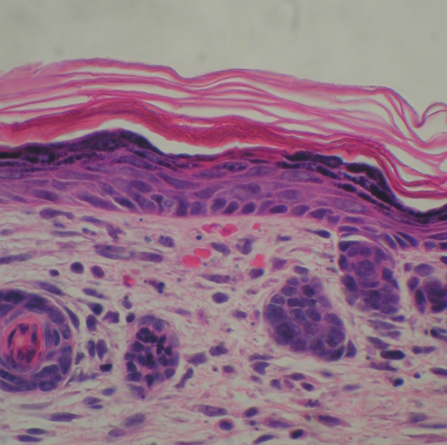
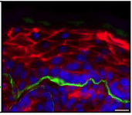
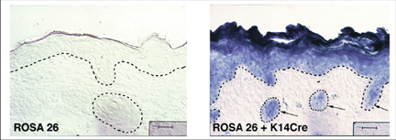
Using a Conditional Nf2 knockout to Study Skin Biology
Differentiation
Nf2^{lox/lox} Mouse
Keratin 1
Keratin 14
Proliferation
β4 Integrin
:Tight Junctions
:Adherens Junctions
:Desmosomes
Giovannini et al. 2000
wild-type
wild-type
Keratin 14-Cre Mouse
Red:
Actin
Green:
β4-Integrin
Vasioukhin et al. 1999
Notes:
17
17
17

Slide 18
The Mouse Genetic Toolbox
Homologous Recombineering in Mice
Nf2^{lox/lox} Mouse
Brightfield
So now you know Cre is working in your model,
but you want to investigate the rate of Cre activity
in live tissue. How would you suggest doing this?
Cy3 Filter
Giovannini et al. 2000
Keratin 14-Cre Mouse
eGFP Filter
Vasioukhin et al. 1999

Slide 19
Goals for today’s class!
Understand the intrinsic cellular response used in genetic engineering.
Understand why the mouse is used as a disease model in the lab.
Learn how to overexpress a gene in a specific mouse tissue.
Identify how to disrupt an endogenous gene in mice or cells.
Become familiar with how human cells or tissue are studied in the lab.
Learn what type of mice are used to grow human tissue.
#1 GOAL!! Participate in class, ask questions as we move through different topics!

Slide 20
CRISPR/CAS9 the New Flavor on the Block
Cas9 is an enzyme
that causes double
strand breaks.
Why is it so
popular?
Fast!
Multiple species.
Easier to generate
guide RNA.
But……
From: Cancer and Zebrafish 2016

Slide 21
Recombination repair DNA breaks by retrieving sequence information from undamaged DNA
Rate of NHEJ
In CRISPR.
30 to 70%
Rate of HR
In CRISPR.
Less than 1%

Slide 22
CRISPR/CAS9 the New Flavor on the Block
Cas9 is an enzyme
that causes double
strand breaks.
Why is it so
popular?
Fast!
Multiple species.
Easier to generate
guide RNA.
But……
From: Cancer and Zebrafish 2016

Slide 23
Goals for today’s class!
Understand the intrinsic cellular response used in genetic engineering.
Understand why the mouse is used as a disease model in the lab.
Learn how to overexpress a gene in a specific mouse tissue.
Identify how to disrupt an endogenous gene in mice or cells.
Become familiar with how human cells or tissue are studied in the lab.
Learn what type of mice are used to grow human tissue.
#1 GOAL!! Participate in class, ask questions as we move through different topics!

Slide 24
What about the bag of cells?
Way down
the tree!
Drosophila
From: The Laboratory Mouse 2012

Slide 25
Clinical Testing Compound Attrition Rates
Rates from ten large pharmaceutical companies
In the US and Europe from 1991-2000.
Phase II, human efficacy assessment, is also
the most expensive.
Sharpless and DePinho, 2006

Slide 26
How do we get a better view of potential efficacy?
Nude mice: Foxn1^{nu} homozygous
no CD4 or CD8 T cells.
SCID mice: Prkdc^{scid} homozygous
no T or B cells.
Sausville and Burger, 2006

Slide 27
How Fast Can we Assess Drug Treatment?
Sharpless and DePinho, 2006

Slide 28
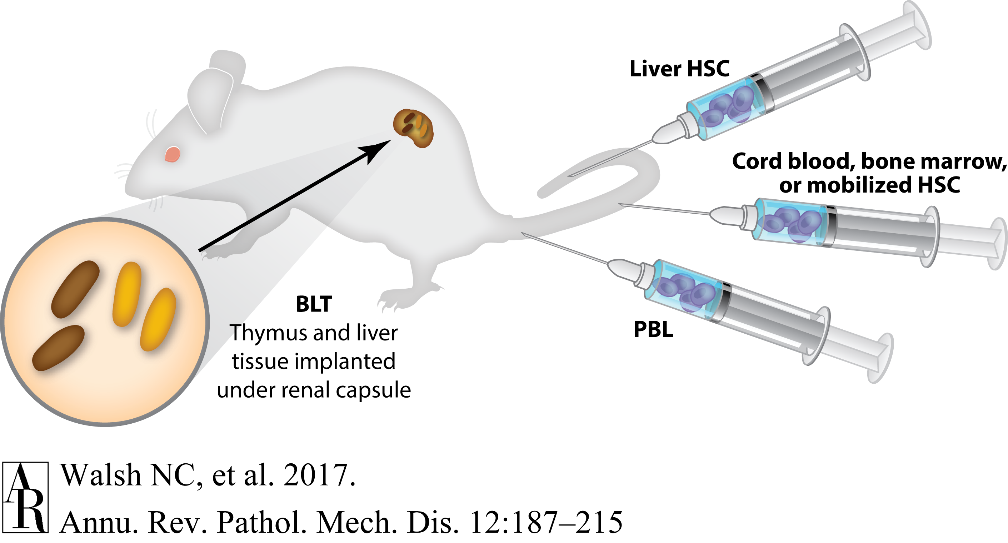
The Future of Humanized Mice
Walsh et al., 2017

Slide 29
Goals for today’s class!
Understand the intrinsic cellular response used in genetic engineering.
Understand why the mouse is used as a disease model in the lab.
Learn how to overexpress a gene in a specific mouse tissue.
Identify how to disrupt an endogenous gene in mice or cells.
Become familiar with how human cells or tissue are studied in the lab.
Learn what type of mice are used to grow human tissue.
#1 GOAL!! Participate in class, ask questions as we move through different topics!

