Slide 1
Tissue Organization; How do vertebrates make a spine?
Andrew B. Gladden, PhD; Associate Professor
Department of Pathology & Laboratory Medicine
University of North Carolina at Chapel Hill
Introduction to Pathology of Disease
August 31, 2021

Slide 2
Goals for today’s class!
Learn how to describe the orientation of cells and tissue in an organism.
Understand what the three Germ Layers are and how they are organized.
Define the proteins in cells that promote cell sorting.
Learn how the neural tube is formed.
Understand what and how different cellular components contribute to heart and vascular development.
Learn how the gut forms and what the different sections look like histological.
Define the different types of epithelial tissues and how skin develops.

Slide 3
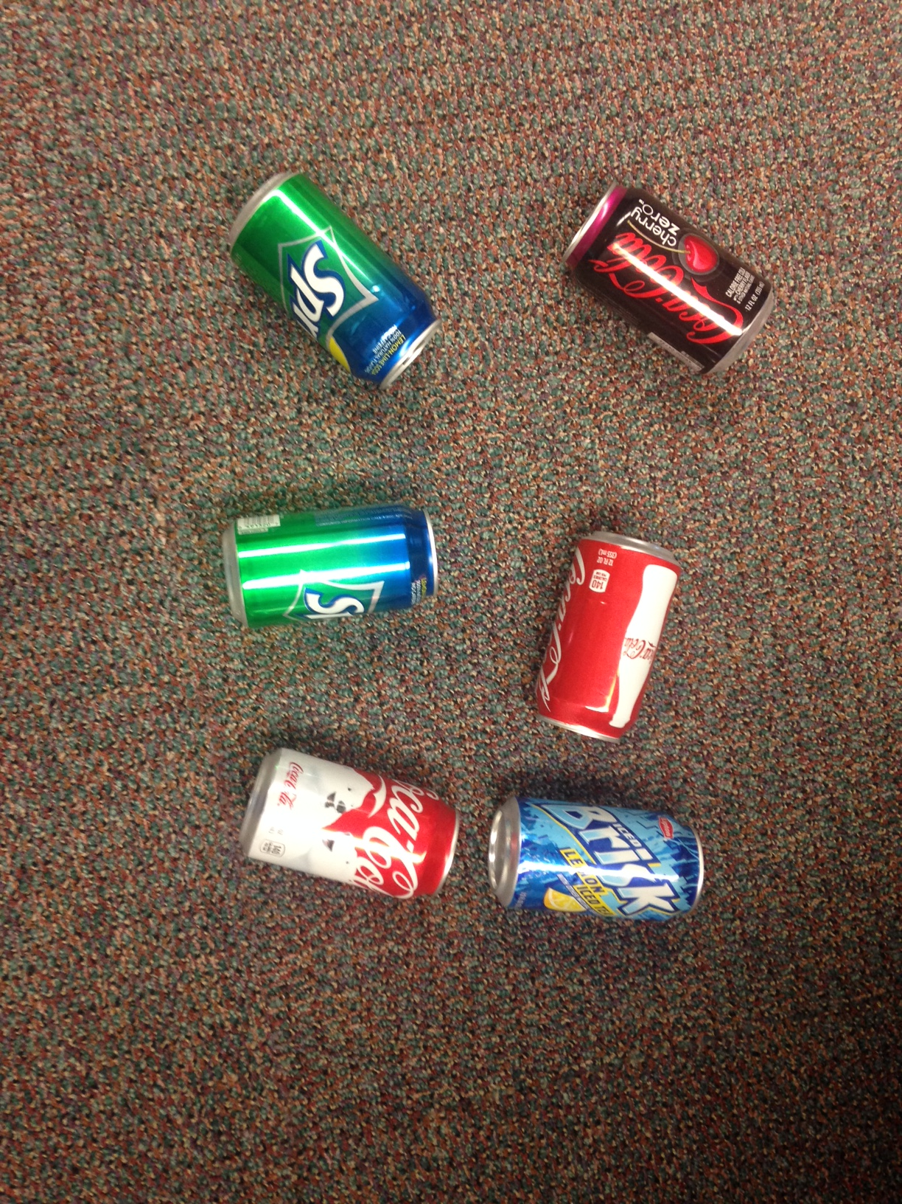
Try to Think in 3D! How Can the Cans be Organized?
Poll Question for this slide:
Pick one answer:
What would you do with these cans?
Throw them in the recycle bin.
Stand them all up.
Put them in small groups by color.
Place in a group with the tabs in one direction.
Notes:
talk about these cans as if they were cells, when we think about our mammalian tissue, everything is organized in a specific way, how do cells know how to organize into a tissue? Well if we found this in our living room then we would put the top up,

Slide 4
Try to Think in 3D! Like This?
Notes:
tabs=pop top

Slide 5
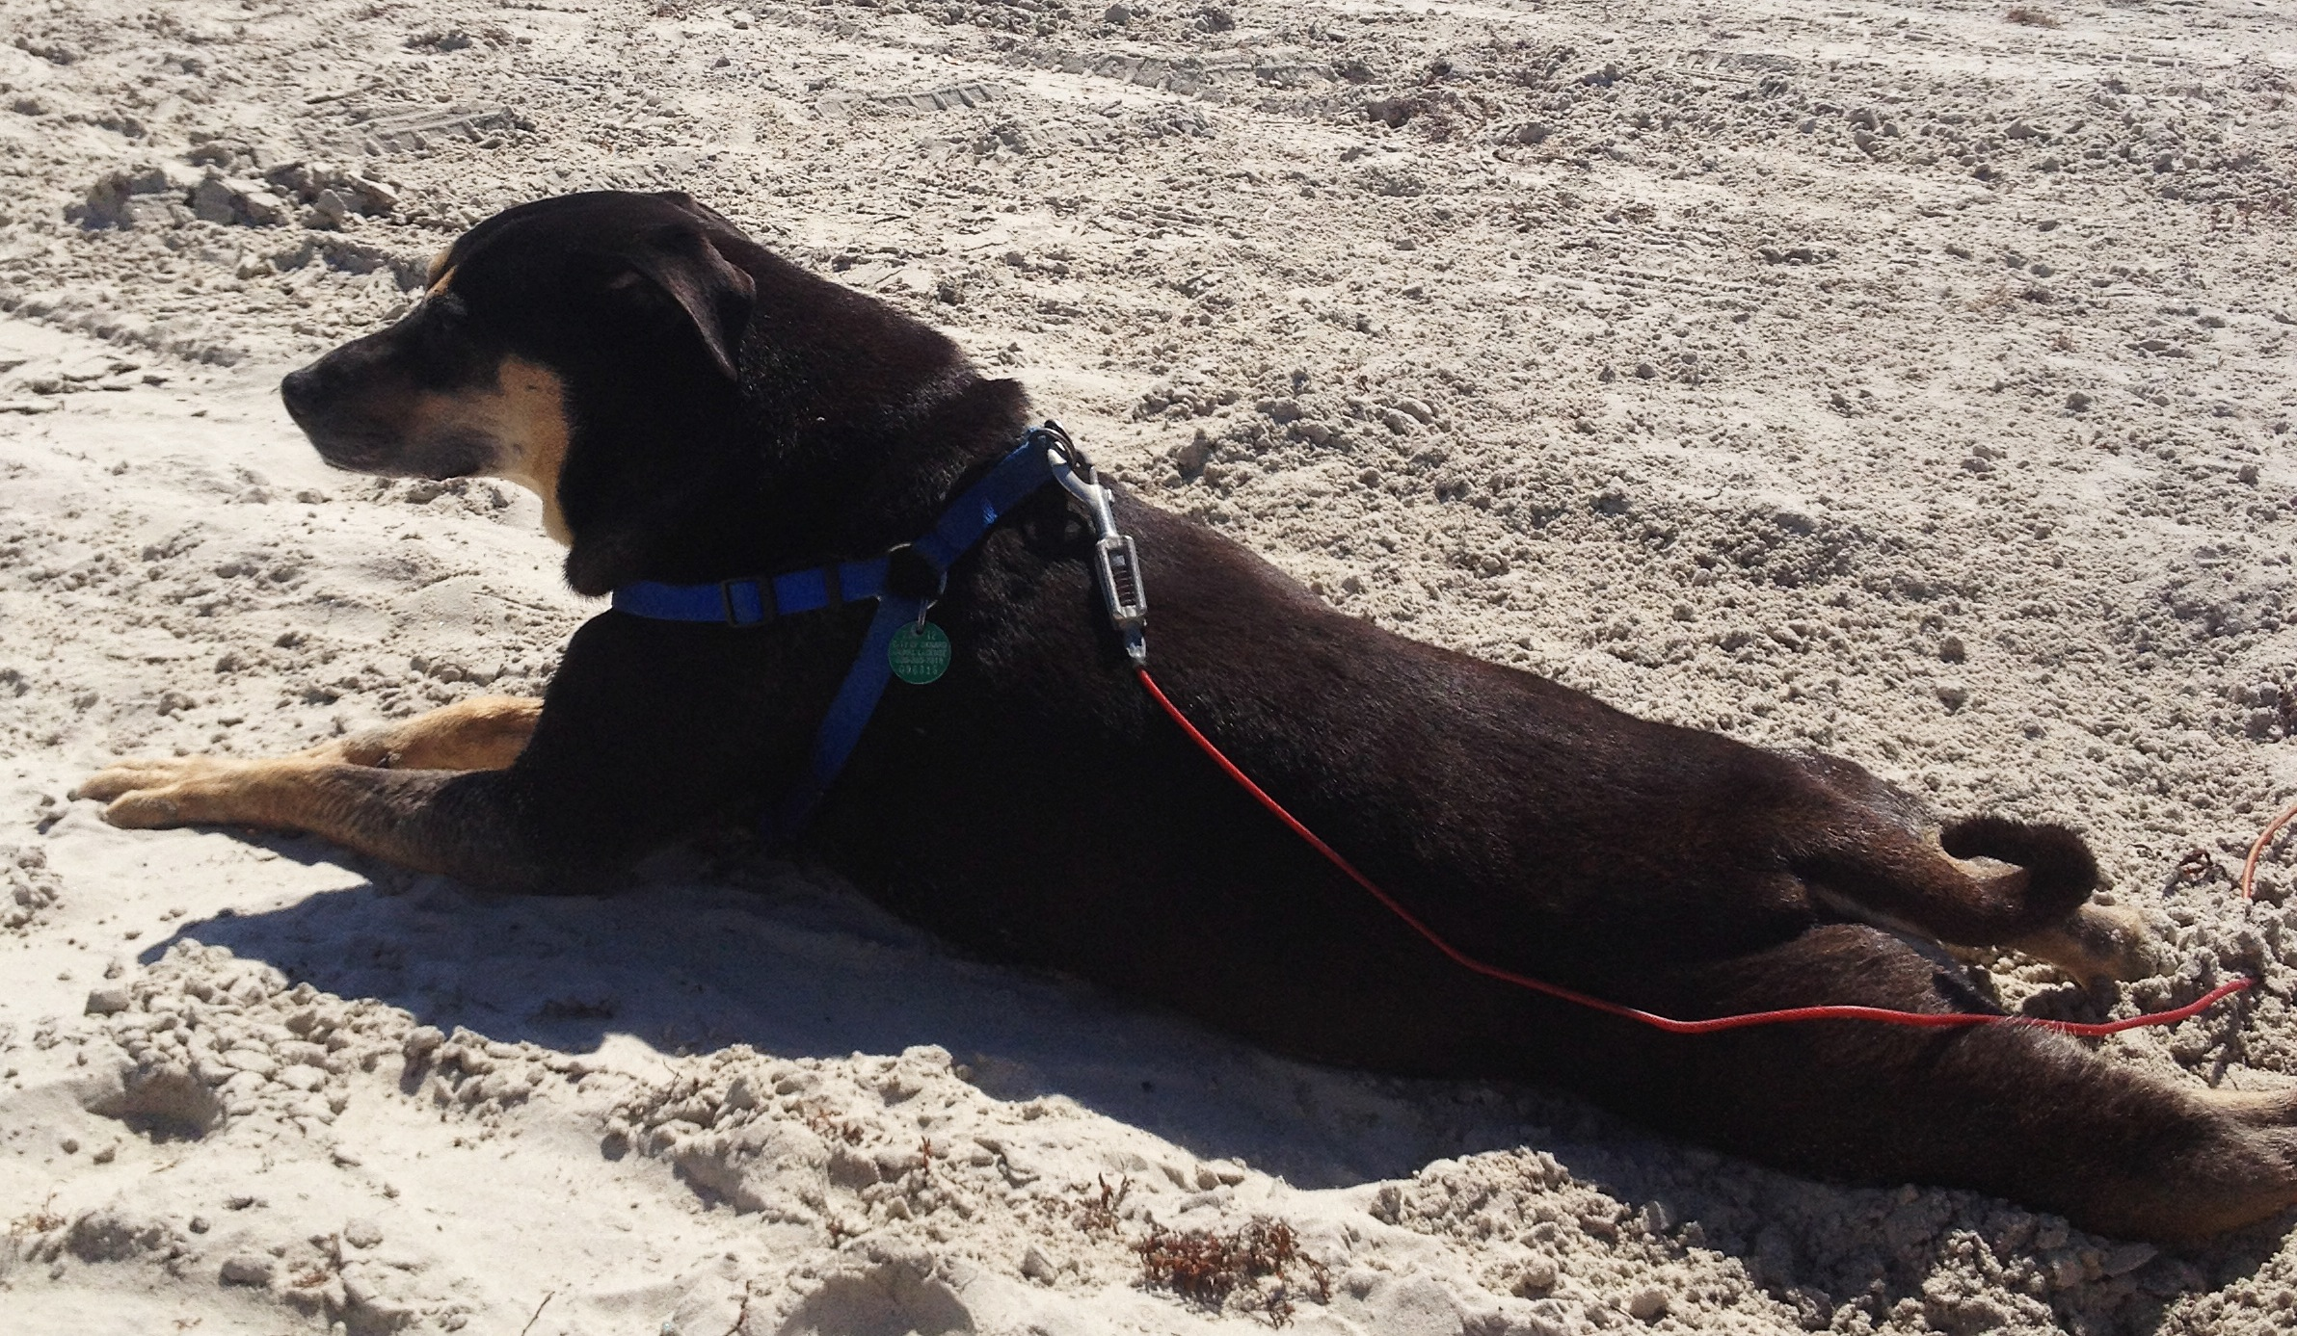
How do you describe orientation in tissue?
Apical
Dorsal
Lateral
Anterior or Cranial
Lateral
Posterior or Caudal
Ventral
Basal
Organisms
Individual Cells
Notes:
tabs=pop top

Slide 6
Mouse versus Human Embryo Development
Xue et al., BMC Genomics 2013
Notes:
The 23 Carnegie stages (CS) only covers the first 60 days of
human embryo development, thereafter that the term embryo is replaced with fetus. 5 human embryos at 4-9th week are shown here. The
double headed arrows point to human and mouse embryos at similar stages of organogenesis.

Slide 7
Goals for today’s class!
Learn how to describe the orientation of cells and tissue in an organism.
Understand what the three Germ Layers are and how they are organized.
Define the proteins in cells that promote cell sorting.
Learn how the neural tube is formed.
Understand what and how different cellular components contribute to heart and vascular development.
Learn how the gut forms and what the different sections look like histological.
Define the different types of epithelial tissues and how skin develops.

Slide 8
The Lab Mouse Developmental Timeline

Slide 9
The Three Germ Layers
MacCord, Kate, "Germ Layers". Embryo Project Encyclopedia, 2013.

Slide 10
Germ Layer Derivatives
Endoderm = Entoderm
Pansky, B. Review of Medical Embryology, 1982.

Slide 11
Goals for today’s class!
Learn how to describe the orientation of cells and tissue in an organism.
Understand what the three Germ Layers are and how they are organized.
Define the proteins in cells that promote cell sorting.
Learn how the neural tube is formed.
Understand what and how different cellular components contribute to heart and vascular development.
Learn how the gut forms and what the different sections look like histological.
Define the different types of epithelial tissues and how skin develops.

Slide 12
How do cells talk to each other?
Dufort … Weaver. Nature Revs 2011
Notes:
Figure 1 | The mechanical network. a | Tissues are mechanically integrated structures, the physical behaviour of which is defined by interconnected networks of cell–cell junctions, cell–matrix adhesions, intracellular filament networks (of actin, microtubules and intermediate filaments) and the extracellular matrix (ECM). Embedded throughout the network are mechanotransducing machines that convert mechanical stimuli into biochemical signals. This process, termed mechanotransduction, enables cells and tissues to sense and respond to their physical surroundings. The ECM controls network connectivity and tension on the network, thereby regulating sites of mechanotransduction. b | Cell–matrix adhesion complexes containing integrins can also directly sense the physical properties of the ECM. These complexes contain specialized protein sensors, including talin, p130Cas (also known as BCAR1), and integrins themselves, that undergo force-dependent conformational changes to elicit downstream signalling responses. The physical properties of the ECM are determined by its composition, the organization of its components, and their degree of intramolecular and intermolecular crosslinking. Interactions between the cell and ECM are dynamic, interwoven and reciprocal. Transcellular tension transmitted across adherens junctions affects ECM remodelling, which in turn regulates cell–matrix and cell–cell adhesions. Increased ECM stiffness owing to remodelling can result in changes in cell and nuclear shape, chromatin organization, assembly of cell–matrix adhesions (called focal adhesions), formation of actin stress fibres, destabilization of cell–cell adhesions, and changes in microtubule dynamics. FAK, focal adhesion kinase.

Slide 13
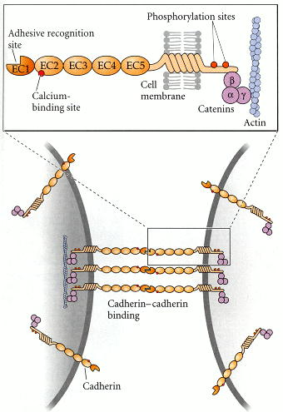
Cadherins Engage in Cell-cell adhesion
Notes:
This shows the protein domains of E-cadherin with the classical 5 extracellular domains. You should note the calcium binding site in the EC2 domain, calcium is necessary for cadheriin-cadherin binding and clustering and the presence or absence of calcium can be used as a tool in studying cadherin biology and AJ biology. In addition to the calcium binding site in EC2 the EC1 domain contains the adhesive recognition site this is the site provides the specific binding to E-cad, E-cad binding. So in developing tissues cells express specific types of cadherins such as E, N, P and VE cadherin. Cells in developing tissues can also downregulate specific cadherins such as E-cadherin and up regulate N-cadherin to promote movement of a sheet of cells in a directed fashion during development.

Slide 14
Cadherins Sort Cells During Embryo Development
Molecules | Ligands | Distribution
Cadherin E (1) | H | Epithelial
Cadherin N (2) | O | Neural
Cadherin BR (12) | M | Brain
Cadherin P (3) | O | Placental
Cadherin R (4) | P | Retinal
Cadherin M (15) | H | Muscle
Cadherin VE(5) (CD144) | I | Epithelial
Cadherin T and H (13) | L | Heart
Cadherin OB (11) | I | Osteoblast
Cadherin K (6) | C | Brain; kidney
Blue
Red
Niessen Physiol Rev. 2011

Slide 15
Goals for today’s class!
Learn how to describe the orientation of cells and tissue in an organism.
Understand what the three Germ Layers are and how they are organized.
Define the proteins in cells that promote cell sorting.
Learn how the neural tube is formed.
Understand what and how different cellular components contribute to heart and vascular development.
Learn how the gut forms and what the different sections look like histological.
Define the different types of epithelial tissues and how skin develops.

Slide 16
Germ Layer Derivatives
Endoderm = Entoderm
Pansky, B. Review of Medical Embryology, 1982.

Slide 17
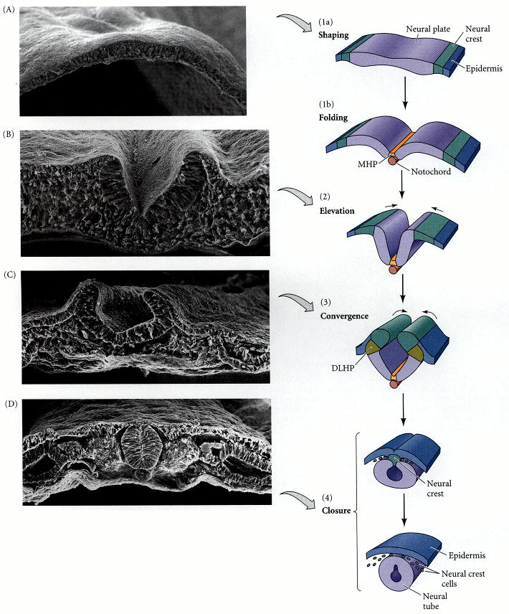
The Beginning of a Spine!
Starts at e8.5 in mouse,
completed at e10.5.
Completed the fourth week
of pregnancy in humans.
Gilbert SF. Developmental Biology. 6th edition. Sunderland (MA): Sinauer Associates; 2000. Formation of the Neural Tube.
Notes:
Here is an example of cadherin switching to promote tissue development, at the top is the neural plate prior to neural tube formation. Almost all of the cells express E-cadherin at this stage. During the process of neural tube development the cells marked in orange and some of the cells marked in purple downregulate E-cadherin and up-regulate N-cadherin to allow the cells to become more flexible and migratory. At the stage of convergence the neural crest cells in green also have increased N-cadherin and once closure is complete it results in the neural tube containing cells with just N-cadherin and the overlying epidermis containing cells with just E-cadherin forming the specialized tissue regions

Slide 18
The Beginning of a Spine! In Real Time!
Axoloti embryo:
Tiger Salamander or
Mexican Salamander
Wallingford, J.B., Harland, R.M. Development, 2002, 12:5815-5825.

Slide 19
The Beginning of a Spine! In Still Time!
NT = Neural Tube
N. = Notocord
TG = Tail gut
S. = Somite
NCR = Neural Crest Cells
M. = Mesenchyme
Chen, VS, et al. Toxicologic Pathology, 2017.

Slide 20
Goals for today’s class!
Learn how to describe the orientation of cells and tissue in an organism.
Understand what the three Germ Layers are and how they are organized.
Define the proteins in cells that promote cell sorting.
Learn how the neural tube is formed.
Understand what and how different cellular components contribute to heart and vascular development.
Learn how the gut forms and what the different sections look like histological.
Define the different types of epithelial tissues and how skin develops.

Slide 21
Germ Layer Derivatives
Endoderm = Entoderm
Pansky, B. Review of Medical Embryology, 1982.

Slide 22
When does the heart form?
MacCord, Kate, "Germ Layers". Embryo Project Encyclopedia, 2013.

Slide 23
What cells form the early heart?
Van Vliet P., et al. Cardiovascular Research 2012

Slide 24
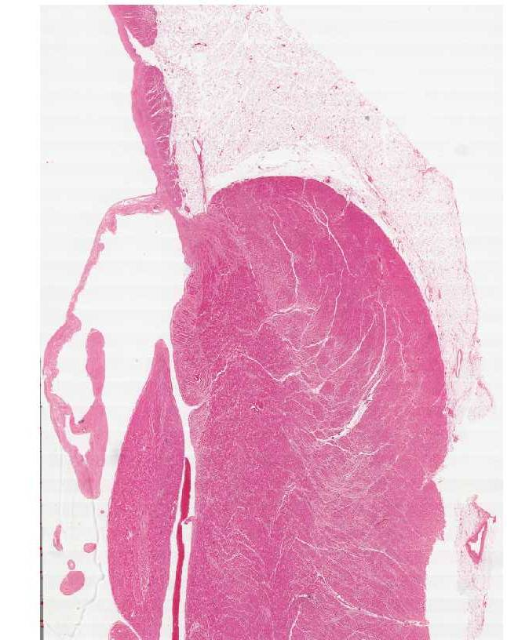
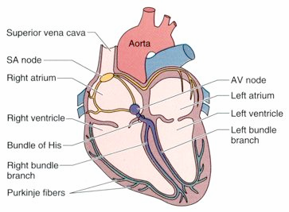
Looking at the Heart by H&E

Slide 25
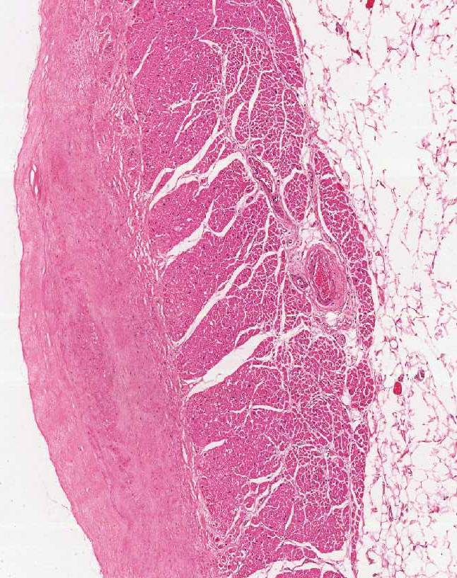
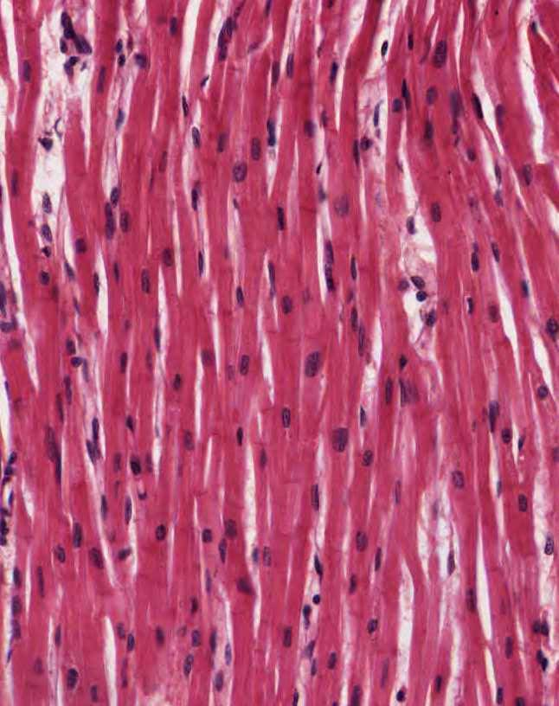
Looking at the Heart by H&E

Slide 26
Forming the Vascular System
Udan RS, et al. WIRE Developmental Biology, 2012

Slide 27
What are the cellular components of the peripheral vasculature?

Slide 28
What are the cellular components of the peripheral vasculature?

Slide 29
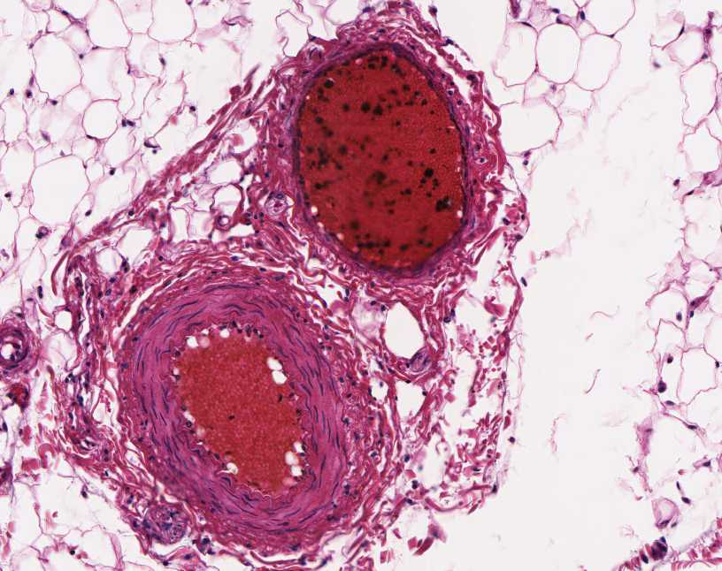
What are the cellular components of the peripheral vasculature?

Slide 30
Goals for today’s class!
Learn how to describe the orientation of cells and tissue in an organism.
Understand what the three Germ Layers are and how they are organized.
Define the proteins in cells that promote cell sorting.
Learn how the neural tube is formed.
Understand what and how different cellular components contribute to heart and vascular development.
Learn how the gut forms and what the different sections look like histological.
Define the different types of epithelial tissues and how skin develops.

Slide 31
Germ Layer Derivatives
Endoderm = Entoderm
Pansky, B. Review of Medical Embryology, 1982.

Slide 32
When does the gut form?
MacCord, Kate, "Germ Layers". Embryo Project Encyclopedia, 2013.

Slide 33
How does the gut form?

Slide 34
How does the gut form?

Slide 35
What happens when villus formation is disrupted?
Saotome, I. et al., Dev. Cell, 2004

Slide 36
Forming different sections of the gut?

Slide 37
Histology of different sections of the gut
Small Intestine
Large Intestine (colon)

Slide 38
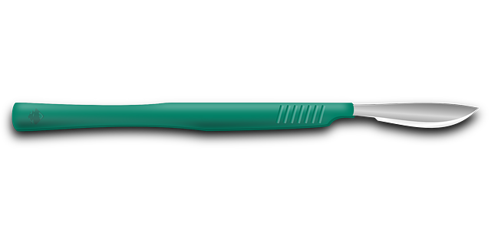
Histology of different orientations of the gut
Small Intestine (lateral)
Small Intestine (transverse)

Slide 39
Goals for today’s class!
Learn how to describe the orientation of cells and tissue in an organism.
Understand what the three Germ Layers are and how they are organized.
Define the proteins in cells that promote cell sorting.
Learn how the neural tube is formed.
Understand what and how different cellular components contribute to heart and vascular development.
Learn how the gut forms and what the different sections look like histological.
Define the different types of epithelial tissues and how skin develops.

Slide 40
Germ Layer Derivatives
Endoderm = Entoderm
Pansky, B. Review of Medical Embryology, 1982.

Slide 41
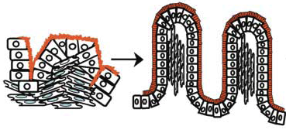
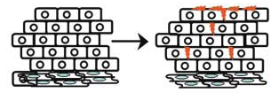
Tail of Two Epithelial Developmental Processes
Intestinal Development
Epidermal Development
e14.5
e15.5
e15.5
e12.5
e15.5
e18.5

Slide 42
Initiation of Stratification in the Embryonic Epidermis
e12.5
e15.5
Ratio of symmetric to asymmetric
spindle orientation in wild type
basal cells: 70% to 30%
Ratio of symmetric to asymmetric
spindle orientation in wild type
basal cells: 30% to 70%

Slide 43
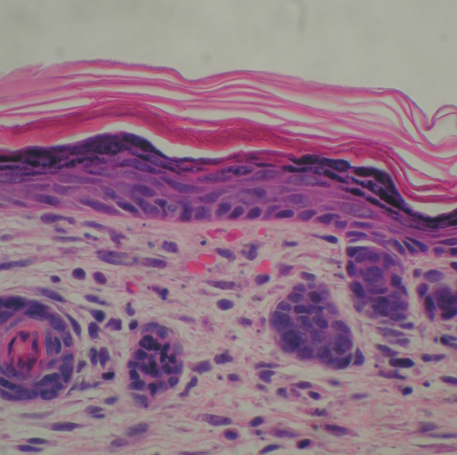
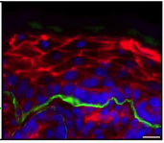
Developmental Process of the Developing Epidermis
Differentiation
wild-type
wild-type
Keratin 1
Keratin 14
Proliferation
β4 Integrin
:Tight Junctions
:Adherens Junctions
Red:
Actin
Green:
β4-Integrin
Notes:
43
43

Slide 44
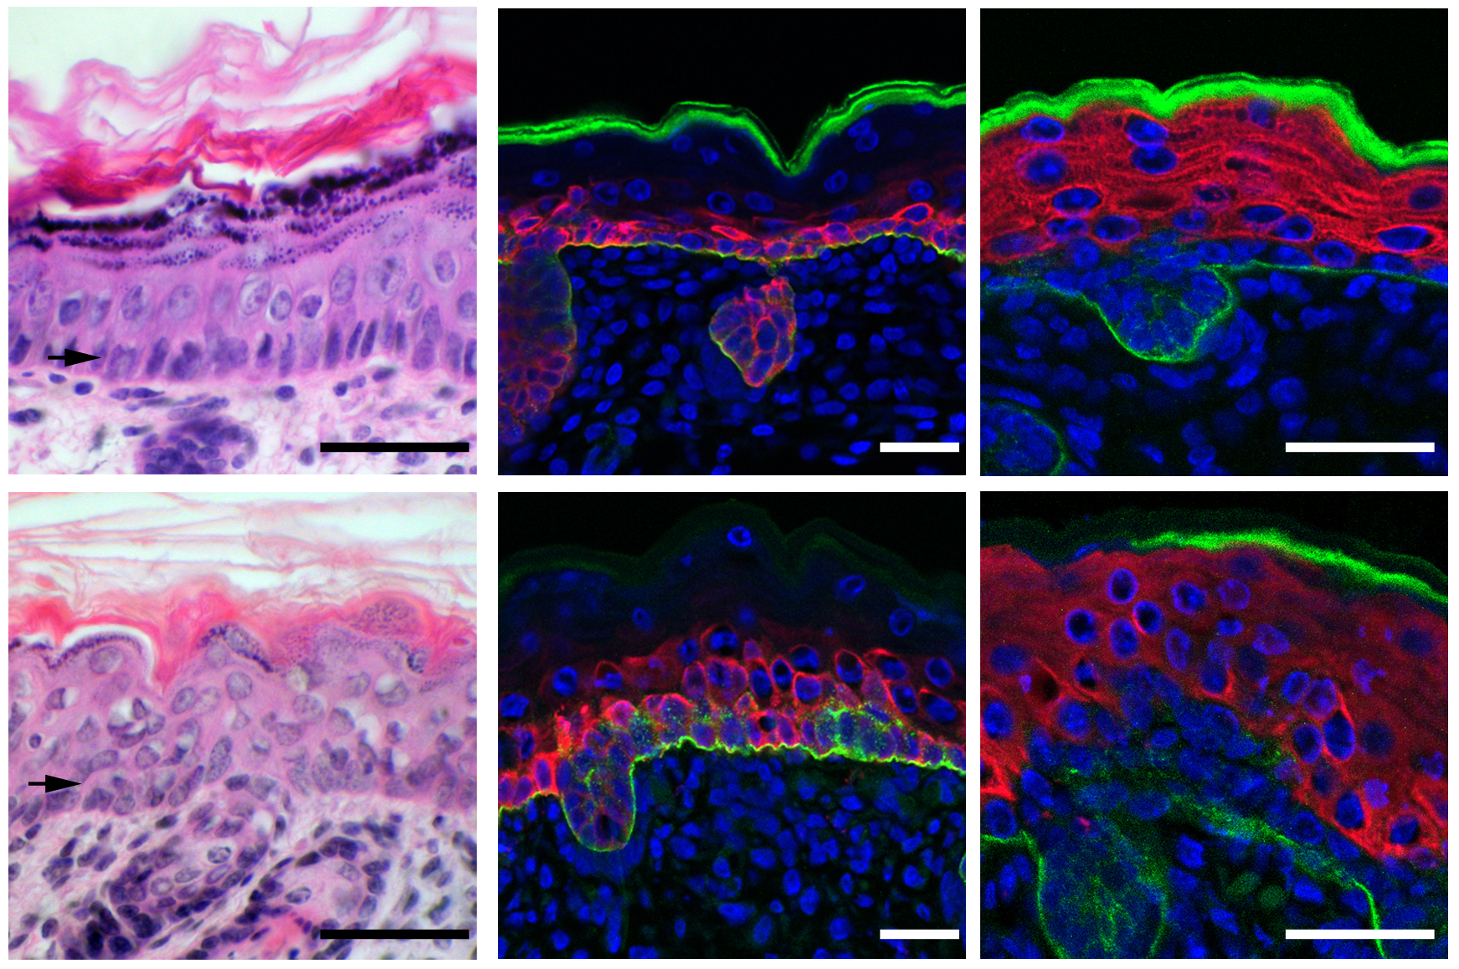
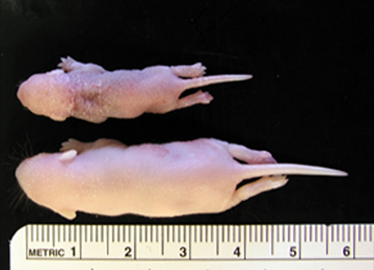
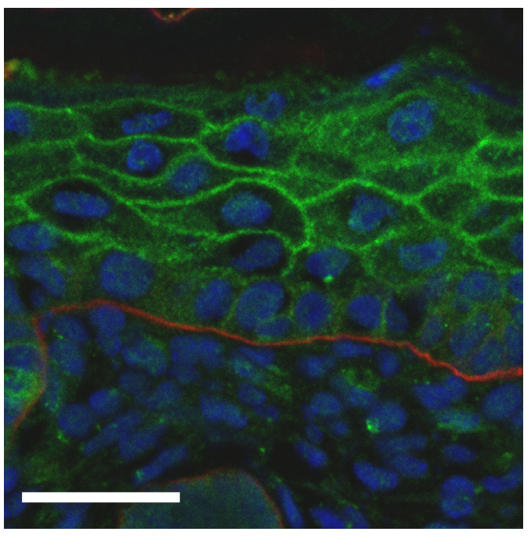
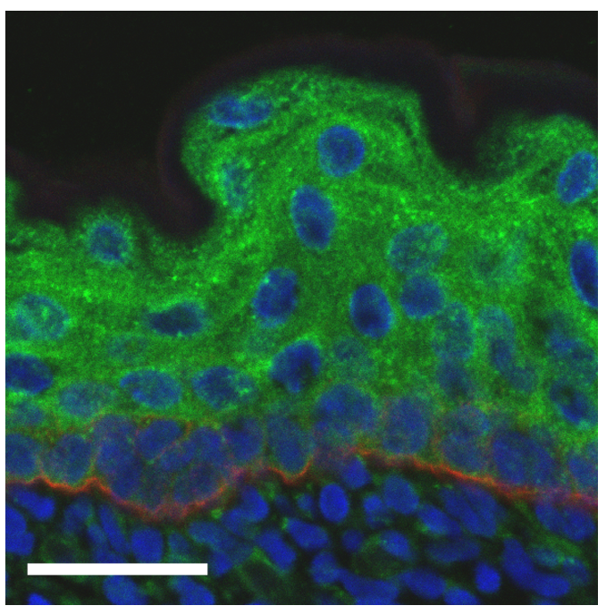
Example of Differentiation Defect in the Epidermis
H & E
Keratin 14
Keratin 1
K14-Cre;Nf2lox/lox
wild-type
wild-type
wild-type
K14-Cre;Nf2lox/lox
K14-Cre;Nf2lox/lox
Green: β4-integrin
Green: Tight Junctions
Red: β4-integrin

Slide 45
Tail of Two Epithelial Developmental Processes
Intestinal Development
Epidermal Development
e14.5
e15.5
e15.5
e12.5
e15.5
e18.5

Slide 46
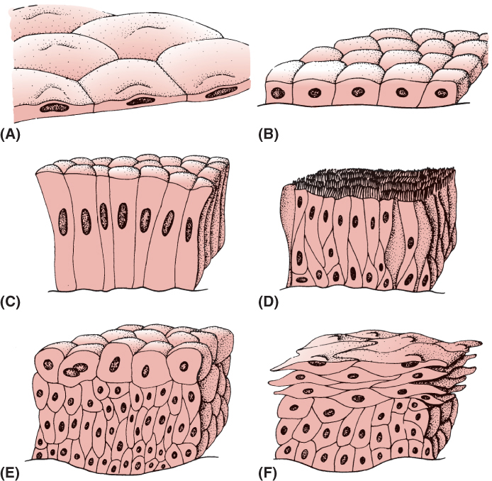
02.F04: Common types of epithelium: (A) simple squamous, (B) cuboidal, (C) columnar, (D) pseudostratified columnar (ciliated), (E) transitional, and (F) stratified squamous.
Different Types of Epithelial Tissues
From Reisner and Reisner, An Introduction to Human Disease. 2022, Jones and Bartlett Learning

Slide 47
Conclusions
Questions:
Email: agladden@email.unc.edu
Endoderm = Entoderm
Pansky, B. Review of Medical Embryology, 1982.

