Slide 9
Notes:
Cancer-related cognitive dysfunction (CRCD) can cause impairments in attention and memory for cancer patients and survivors. http://www.polleverywhere.com/multiple_choice_polls/aGEyZQ5k9COk2zum9QbAi

Slide 10
Addressing Cognitive dysfunction in patients with cancer
Zev Nakamura, MD
Assistant Professor
Department of Psychiatry
Lineberger Comprehensive Cancer Center
Patient Centered Care Series
7/14/2021

Slide 11
Outline
Background
Causes and underlying mechanisms
Screening and diagnosis
Treatment
LCCC 1921: Memantine for prevention of cognitive decline in patients with breast cancer

Slide 12
Learning objectives
Identify causes of cancer-related cognitive dysfunction
Describe the impact of cognitive problems in cancer patients on quality of life and medical outcomes
Recognize available treatments for patients with cancer experiencing cognitive dysfunction

Slide 13
Historical Perspective
Awareness since 1970s - “Serial Cognitive Testing in Cancer Patients Receiving Chemotherapy” (Oxman 1980)
“Chemobrain” defined in late 1990s in cross-sectional studies in breast CA
2002 – Ahles et al. showed long-term effects of chemo
2004 – Wefel et al. first prospective longitudinal study
Growing appreciation for cognitive difficulties resulting from cancer and its treatments over the last 15-20 years (i.e. CRCD, CRCI, “Tumor brain”)

Slide 14
Prevalence of CRCI
Up to 30% with cognitive impairment before treatment
75% report cognitive deficits during treatment
15-50% exhibit objective impairment for years after treatment
Janelsins 2014, Ahles 2018

Slide 15
Quality of Cognitive Problems Reported Post-treatment
Memory
Concentration
Executive function
Ability to learn new material
Subtle (usually) or dramatic
Variable course

Slide 16
Notes:
Which of these are consequences of cancer-related cognitive impairment? http://www.polleverywhere.com/multiple_choice_polls/TU9Av6gVFJyZb2wgGxhXp

Slide 17
Significance of crci
Associations
adverse mental health
inability to return to work
worse emotional and social well-being
impaired physical function
increased mortality
Greater influence on chemotherapy prescribing than age or functional status
Worsens medication compliance
One of the most feared problems among cancer survivors
Janelsins 2014, Yang 2018, Von Ah 2021, Von Ah 2015, Klaver 2020, Nakamura 2020, Hshieh 2018, Mohile 2018

Slide 18
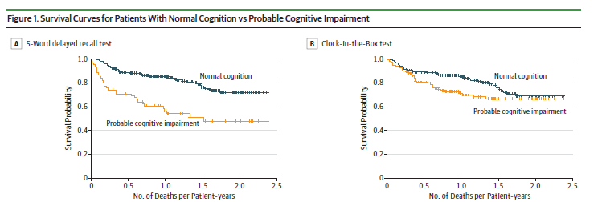
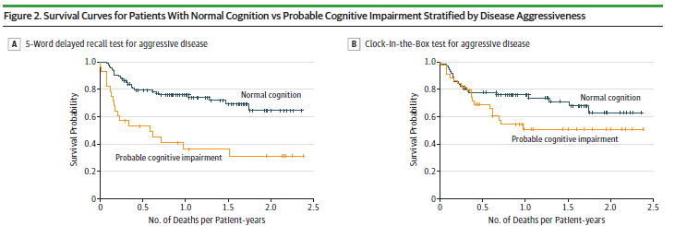
Hsieh 2018

Slide 19
Notes:
What are causes of cancer-related cognitive impairment? http://www.polleverywhere.com/multiple_choice_polls/wmrSSpDzlBFma9d7ZlZoI

Slide 20
Overarching Mechanisms
Direct toxicity
Cytokine-mediated neuroinflammation
Oxidative stress
Genetic risk factors
Survivors w/ APOEe4 with worse cognitive problems
Breast CA survivors treated w/ chemotherapy with COMTVal158Met had greater decline
BDNF Met/Met genotype protective against chemo-induced cognitive changes
Ahles 2018, Ahles 2014, Wefel 2015, Mandelblatt 2018

Slide 21
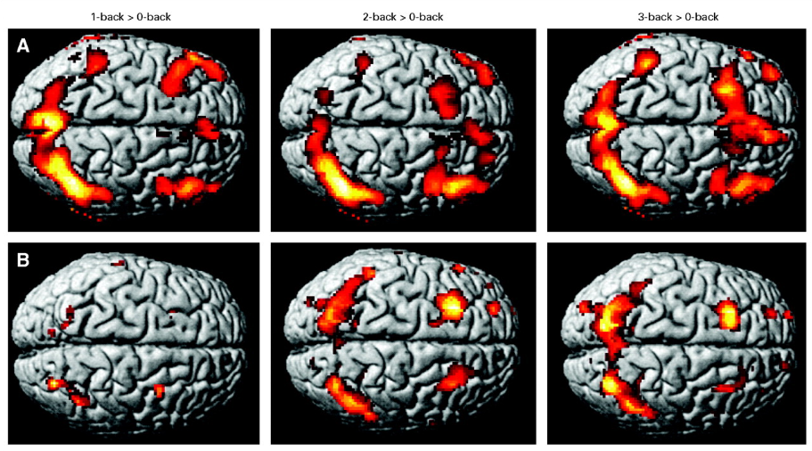
Ferguson 2007 (Landmark Study)

Slide 22
Imaging findings
↓gray matter volume
↓white matter connectivity
Altered functional brain activation and connectivity
Decreased volume and connectivity correlate with worse function
Sousa 2020, Kaiser 2014, Kesler 2020, Kesler 2014, Deprez 2018, Amidi 2019

Slide 23
Inflammation
Associated with ↑ risk for cancer and neurocognitive disorders
↑ cytokine levels in CA pts at baseline relative to controls
↑ during chemo and ↓ (but stay elevated) with time
Correlate with self-reported and objective cognitive
Strongest data for TNFα, IL-6, and IL-1β
Patel 2015, Wang 2016, Kesler 2013 (Landmark Study), Lyon 2016, Hoogland 2019

Slide 24
Cancer Treatment and Aging
Chronic inflammation
Increased oxidative stress
Accumulation of DNA damage
Shortening of telomeres
Increased cell senescence
Increased expression of p16^{INK4a} and ARF in breast cancer patients (estimated 10 yrs of aging)
Increased activation of ERK and AKT signaling pathways in rats
Sanoff 2014, Salas-Ramirez 2015

Slide 25
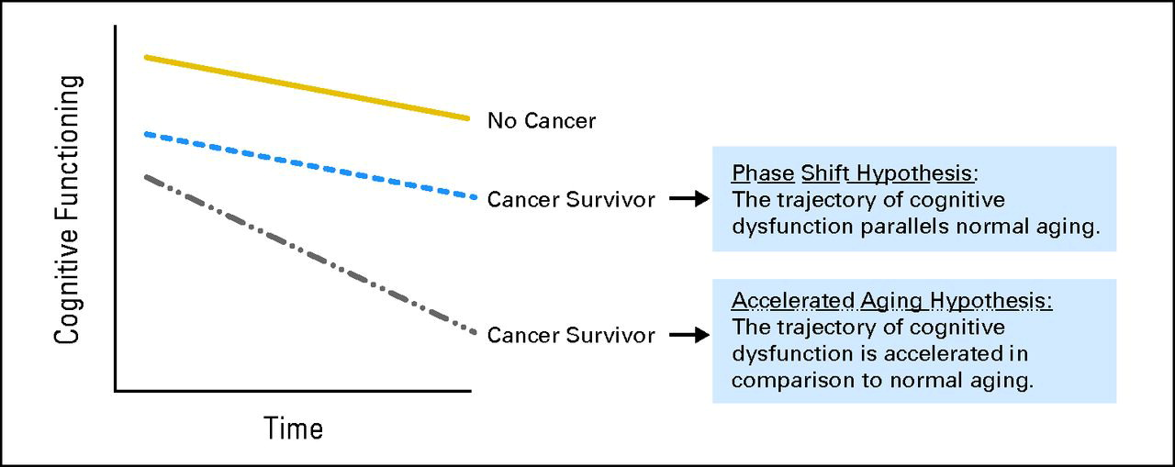
Ahles 2012 (Landmark)

Slide 26
Cancer/tumor
Non-CNS Cancers
Immune system dysfunction → disrupt brain structure and function
Feeling physically ill, fatigued, depressed, etc.
Primary brain tumors and brain metastases
↑ Intracranial pressure
Edema
Displacement of brain tissue
↓ blood supply

Slide 27
Chemotherapy
Most chemo cannot cross the BBB
CA increases BBB permeability
Even small amounts can cause significant damage
Toxic to neural progenitor cells
Increases levels of pro-inflammatory cytokines
Cytokines increase BBB permeability
Elevated cytokines can lead to damage through oxidative stress and DNA damage
Diminution of neurogenesis
Disruption of myelin and oligodendrocyte precursors
Mitochondrial dysfunction
Hodgson 2013 (Landmark), El-Agamy 2019, Ren 2019, Lange 2019

Slide 28
Surgery
Mastectomy implicated in cognitive effects
May be 2/2 increased inflammation, pain, psychological effects
Impact of anesthesia (especially in elderly)
In pts w/ brain tumors, can improve or worsen cognitive function
Reid-Arndt 2012 (Landmark), Cimprich 2010 (Landmark), Su 2020

Slide 29
Radiation
Cranial, Head & Neck
Radiation necrosis
Disrupts creation of new neurons in the hippocampus
Local
Some evidence for adverse cognitive effects
Mechanisms
Chronic oxidative stress and inflammation
Neuronal damage
Changes to BBB, ischemia, oligodendrocyte function
Wilke 2018, Dong 2015, Carvalho 2018

Slide 30
Hormonal therapy
Estrogen and testosterone support brain function
Tamoxifen and aromatase inhibitors
Smaller hippocampal size
Combination with chemo may lead to greater cognitive difficulties
Other studies show no association
ADT with adverse cognitive consequences
Ganz 2014, Van Dyk 2019, Le Rhun 2015, Morote 2017, Bender 2015, Gonzalez 2015

Slide 31
immunotherapy
Checkpoint inhibitors increasingly important treatment for many cancers
May lead to neuroinflammation, which in combination with radiation or other immunotherapies could cause cognitive impairment
Reports of cognitive impairment in clinical trials, but further research needed
CAR T cell therapy associated with a profound, immune-mediated encephalopathy in ~30%, but long-term effects not known
Topalian 2012 (Landmark), McGinnis 2017, Goldberg 2016, Joly 2020

Slide 32
Targeted therapies
Monoclonal antibodies and small-molecule tyrosine kinase inhibitors also increasingly common
Anti-VEGF antibody bevacizumab associated with objective global cognitive decline
Improvement in cognitive function in patients with metastatic RCC or GIST tumors receiving sorafenib or sunitinb
Chronic encephalopathy in some MM patients exposed to proteasome inhibitors
Long-term sequelae not studied
Fathpour 2014, Gilbert 2014, Ng 2018, Mulder 2014, Wick 2016

Slide 33
Comorbidities affecting cognitive function
Sleep disorders (insomnia, sleep apnea)
Depression, anxiety, distress
Pain and pain medications
Other physical illnesses
Fatigue
Anemia

Slide 34
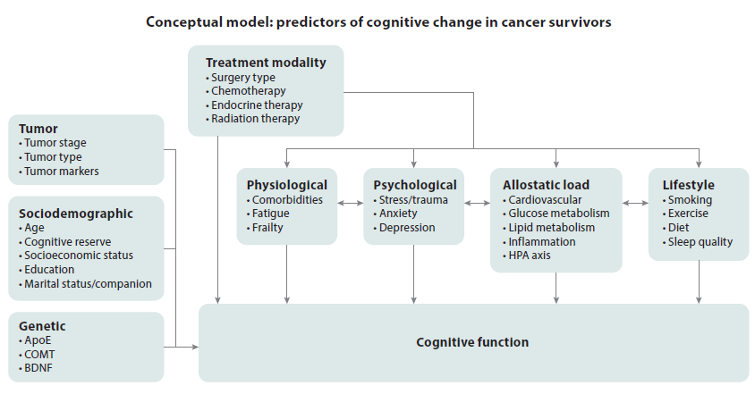
Ahles and Root 2018

Slide 35
Self-report vs. Objective Measurement
Self-reported problems more common
Self-report limitations
Is it really measuring cognitive impairment?
Objective measurement limitations
Is it sensitive enough?
Logistically feasible?

Slide 36
Measurement of CRCI
No standard for screening, monitoring
Self-report measures: PROMIS Cognitive Function, FACT-Cog, EORTC-QLQ-30, PRO-CTCAE
Objective screening instruments: MMSE, MOCA, RBANS, BOMC
Neuropsychological Assessment (NPA) * Gold Standard
ICCTF recommends: Hopkins Verbal Learning Test, Trail Making Test, Controlled Oral Word Association Test

Slide 37
Measurement in the Clinic
Self-report screeners
Primary care
Oncology
Objective Screening Instruments
Psychiatry, Psychology, Neurology
Occupational Therapy
Speech Therapy
Neuropsychological Assessment
Neuropsychology

Slide 38
Notes:
Which of these Does NOT have at least some evidence for Treatment of CRCI? http://www.polleverywhere.com/multiple_choice_polls/Pw7yrRyXgLYEXfpePNZUF

Slide 39
Interventions studied for CRCI
Behavioral: Cognitive rehabilitation, Cognitive Training, Combination
Physical activity: Yoga, Exercise programs
Mind-Body: Meditation, Mindfulness, Acupuncture
Pharmacotherapies: Donepezil, Memantine, Modafinil, Methylphenidate, Epo-stimulating agents, Vitamin E, Ginkgo biloba, SSRIs

Slide 40
Cognitive Training
Repetitive, increasing challenging tasks (often via computer) to improve, maintain, or restore cognitive function
Start out with 4-5, 30-60 min sessions per week for at least 6 weeks
Research
~ 10 studies
Primarily in early stage breast CA survivors
Completed adjuvant therapy and were reporting cognitive concerns
Fernandez 2019, Mayo 2020

Slide 41
Cognitive rehabilitation
↑ self-awareness to support problem-solving and compensatory strategies
Initially developed in TBI and stroke populations
Usually weekly therapy for 30-60 min with neuropsychologist, occupational therapist, speech/language pathologist
Research
~10 studies
Individual and group delivery (in person or online)
4-7 sessions
Improve cognitive symptoms > neuropsychological performance
Fernandez 2019, Mayo 2020

Slide 42
Physical activity
↑ new neurons in the hippocampus, BDNF levels, reduces inflammation
↓ risk of Alzheimer’s and slows age-related cognitive decline
Moderate intensity exercise at least 150 min/week OR vigorous exercise at least 120 min/week
Local Resources
Get REAL & HEEL
Health Coaching
LIVESTRONG at the YMCA
Yoga
Campbell 2018, Zimmer 2016, Myers 2018, Campbell 2020

Slide 43
Mind-Body
Bring an awareness of individual potential for healing or restoration
Guided imagery, meditation, mindfulness-based stress reduction, neuro/biofeedback, and acupuncture
Mindfulness
UCLA MAPS classes
Apps: The Mindfulness App (1&II), Sitting Still, Headspace, Insight Timer, Mindfulness Bell
Local courses through UNC-Chapel Hill Program on Integrative Medicine and Duke Integrative Medicine
Acupuncture
UNC Family Medicine Acupuncture Clinic
NC Society of Acupuncture and Asian Medicine
Freeman 2014, Milbury 2013, Hoffman 2012, Johns 2016, Alvarez 2013, Johnston 2011, Cimprich 1993, Cimprich and Ronis 2003, Van der Gucht 2020

Slide 44
medications
Stimulants (methylphenidate and modafinil)
Alzheimer’s drugs (donepezil and memantine)
SSRIs (sertraline and paroxetine)
Ginkgo biloba
Vitamin E
Erythropoietin-Stimulating agents*
Weigh risk/benefit
Karschnia 2019, Miladi 2019, Mayo 2020

Slide 45
medications
Fewer than 10 published RCTs
Only 3 agents that have been studied as prevention
Epo-stimulating agents: not effective + adverse effects
Methylphenidate: closed prematurely due poor recruitment
Ginkgo Biloba: Large study, not effective
Karschnia 2019, Mayo 2020

Slide 46
LCCC 1921: Memantine for prevention of cognitive decline in patients with breast cancer

Slide 47
Can memantine help?
A pill taken by mouth
Blocks harmful inflammation in the brain
What is it?
Why for Chemo Brain?
Decades of safety data
Most studied for Alzheimer’s disease, but effective in many medical conditions
Helpful for patients during brain radiation
Prevented chemo brain in animal studies
McShane 2006 (Landmark), Brown 2013 (Landmark), Cole 2013 (Landmark)

Slide 48
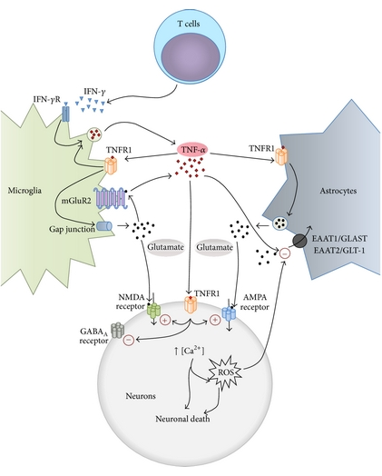
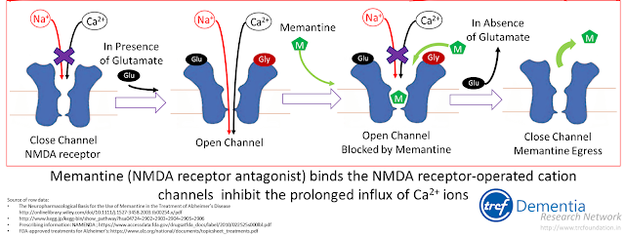
Inflammatory Hypothesis of CRCI
Inflammatory cytokines:
1.) elevated in cancer
2.) increase during chemotherapy
3.) correlate with cognitive deficits
Olmos and Llado 2014

Slide 49
About the study
What is the purpose of the study?
We want to learn if giving memantine can prevent cognitive changes in people with breast cancer who are receiving chemotherapy.
What will be done?
Patients will be given memantine during chemotherapy. This is a pill taken two times each day.
Cognition will be tested with cognitive tasks and surveys over ~1 hour.
Before starting chemotherapy
4 weeks after ending chemotherapy.
Patients will receive a $25 gift card for each survey.

Slide 50
More information if you are interested
Eligibility Criteria
Contact us
Are 18 years old or older
Have stage I, II, or III breast cancer
Are scheduled to begin chemotherapy at
UNC Chapel Hill,
UNC Hillsborough, or
UNC REX
Speak English
e-mail:
Zev Nakamura, MD zev_nakamura@med.unc.edu
Or
Yesy Lopez, BA
yesy_lopez@med.unc.edu

Slide 51
Future directions
Complete single-arm, pre-post study of memantine
RCT of memantine vs. placebo to mitigate chemotherapy-related cognitive changes
Other cancers, cancer treatments

Slide 52
Cramer 2019

Slide 53
For all patients
Active journaling
Describe an experience, why it was important, what it meant for you, what you learned from it
Goal to increase “idea-density”
External aids
Day planner
Alerts/reminders on smart phone or tablet
Sticky notes, whiteboards
Routine
Workplace accommodations
Examples and procedural information available at www.eeoc.gov/policy/docs/accommodation.html

Slide 55
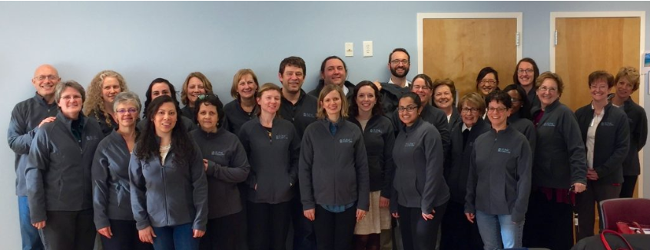
UNC Comprehensive cancer support program (Ccsp)
https://unclineberger.org/ccsp/

Slide 56
Notes:
Questions? http://www.polleverywhere.com/free_text_polls/4apTUqlVtGLdU4QV6saKI

